Slide 1
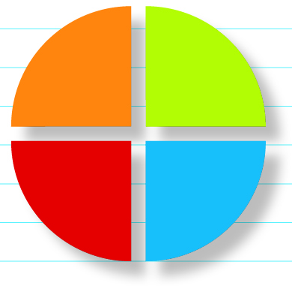
Time & Money

Slide 2
Use this Master Student Map to ask yourself,
WHY?
...because procrastination, lack of planning, and money problems can undermine success.
WHAT?
Power Process: Be Here Now
You’ve got the time – and the money
Setting and Achieving Goals
ABC Daily To-Do List
Break it down, get it done: Using a long-term planner
Stop Procrastination Now
25 Ways to Get the Most Out of Now
Making choices about multitasking
Earn more money
Spend less money
Managing money during tough times
Education is worth it – and you can pay for it
Take charge of your credit
Master Student Profile: Richard Anderson
HOW?
to discover how you manage time & money
to set time and money goals to improve the quality of your life
to eliminate procrastination
WHAT IF?
...you could meet your goals with time to spare?
Notes:
Master Student Maps that introduce each chapter guide students through the chapter with an overview while reinforcing the four key questions of the Kolb Learning Style Inventory – Why? What? How? and What If? You may wish to highlight key articles as you walk students through this slide, or ask if there are any questions about any of the articles.

Slide 3

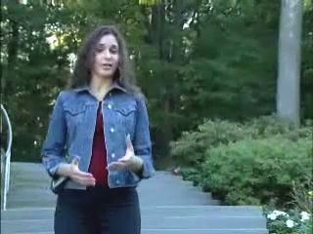
Be Here Now
Video: In Show Mode click image above
Notes:
This movie clip focuses on what Be Here Now means and how it can be a helpful tool for students.

Slide 4
Be Here Now
Be Here Now is about focusing your attention where you want it to be.
The voice inside our head directs our attention…
Buy cat food on the way home
Pay the gas bill
Email Carli about Friday
Bring your iPod to work tonight
English paper due tomorrow!
Change doctor appointment
Call Jeff!
Notes:
“Be Here Now” is about doing what you’re doing when you’re doing it…. Being where you are when you are there. When aren’t in the here and now, it’s usually because we are listening to that voice in our head that’s always chatting…. Trying to get our attention. This slide provides an example of some of the internal chattering that sometimes goes on in students’ heads when they should really be listening intently to a class lecture.

Slide 5
Be Here Now
Buy cat food on the way home
Pay the gas bill
Email Carli about Friday
Bring your iPod to work tonight
English paper due tomorrow!
Change doctor appointment
Call Jeff!
Notice the voice
Acknowledge the voice
Gently return your focus to the task at hand
Repeat
Repeat again....
Notes:
Here are the steps to do “Be Here Now.” The tool is easy - it just takes practice. Students might try Being Here Now for the ensuing 24 hours, no matter what they are doing. Then analyze if they feel they were more effective when they were Being Here Now.
5

Slide 6

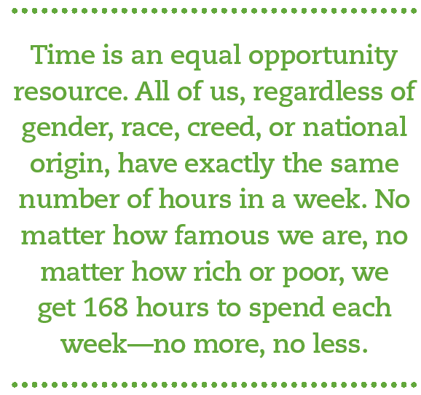
You’ve got the time – and the money
Notes:
Students can approach the resources of time and money with the mentality that they have more than they need. In reality, students do not have all the time and money in the world; but they do have enough time to get everything that is really important to them done and probably enough money to be reasonably comfortable…they only need to manage these resources effectively.

Slide 7
Setting and
Achieving goals
Write them down
Make them specific
Several time frames (long, midterm, short)
Several areas of life (career, family, spiritual, etc.)
Reflect on them
Move into action immediately
Reward yourself
Benefits
Notes:
Here are eight steps to set and achieve goals. When we have a goal, we have direction… we know where we are going. Without a goal, what direction do we go? Students can practice by choosing a goal and then working that goal through these 8 steps.

Slide 8
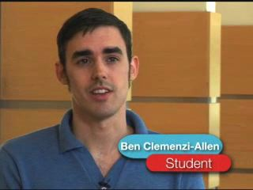
Setting and
Achieving goals
Video: In Show Mode click image above
Notes:
In this movie clip meet students who are in the process of setting up goals.

Slide 9
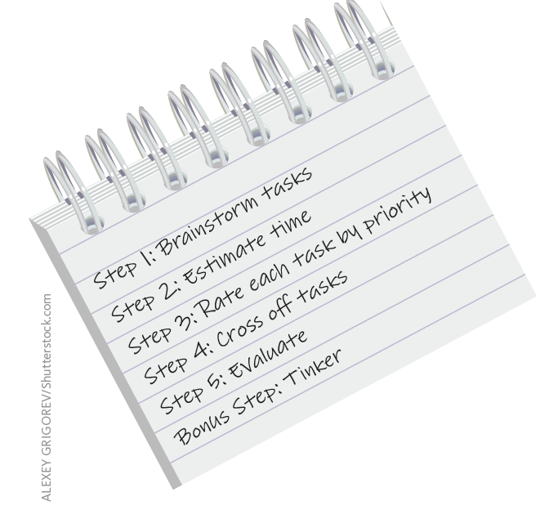
The ABC daily to-do list
Notes:
Making to-do lists is a great way to set short term goals and to organize one’s behavior. There are many ways to make them. Here is a 5-step process. Students could make a to-do list for tomorrow using these five steps.

Slide 10
The ABC daily to-do list
Brainstorm Tasks | Estimate Time | Rate Tasks | Cross Off Tasks | Evaluate
Take dog to vet | 2:00 | A | ✓ | Good!
Spanish Class | 1:40 | A | ✓ | Good!
Work | 5:00 | A | ✓ | I work too much!
Sleep | 9:00 | A | ✓ | Good!
Math class | 1:40 | A | ✓ | Good!
Dinner w/ friends | 1:30 | B |  | Sad – maybe Sunday?
Finish history project | 1:00 | A | ✓ | Yay!
Start English paper | 1:30 | B |  | ‘A’ priority tomorrow
Household chores | 2:00 | B | ✓ | My bathroom is clean!
Answer emails | 1:00 | B |  | Check emails!
Surf the web | 1:00 | C
Relax | Relax | B | ✓ | I like to relax
Notes:
This slide is an example of a student creating a daily to-do list using the 5-step system.

Slide 11
The ABC daily to-do list
Advantages include:
remembering important dates/activities
get the most important tasks done each day
less stress
adapt the concept to fit your needs
11
Notes:
This slide points out some of the advantages of making to-do lists. Some students in your class likely already make to-do lists. Ask for testimonials from them in class about how to-do lists help them.

Slide 12
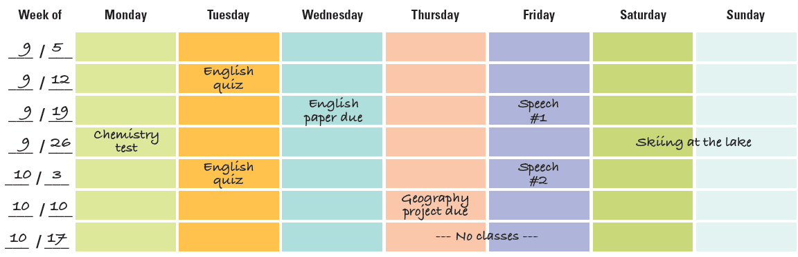
Using a Long-Term Planner
Find one or make your own
Enter scheduled future dates
Create a master assignment list
Include non-academic events
Divide and conquer
Notes:
This slide summarizes five steps to making longer range planning. A good example is a college term or an academic year. Students may make commitments to specific classes for the ensuing terms. Using these tools may help students make better choices.

Slide 13
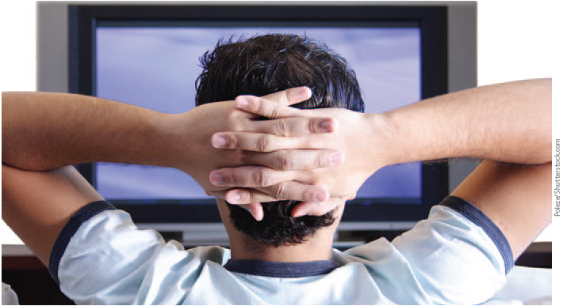
Stop Procrastination Now
Discover the costs
Discover your procrastination style
Trick yourself into getting started
Feelings follow action
Choose to work under pressure
Think ahead
Create goals that draw you forward
Notes:
Procrastination – The student’s number one academic problem is also a problem for others at work, at home, in relationships, etc. Overcoming procrastination is a challenge. This slide summarizes the first seven tools in the book. Ask for an example of each tool in action.

Slide 14
THE 7-DAY anti-procrastination plan
Monday | Make it meaningful
Tuesday | Take it apart
Wednesday | Write an intention statement
Thursday | Tell everyone
Friday | Find a reward
Saturday | Settle it now
Sunday | Say no
Notes:
Here are seven more anti-procrastination tools. The keyword for each of these terms is the same as the first letter of each day of the week. Ask students if they have ever tried any of these successfully, and if so, to share with the class.
14

Slide 15
25 Ways
to get the most out of now
When
Where
Getting Focused
Questions
Study difficult or boring subjects first.
Be aware of your best time of day.
Use waiting time.
Study 2 hours for every hour in class.
Monitor your time online.
Notes:
This slide highlights 5 of the many ways to get the most out of now. Give an example of how these might be used, or ask students to discuss any they have used.

Slide 16
25 Ways
to get the most out of now
When Where Getting Focused Questions
Use a regular study area.
Use a library.
Notes:
This slide highlights 2 of the many ways to get the most out of now. Give an example of how these might be used, or ask students to discuss any they have used.

Slide 17
25 Ways to get the most out of now
When
Where
Getting Focused
Questions
Pay attention to your attention.
Agree with living mates about study time.
Get off the phone.
Learn to say no.
Hang a “do not disturb” sign on your door.
Get ready the night before.
Call ahead.
Avoid noise distractions.
Manage interruptions.
Notes:
This slide highlights 9 of the many ways to get the most out of now. Give an example of how these might be used, or ask students to discuss any they have used.

Slide 18
25 Ways to get the most out of now
When Where Getting Focused Questions
What is one task I can accomplish towards my goal?
Am I being too hard on myself?
Is this a piano?
Would I pay myself for what I’m doing?
Can I do just one more thing?
Can I delegate this?
How did I just waste time?
Could I find the time if I really wanted to?
Am I willing to promise it?
Notes:
This slide highlights 9 of the many ways to get the most out of now. Give an example of how these might be used, or ask students to discuss any they have used.

Slide 19

^{Setting Limits on} screen time
How much time do you spend using electronic devices every day?
Facebook is no substitute for
real face time.
Notes:
Help students become aware of the amount of time they spend tweeting, surfing, texting, IMing, playing games, listening to music, etc. using the time monitor exercise in this chapter. Next, make a conscious choice how much time is reasonable to spend connected to a device. It is important to recognize that electronics are no substitute for real face time with friends and family (we are not talking about facebook!). True friends know when to go offline and head across campus to resolve a conflict and when to go home to support a family member. When you are with friends: close up your laptop, remove your ear plugs, and turn off your phone. Give the gift of your attention and your presence.

Slide 20
Make choices about multitasking
Unplug
Capture fast-breaking ideas with minimal interruption
Monitor moment-to-moment shifts in attention
Handle interruptions with care
Multitask by conscious choice
Align your activities with your passion
Notes:
Our brains are basically wired to do one thing at a time. When people interrupt an activity to check e-mail or surf the internet, they loose efficiency, make errors and accidents increase. Master students practice focused attention and get more done in less time with less errors! The power process, “Be here now.” will help students pay attention to their attention. These additional strategies will reinforce the skill of being totally present and engaged in what students choose to focus on in the present moment.

Slide 21
Earn more money/Spend less money
Focus on your education.
Work while in school.
Treat people well.
Use “downtime.”
Do your best at every job.
Take the long view.
Look at big-ticket items.
Do comparison shopping.
Be aware of quality.
Save money on eating and drinking.
Lower your phone bills.
Go “green.”
Postpone purchases.
Use the envelope system.
Use the money you save for emergencies and to reduce debt.
Notes:
Money problems are mostly the result of spending more than we have. We can address the source of our problems by completing the money monitor/money plan in the textbook. Essentially, students should evaluate both sides of the coin: ways to increase income and ways to decrease spending. Here are some great suggestions. Put students in groups and ask each group to come up with additional ways to increase income and decrease spending. They could brainstorm a list of activities they can do for free. They can share how they save money on cell phones, eating, and maybe cutting out the daily coffee shop stop.

Slide 22
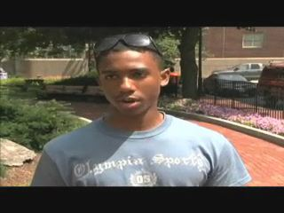
The end of money worries
Video: In Show Mode click image above
Notes:
In this movie clip a student talks about how his father taught him about the value of money, and how to spend and not spend it. Ask students where they learned their money management tools…. If anywhere.

Slide 23
Managing Money During Tough Times
Take a first step
Spend less, save more
Make sure savings are protected
Pay off credit cards
Invest only after saving
Do stellar work at your current job
Think about your next job
Research unemployment benefits
Get health insurance
Get help that you can trust
Put your plan in writing
Cope with stress positively
Choose your money conversations
Notes:
During difficult economic times managing money becomes even more challenging. Review these strategies with your students. Ask them to copy this list into their notes and to star those they have tried and have worked for them. Then ask them to make a second list of new strategies they have not yet tried but intend to implement.

Slide 24
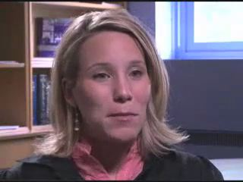
Education is worth it – and you can pay for it
Greater likelihood of being employed
Health insurance
Higher income
Job satisfaction
Higher tax revenues for your community
Lower dependence on income support services
Higher involvement in volunteer activities
Video: In Show Mode click image above
Notes:
Many students wonder whether their investment of time and money into higher education is worth it. Here are several benefits of higher education. You might share personally ways your higher education experience has been worth it in your life. The movie clip talks about managing student debt in order to achieve a higher education experience.
Education is a great investment. The financial aid office offers grants/scholarships, loans, and work-study programs to students with financial need. Ask a financial aid representative to speak to class about these.

Slide 25
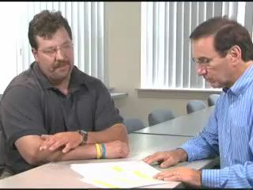
Take charge of your credit
Video: In Show Mode click image above
Notes:
Charge cards and other forms of credit can be traps that companies use against money-needy college students. Use credit to your advantage by taking charge of it. The movie clip in this slide talks about the lack of education about money management students receive.

Slide 26
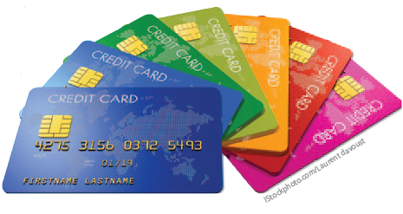
Take charge of your credit
Use credit cards with caution
Pay off balance each month
Scrutinize credit card offers
Avoid cash advances
Check statements against your records
Use just one card
Get a copy of your credit report
Protect your credit score
Notes:
Here are 7 strategies to use with credit cards. Give each student a 3x5 card. Ask students to look at this list and write the number on the anonymous card that corresponds with the number of these tools they regularly use regarding their credit cards. Collect the cards. Have students summarize the results to drive home the point that students don’t know what they should be doing when they have and use credit cards.

Slide 27
Take charge of your credit
Manage student loans
Choose schools with costs in mind
Avoid debt when possible
Shop carefully for loans
Repay your loans
Notes:
Invite a representative from the Financial Aid Office to speak on student loans. Students should not take out loans unless they are absolutely necessary. Loans must be paid back with interest and in many cases, interest is accumulating while students are in school, even though the repayment doesn’t begin until they graduate or leave school!
27

