Slide 1
Chapter Five
Consumer Markets and Consumer Buyer Behavior
Copyright ©2014 by Pearson Education, Inc. All rights reserved

Slide 2
Consumer Markets and Consumer Buyer Behavior
Topic Outline
Model of Consumer Behavior
Characteristics Affecting Consumer Behavior
Types of Buying Decision Behavior
The Buyer Decision Process
The Buyer Decision Process for New Products
Copyright ©2014 by Pearson Education, Inc. All rights reserved
Notes:
In this chapter, we continue with a closer look at the most important element of the marketplace—customers. The aim of marketing is to affect how customers think and act. To affect the whats, whens, and hows of buyer behavior, marketers must first understand the whys. In this chapter, we look at final consumer buying influences and processes. In the next chapter, we’ll study the buyer behavior of business customers. You’ll see that understanding buyer behavior is an essential but very difficult task.

Slide 3
Model of Consumer Behavior
Consumer buyer behavior : the buying behavior of final consumers, individuals and households, who buy goods and services for personal consumption
Consumer market : all of the personal consumption of final consumers
Copyright ©2014 by Pearson Education, Inc. All rights reserved
Notes:
Note to Instructor
Discussion Question
What have you recently purchased that cost over $100? Write down all the reasons you purchased this particular item.
Because students are all consumers—it is interesting to start the class with a discussion of products they have recently purchased. When you ask them why they purchased a particular item or product, you can bring them through many topics in this chapter including the characteristics that affect consumer behavior (cultural, social, personal, and psychological). You can also try to determine the process they went through including how and where they searched for information and how they evaluated their alternatives. Finally, ask them how they feel about their purchase (postpurchase behavior). This discussion will lead nicely to the next slide which is the Model of Buyer Behavior.
Consumers make many buying decisions every day, and the buying decision is the focal point of the marketer’s effort. Most large companies research consumer buying decisions in great detail to answer questions about what consumers buy, where they buy, how and how much they buy, when they buy, and why they buy. Marketers can study actual consumer purchases to find out what they buy, where, and how much. But learning about the whys of consumer buying behavior is not so easy—the answers are often locked deep within the consumer’s mind. Often, consumers themselves don’t know exactly what influences their purchases.

Slide 4
Model of Consumer Behavior
Copyright ©2014 by Pearson Education, Inc. All rights reserved
Notes:
Note to Instructor
Figure 5.1 Understanding the whys of buying behavior is very difficult. Says one expert, “The mind is a whirling, swirling, jumbled mass of neurons
bouncing around…”
It is interesting to talk about the buyer’s black box and one of the largest challenges in marketing is to understand what happens in this black box. Students will enjoy this video by Derren Brown. It is unclear how he obtains his results and how scientific this is, but it will certainly have students realize the mystery of the consumer’s brain.
The central question for marketers is this: How do consumers respond to various marketing efforts the company might use? The starting point is the stimulus-response model of buyer behavior shown in Figure 5.1. This figure shows that marketing and other stimuli enter the consumer’s “black box” and produce certain responses. Marketers must figure out what is in the buyer’s black box.
Marketing stimuli consist of the four Ps: product, price, place, and promotion. Other stimuli include major forces and events in the buyer’s environment: economic, technological, social, and cultural. All these inputs enter the buyer’s black box, where they are turned into a set of buyer responses—the buyer’s brand and company relationship behavior and what he or she buys, when, where, and how much.
Marketers want to understand how the stimuli are changed into responses inside the consumer’s black box, which has two parts. First, the buyer’s characteristics influence how he or she perceives and reacts to the stimuli. Second, the buyer’s decision process itself affects his or her behavior. We look first at buyer characteristics as they affect buyer behavior and then discuss the buyer decision process.

Slide 5
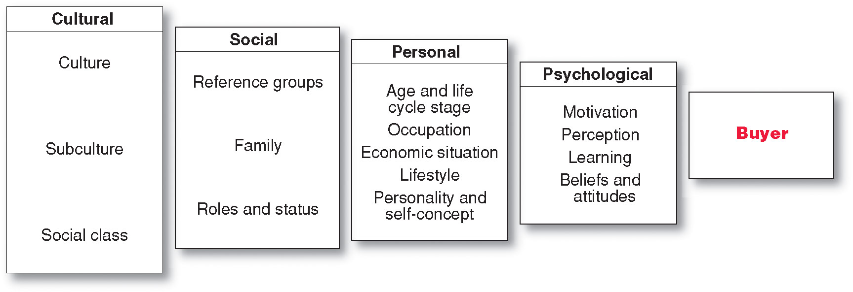
Characteristics Affecting Consumer Behavior
Factors Influencing Consumer Behavior
Copyright ©2014 by Pearson Education, Inc. All rights reserved
Notes:
Consumer purchases are influenced strongly by cultural, social, personal, and psychological characteristics, as shown in Figure 5.2. For the most part, marketers cannot control such factors, but they must take them into account.
Discussion Question: Many levels of factors affect our buying behavior—from broad cultural and social influences to motivations, beliefs, and attitudes lying deep within us.
For example, why did you buy that specific cell phone?

Slide 6
Characteristics Affecting Consumer Behavior
Culture is the learned values, perceptions, wants, and behavior from family and other important institutions and is the most basic cause of a person’s wants and behavior
Copyright ©2014 by Pearson Education, Inc. All rights reserved
Notes:
Cultural Factors
Cultural factors exert a broad and deep influence on consumer behavior. Marketers need to understand the role played by the buyer’s culture, subculture, and social class.
Culture
Culture is the most basic cause of a person’s wants and behavior. Human behavior is largely learned. Growing up in a society, a child learns basic values, perceptions, wants, and behaviors from his or her family and other important institutions. A child in the United States normally learns or is exposed to the following values: achievement and success, individualism, freedom, hard work, activity and involvement, efficiency and practicality, material comfort, youthfulness, and fitness and health. Every group or society has a culture, and cultural influences on buying behavior may vary greatly from both county to county and country to country.
Marketers are always trying to spot cultural shifts so as to discover new products that might be wanted. For example, the cultural shift toward greater concern about health and fitness has created a huge industry for health-and-fitness services, exercise equipment and clothing, organic foods, and a variety of diets.

Slide 7
Characteristics Affecting Consumer Behavior
Subcultures are groups of people within a culture with shared value systems based on common life experiences and situations
Hispanic American
African American
Asian American
Cross-Cultural
Copyright ©2014 by Pearson Education, Inc. All rights reserved
Notes:
Each culture contains smaller subcultures, or groups of people with shared value systems based on common life experiences and situations. Subcultures include nationalities, religions, racial groups, and geographic regions. Many subcultures make up important market segments, and marketers often design products and marketing programs tailored to their needs. Examples of three such important subculture groups are Hispanic American, African American, and Asian American consumers.
Discussion Question
What subculture do you belong to? How does this influence you as a consumer?
Although Hispanic consumers share many characteristics and behaviors with the mainstream buying public, there are also distinct differences. They tend to be deeply family oriented and make shopping a family affair—children have a big say in what brands they buy. Older, first-generation Hispanic consumers tend to be very brand loyal and to favor brands and sellers who show special interest in them. Younger Hispanics, however, have shown increasing price sensitivity in recent years and a willingness to switch to store brands.
Within the Hispanic market, there exist many distinct subsegments based on nationality, age, income, and other factors. A company’s product or message may be more relevant to one nationality over another, such as Mexicans, Costa Ricans, Argentineans, or Cubans. Companies must also vary their pitches across different Hispanic economic segments.
Similarly, Hispanic consumers shop for groceries three times more often than the general U.S. shopper, so Nestlé, General Mills, and other food companies compete heavily to get their brands into Hispanic shoppers’ grocery carts. For example, Nestlé targets Hispanic family buyers with its extensive Construye el Mejor Nido (Create the Best Nest) marketing campaign, which connects Nestlé’s products with family nutrition and wellness resources. The multi-pronged campaign includes a bilingual website (www.elmejornido.com), a Facebook page, Spanish-language television ads, sampling, and in-store marketing. No matter what the medium, the Construye el Mejor Nido campaign focuses heavily on how Nestlé and its brands help to build family togetherness and wellbeing. For example, four Hispanic mothers blog on the website, offering tips on parenting and healthy eating.
African American Consumers The U.S. African American population is growing in affluence and sophistication. In recent years, many companies have developed special products, appeals, and marketing programs for African American consumers. For example, Procter & Gamble has long been the leader in African American advertising, spending nearly twice as much as the second-place spender. P&G also tailors products to the specific needs of black consumers. For example, its CoverGirl Queen Latifah line is specially formulated “to celebrate the beauty of women of color.”
Asian American Consumers Asian Americans are the most affluent U.S. demographic segment. They now number more than 16 million, with annual buying power approaching buying power of $775 billion by 2015. Asian Americans are the second-fastest-growing subsegment after Hispanic Americans. And like Hispanic Americans, they are a diverse group. Chinese Americans constitute the largest group, followed by Filipinos, Asian Indians, Vietnamese, Korean Americans, and Japanese Americans. Yet, unlike Hispanics that all speak various dialects of Spanish, Asians speaks many different languages.
As a group, Asian consumers shop frequently and are the most brand conscious of all the ethnic groups. They can be fiercely brand loyal. As a result, many firms now target the Asian American market.
cross-cultural marketing—the practice of including ethnic themes and cross-cultural perspectives within their mainstream marketing. Cross-cultural marketing appeals to consumer similarities across subcultures rather than differences. Many marketers are finding that insights gleaned from ethnic consumers can influence their broader markets.

Slide 8
Characteristics Affecting Consumer Behavior
Social classes are society’s relatively permanent and ordered divisions whose members share similar values, interests, and behaviors
Measured by a combination of occupation, income, education, wealth, and other variables
Copyright ©2014 by Pearson Education, Inc. All rights reserved
Notes:
Social class is not determined by a single factor, such as income, but is measured as a combination of occupation, income, education, wealth, and other variables. In some social systems, members of different classes are reared for certain roles and cannot change their social positions. In the United States, however, the lines between social classes are not fixed and rigid; people can move to a higher social class or drop into a lower one.

Slide 9
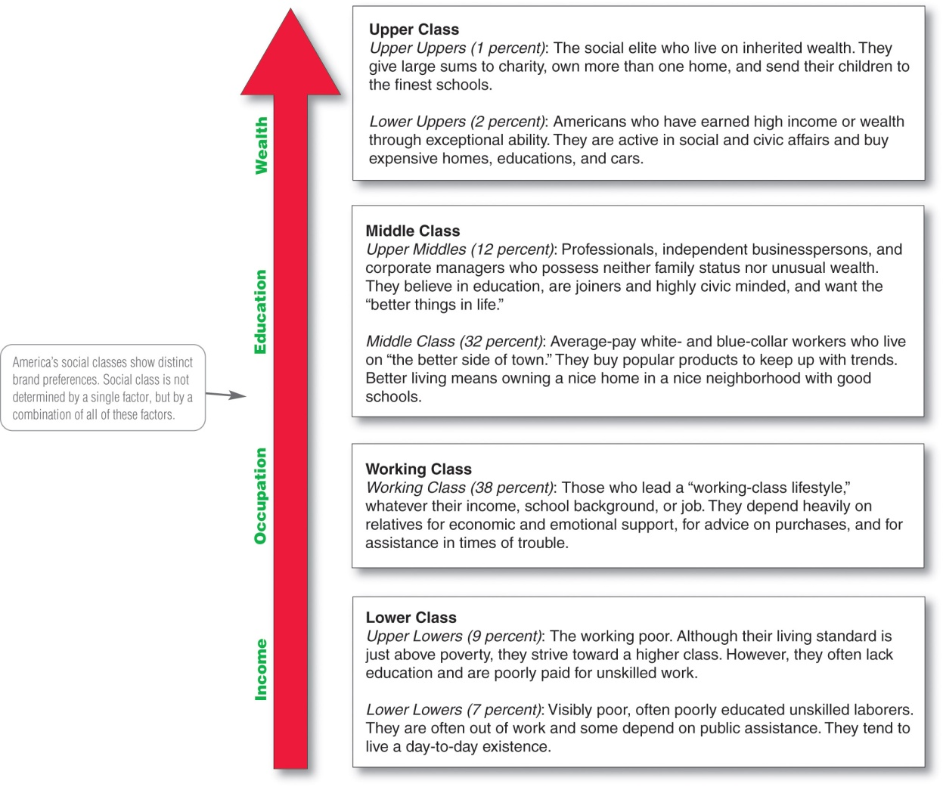
Major American Social Classes
Copyright ©2014 by Pearson Education, Inc. All rights reserved
Notes:
Figure 5.3 Marketers are interested in social class because people within a given social class tend to exhibit similar buying behavior. Social classes show distinct product and brand preferences in areas such as clothing, home furnishings, travel and leisure activity, financial services, and automobiles.

Slide 10
Characteristics Affecting Consumer Behavior
Groups and Social Networks
Membership Groups
Groups with direct influence and to which a person belongs
Aspirational Groups
Groups an individual wishes to belong to
Reference Groups
Groups that form a comparison or reference in forming attitudes or behavior
Copyright ©2014 by Pearson Education, Inc. All rights reserved
Notes:
Groups that have a direct influence and to which a person belongs are called membership groups.
Aspirational: People often are influenced by reference groups to which they do not belong.
Reference groups serve as direct (face-to-face) or indirect points of comparison or reference in forming a person’s attitudes or behavior.
Discussion Question
What groups are you a member of and what are your aspirational groups. How does this influence you as a consumers?
Marketers try to identify the reference groups of their target markets. Reference groups expose a person to new behaviors and lifestyles, influence the person’s attitudes and self-concept, and create pressures to conform that may affect the person’s product and brand choices. The importance of group influence varies across products and brands. It tends to be strongest when the product is visible to others whom the buyer respects.

Slide 11
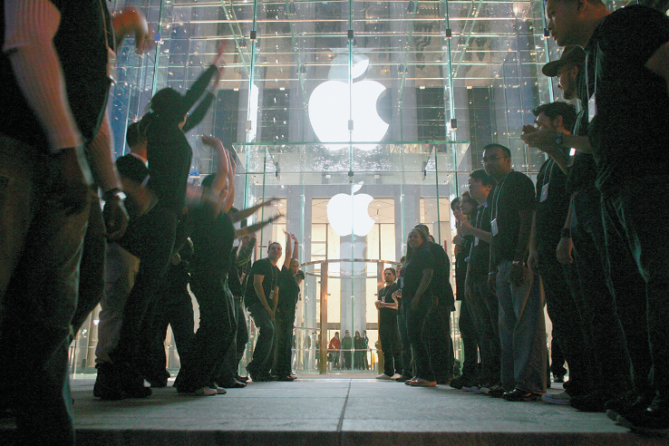
Characteristics Affecting Consumer Behavior
Groups and Social Networks
Word-of-mouth influence and buzz marketing
Opinion leaders are people within a reference group who exert social influence on others
Also called influentials or leading adopters
Marketers identify them to use as brand ambassadors
Copyright ©2014 by Pearson Education, Inc. All rights reserved
Notes:
Word-of-Mouth Influence and Buzz Marketing Word-of-mouth influence can have a powerful impact on consumer buying behavior. The personal words and recommendations of trusted friends, associates, and other consumers tend to be more credible than those coming from commercial sources, such as advertisements or salespeople. Most word-of-mouth influence happens naturally: Consumers start chatting about a brand they use or feel strongly about one way or the other. Often, however, rather than leaving it to chance, marketers can help to create positive conversations about their brands.
Marketers of brands subjected to strong group influence must figure out how to reach opinion leaders—people within a reference group who, because of special skills, knowledge, personality, or other characteristics, exert social influence on others. Some experts call this group the influentials or leading adopters. When these influentials talk, consumers listen. Marketers try to identify opinion leaders for their products and direct marketing efforts toward them.
Buzz marketing involves enlisting or even creating opinion leaders to serve as “brand ambassadors” who spread the word about a company’s products. Many companies are now turning everyday customers into brand evangelists.

Slide 12
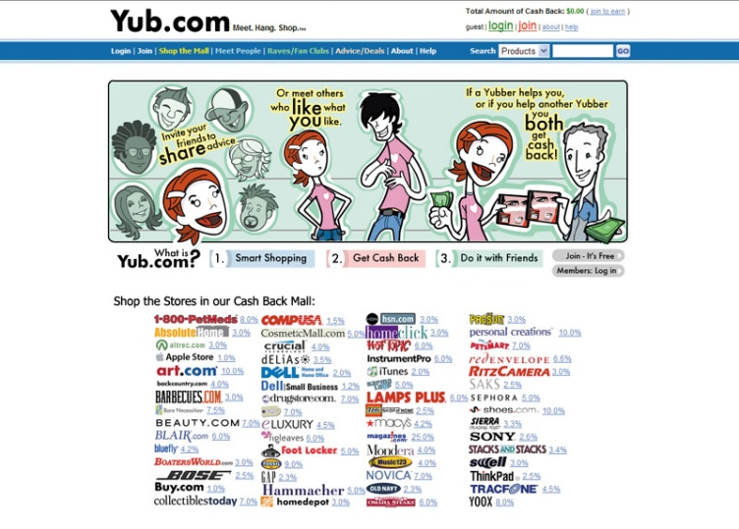
Characteristics Affecting Consumer Behavior
Groups and Social Networks
Online Social Networks are online communities where people socialize or exchange information and opinions
Include blogs, social networking sites (facebook), virtual worlds (second life)
Copyright ©2014 by Pearson Education, Inc. All rights reserved
Notes:
Note to Instructor:
Discussion Question
How can marketers use these networks?
This slide should provide a lively discussion for students because they all are users of social networks. Ask students for examples they have seen or experienced. Then be sure to ask if they think the marketing efforts were effective for the marketer and why? The text gives many examples .
Online Social Networks More broadly, over the past few years, a new type of social interaction has exploded onto the scene—online social networking. Online social networks are online communities where people socialize or exchange information and opinions. Social networking media range from blogs (Gizmodo, Zenhabits) and message boards (Craigslist) to social networking websites (Facebook, Twitter, and Foursquare) and virtual worlds (Second Life). This new form of consumer-to-consumer and business-to-consumer dialog has big implications for marketers.
Marketers are working to harness the power of these new social networks and other “word-of-Web” opportunities to promote their products and build closer customer relationships. Instead of throwing more one-way commercial messages at consumers, they hope to use the Internet and social networks to interact with consumers and become a part of their conversations and lives.
Most brands have built a comprehensive social media presence. But marketers must be careful when tapping into online social networks. Results are difficult to measure and control. Ultimately, the users control the content, so social network marketing attempts can easily backfire.

Slide 13
Characteristics Affecting Consumer Behavior
Social Factors
Family is the most important consumer-buying organization in society
Social roles and status are the groups, family, clubs, and organizations that a person belongs to that can define role and social status
Copyright ©2014 by Pearson Education, Inc. All rights reserved
Notes:
Note to Instructor
Discussion Question
What brands do you purchase because it is what their parents used? Why do you think this occurs?
Family
Family members can strongly influence buyer behavior. The family is the most important consumer buying organization in society, and it has been researched extensively. Marketers are interested in the roles and influence of the husband, wife, and children on the purchase of different products and services.
Husband-wife involvement varies widely by product category and by stage in the buying process. Buying roles change with evolving consumer lifestyles. For example, in the United States, the wife traditionally has been considered the main purchasing agent for the family in the areas of food, household products, and clothing. But with more women working outside the home and the willingness of husbands to do more of the family’s purchasing, all this is changing. A recent survey of men ages 18 to 64 found that 51 percent identify themselves as primary grocery shoppers in their households and 39 percent handle most of their household’s laundry. At the same time, today women account for 50 percent of all technology purchases and influence two-thirds of all new car purchases.
Such shifting roles signal a new marketing reality. Marketers in industries that have traditionally sold their products to only women or only men—from groceries and personal care products to cars and consumer electronics—are now carefully targeting the opposite sex. For example, most grocery products marketers have now added pitches to dads.
Children may also have a strong influence on family buying decisions. The nation’s 36 million children ages 9 to 12 wield an estimated $43 billion in disposable income. They also influence an additional $150 billion that their families spend on them in areas such as food, clothing, entertainment, and personal care items. One study found that kids significantly influence family decisions about everything from what cars they buy to where they eat out and take vacations.
Roles and Status
A person belongs to many groups—family, clubs, organizations, online communities. The person’s position in each group can be defined in terms of both role and status. A role consists of the activities people are expected to perform according to the people around them. Each role carries a status reflecting the general esteem given to it by society.
People usually choose products appropriate to their roles and status. Consider the various roles a working mother plays. In her company, she may play the role of a brand manager; in her family, she plays the role of wife and mother; at her favorite sporting events, she plays the role of avid fan. As a brand manager, she will buy the kind of clothing that reflects her role and status in her company. At the game, she may wear clothing supporting her favorite team.

Slide 14
Characteristics Affecting Consumer Behavior
Personal Factors
Age and life-cycle stage
PersonicX life-stage segmentation system:
--70 segments
--21 life-stage groups
Includes Taking Hold (young, energetic couples and families) and Transition Blues (blue-dollar, less educated mid-income)
Copyright ©2014 by Pearson Education, Inc. All rights reserved
Notes:
Personal Factors
A buyer’s decisions also are influenced by personal characteristics such as the buyer’s age and life-cycle stage, occupation, economic situation, lifestyle, and personality and self-concept.
Age and Life-Cycle Stage
People change the goods and services they buy over their lifetimes. Tastes in food, clothes, furniture, and recreation are often age related. Buying is also shaped by the stage of the family life cycle—the stages through which families might pass as they mature over time. Life-stage changes usually result from demographics and life-changing events—marriage, having children, purchasing a home, divorce, children going to college, changes in personal income, moving out of the house, and retirement. Marketers often define their target markets in terms of life-cycle stage and develop appropriate products and marketing plans for each stage.
“Consumers experience many life-stage changes during their lifetimes,” says Acxiom. “As their life stages change, so do their behaviors and purchasing preferences.” Armed with data about the timing and makeup of life-stage changes, marketers can create targeted, personalized campaigns.
In line with recent tougher economic times, Acxiom has also developed a set of economic life-stage segments, including groups such as Squeaking By, Eye on Essentials, Tight with a Purpose, It’s My Life, Full Speed Ahead, and Potential Rebounders. The Potential Rebounders are those more likely to loosen up on spending sooner. This group appears more likely than other segments to use online research before purchasing electronics, appliances, home decor, and jewelry. Thus, home improvement retailers appealing to this segment should have a strong online presence, providing pricing, features and benefits, and product availability.

Slide 15
Characteristics Affecting Consumer Behavior
Personal Factors
Occupation affects the goods and services bought by consumers
Economic situation includes trends in:
Personal income
Savings
Interest rates
Copyright ©2014 by Pearson Education, Inc. All rights reserved
Notes:
Discussion Question: Ask the students how their occupations and economic situations affect the goods and services they buy.
Occupation
A person’s occupation affects the goods and services bought. Blue-collar workers tend to buy more rugged work clothes, whereas executives buy more business suits. Marketers try to identify the occupational groups that have an above-average interest in their products and services. A company can even specialize in making products needed by a given occupational group.
Economic Situation
A person’s economic situation will affect his or her store and product choices. Marketers watch trends in personal income, savings, and interest rates. In the more frugal times following the Great Recession, most companies have taken steps to redesign, reposition, and reprice their products and services. For example, upscale discounter Target has replaced some of its “chic” with “cheap.” It is putting more emphasis on the “Pay less” side of its “Expect more. Pay less.” positioning promise.

Slide 16
Characteristics Affecting Consumer Behavior
Personal Factors
Lifestyle is a person’s pattern of living as expressed in his or her psychographics
Measures a consumer’s AIOs (activities, interests, opinions) to capture information about a person’s pattern of acting and interacting in the environment
Copyright ©2014 by Pearson Education, Inc. All rights reserved
Notes:
Note to Instructor
Discussion Question
What categories of products seem to be targeted to consumer’s lifestyles?
They will realize many products in addition to cars including food, cosmetics, shampoo also appeal to a consumer’s lifestyles.
When used carefully, the lifestyle concept can help marketers understand changing consumer values and how they affect buyer behavior. Consumers don’t just buy products; they buy the values and lifestyles those products represent.
Marketers look for lifestyle segments with needs that can be served through special products or marketing approaches. Such segments might be defined buy anything from family characteristics or outdoor interests to pet ownership. In fact, today’s involved pet ownership lifestyles have created a huge market for everything from basic pet supplies to exotic pet services marketed to indulgent “pet parents.”

Slide 17
Characteristics Affecting Consumer Behavior
Personal Factors
Personality: the unique psychological characteristics that lead to consistent and lasting responses to the consumer’s environment
Copyright ©2014 by Pearson Education, Inc. All rights reserved
Notes:
Personality is usually described in terms of traits such as self-confidence, dominance, sociability, autonomy, defensiveness, adaptability, and aggressiveness. Personality can be useful in analyzing consumer behavior for certain product or brand choices.
The idea is that brands also have personalities, and consumers are likely to choose brands with personalities that match their own. A brand personality is the specific mix of human traits that may be attributed to a particular brand. One researcher identified five brand personality traits: sincerity (down-to-earth, honest, wholesome, and cheerful); excitement (daring, spirited, imaginative, and up-to-date); competence (reliable, intelligent, and successful); sophistication (upper class and charming); and ruggedness (outdoorsy and tough). “Your personality determines what you consume, what TV shows you watch, what products you buy, and [most] other decisions you make,” says one consumer behavior expert.
Most well-known brands are strongly associated with one particular trait: the Ford F150 with “ruggedness,” Apple with “excitement,” the Washington Post with “competence,” and Method with “sincerity.” Hence, these brands will attract persons who are high on the same personality traits.
Many marketers use a concept related to personality—a person’s self-concept (also called self-image). The idea is that people’s possessions contribute to and reflect their identities—that is, “we are what we consume.” Thus, to understand consumer behavior, marketers must first understand the relationship between consumer self-concept and possessions.

Slide 18
Characteristics Affecting Consumer Behavior
Personal Factors
Dominance
Autonomy
Defensiveness
Adaptability
Aggressiveness
Copyright ©2014 by Pearson Education, Inc. All rights reserved
Notes:
Note to Instructor
It is interesting to talk about brand personalities and ask students the personality of several brands:
A brand personality is the specific mix of human traits that may be attributed to a particular brand.
One researcher identified five brand personality traits
1. Sincerity (down-to-earth, honest, wholesome, and cheerful)
2. Excitement (daring, spirited, imaginative, and up-to-date)
3. Competence (reliable, intelligent, and successful)
4. Sophistication (upper class and charming)
5. Ruggedness (outdoorsy and tough)

Slide 19
Characteristics Affecting Consumer Behavior
Psychological Factors
Motivation
Perception
Learning
Beliefs and attitudes
Copyright ©2014 by Pearson Education, Inc. All rights reserved
Notes:
A person has many needs at any given time. Some are biological, arising from states of tension such as hunger, thirst, or discomfort. Others are psychological, arising from the need for recognition, esteem, or belonging.

Slide 20
Characteristics Affecting Consumer Behavior
Psychological Factors
Motivation
A motive is a need that is sufficiently pressing to direct the person to seek satisfaction
Motivation research refers to qualitative research designed to probe consumers’ hidden, subconscious motivations
Copyright ©2014 by Pearson Education, Inc. All rights reserved
Notes:
Psychologists have developed theories of human motivation. Two of the most popular—the theories of Sigmund Freud and Abraham Maslow—carry quite different meanings for consumer analysis and marketing.
Sigmund Freud assumed that people are largely unconscious about the real psychological forces shaping their behavior. His theory suggests that a person’s buying decisions are affected by subconscious motives that even the buyer may not fully understand. Thus, an aging baby boomer who buys a sporty BMW convertible might explain that he simply likes the feel of the wind in his thinning hair. At a deeper level, he may be trying to impress others with his success. At a still deeper level, he may be buying the car to feel young and independent again.
The term motivation research refers to qualitative research designed to probe consumers’ hidden, subconscious motivations. Consumers often don’t know or can’t describe why they act as they do. Thus, motivation researchers use a variety of probing techniques to uncover underlying emotions and attitudes toward brands and buying situations.
Many companies employ teams of psychologists, anthropologists, and other social scientists to carry out motivation research. One ad agency routinely conducts one-on-one, therapy-like interviews to delve into the inner workings of consumers. Another company asks consumers to describe their favorite brands as animals or cars (say, a Mercedes versus a Chevy) to assess the prestige associated with various brands. Still others rely on hypnosis, dream therapy, or soft lights and mood music to plumb the murky depths of consumer psyches.
Such projective techniques seem pretty goofy, and some marketers dismiss such motivation research as mumbo jumbo. But many marketers use such touchy-feely approaches, now sometimes called interpretive consumer research, to dig deeper into consumer psyches and develop better marketing strategies.

Slide 21
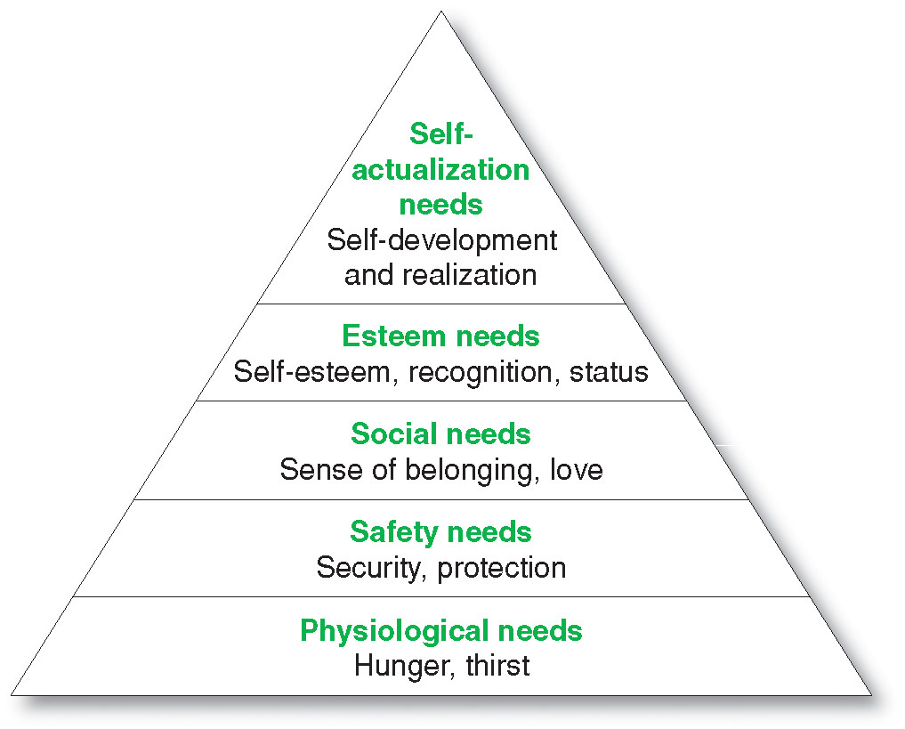
Characteristics Affecting Consumer Behavior
Maslow’s
Hierarchy of Needs
Copyright ©2014 by Pearson Education, Inc. All rights reserved
Notes:
Abraham Maslow sought to explain why people are driven by particular needs at particular times. Why does one person spend a lot of time and energy on personal safety and another on gaining the esteem of others? Maslow’s answer is that human needs are arranged in a hierarchy, as shown in Figure 5.4, from the most pressing at the bottom to the least pressing at the top. They include physiological needs, safety needs, social needs, esteem needs, and self-actualization needs.
A person tries to satisfy the most important need first. When that need is satisfied, it will stop being a motivator, and the person will then try to satisfy the next most important need. For example, starving people (physiological need) will not take an interest in the latest happenings in the art world (self-actualization needs) nor in how they are seen or esteemed by others (social or esteem needs) nor even in whether they are breathing clean air (safety needs). But as each important need is satisfied, the next most important need will come into play.
See Abraham H. Maslow, “A Theory of Human Motivation,” Psychological Review, 50 (1943), pp. 370–396. Also see Maslow, Motivation and Personality, 3rd ed. (New York: HarperCollins Publishers, 1987); and Michael R. Solomon, Consumer Behavior, 9th ed. (Upper Saddle River, NJ: Prentice Hall, 2011), pp. 135-136.

Slide 22
Characteristics Affecting Consumer Behavior
Psychological Factors
Perception is the process by which people select, organize, and interpret information to form a meaningful picture of the world from three perceptual processes
Selective attention
Selective distortion
Selective retention
Copyright ©2014 by Pearson Education, Inc. All rights reserved
Notes:
Note to Instructor
Discussion Question
If you watched television last night, what ads do you remember seeing?
Probe to find out why they remember certain ads—was it that they broke through the clutter, that they saw them many times, or that they are in the market for that certain product? A motivated person is ready to act. How the person acts is influenced by his or her own perception of the situation. All of us learn by the flow of information through our five senses: sight, hearing, smell, touch, and taste. However, each of us receives, organizes, and interprets this sensory information in an individual way.

Slide 23
Characteristics Affecting Consumer Behavior
Psychological Factors
Selective attention is the tendency for people to screen out most of the information to which they are exposed
Selective distortion is the tendency for people to interpret information in a way that will support what they already believe
Selective retention is the tendency to remember good points made about a brand they favor and forget good points about competing brands
Copyright ©2014 by Pearson Education, Inc. All rights reserved
Notes:
People can form different perceptions of the same stimulus because of three perceptual processes: selective attention, selective distortion, and selective retention. People are exposed to a great amount of stimuli every day. For example, people are exposed to an estimated 3,000 to 5,000 ad messages every day. It is impossible for a person to pay attention to all these stimuli. Selective attention—the tendency for people to screen out most of the information to which they are exposed—means that marketers must work especially hard to attract the consumer’s attention.
Even noticed stimuli do not always come across in the intended way. Each person fits incoming information into an existing mind-set. Selective distortion describes the tendency of people to interpret information in a way that will support what they already believe. People also will forget much of what they learn. They tend to retain information that supports their attitudes and beliefs. Selective retention means that consumers are likely to remember good points made about a brand they favor and forget good points made about competing brands. Because of selective attention, distortion, and retention, marketers must work hard to get their messages through.

Slide 24
Characteristics Affecting Consumer Behavior
Psychological Factors
Learning is the change in an individual’s behavior arising from experience and occurs through interplay of:
Drives
Stimuli
Cues
Responses
Reinforcement
Copyright ©2014 by Pearson Education, Inc. All rights reserved
Notes:
Learning theorists say that most human behavior is learned. Learning occurs through the interplay of drives, stimuli, cues, responses, and reinforcement.
A drive is a strong internal stimulus that calls for action. A drive becomes a motive when it is directed toward a particular stimulus object. For example, a person’s drive for self-actualization might motivate him or her to look into buying a camera. The consumer’s response to the idea of buying a camera is conditioned by the surrounding cues. Cues are minor stimuli that determine when, where, and how the person responds. For example, the person might spot several camera brands in a shop window, hear of a special sale price, or discuss cameras with a friend. These are all cues that might influence a consumer’s response to his or her interest in buying the product.
Suppose the consumer buys a Nikon camera. If the experience is rewarding, the consumer will probably use the camera more and more, and his or her response will be reinforced. Then the next time he or she shops for a camera, or for binoculars or some similar product, the probability is greater that he or she will buy a Nikon product. The practical significance of learning theory for marketers is that they can build up demand for a product by associating it with strong drives, using motivating cues, and providing positive reinforcement.

Slide 25
Characteristics Affecting Consumer Behavior
Psychological Factors
Beliefs and Attitudes
Belief is a descriptive thought that a person has about something based on:
Knowledge
Opinion
Faith
Copyright ©2014 by Pearson Education, Inc. All rights reserved
Notes:
Through doing and learning, people acquire beliefs and attitudes. These, in turn, influence their buying behavior. A belief is a descriptive thought that a person has about something. Beliefs may be based on real knowledge, opinion, or faith and may or may not carry an emotional charge. Marketers are interested in the beliefs that people formulate about specific products and services because these beliefs make up product and brand images that affect buying behavior. If some of the beliefs are wrong and prevent purchase, the marketer will want to launch a campaign to correct them.
Discussion Question: Ask the students how a belief they hold influenced one of their purchase decisions.

Slide 26
Characteristics Affecting Consumer Behavior
Psychological Factors
Attitudes
describe a person’s relatively consistent evaluations, feelings, and tendencies toward an object or idea
Copyright ©2014 by Pearson Education, Inc. All rights reserved
Notes:
People have attitudes regarding religion, politics, clothes, music, food, and almost everything else. Attitude describes a person’s relatively consistent evaluations, feelings, and tendencies toward an object or idea. Attitudes put people into a frame of mind of liking or disliking things, of moving toward or away from them. Our camera buyer may hold attitudes such as “Buy the best,” “The Japanese make the best electronics products in the world,” and “Creativity and self-expression are among the most important things in life.” If so, the Nikon camera would fit well into the consumer’s existing attitudes.
Attitudes are difficult to change. A person’s attitudes fit into a pattern; changing one attitude may require difficult adjustments in many others. Thus, a company should usually try to fit its products into existing attitudes rather than attempt to change attitudes.

Slide 27
Types of Buying Decision Behavior
Complex buying behavior
Dissonance-reducing buying behavior
Habitual buying behavior
Variety-seeking buying behavior
Copyright ©2014 by Pearson Education, Inc. All rights reserved
Notes:
Some purchases are simple and routine, even habitual. Others are far more complex—involving extensive information gathering and evaluation—and are subject to sometimes subtle influences. For example, think of all that goes into a new car buying decision.

Slide 28
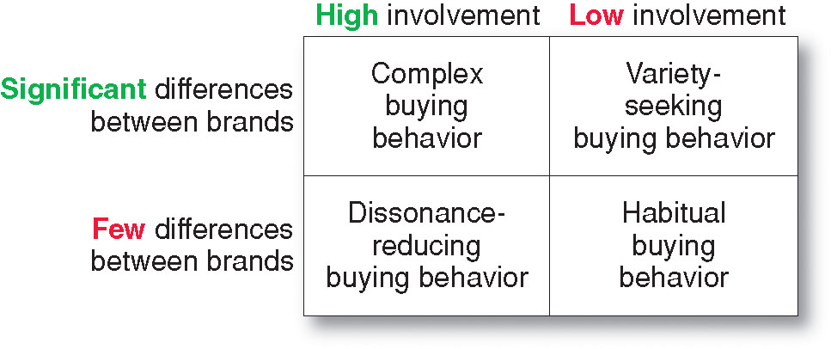
Types of Buying Decision Behavior
Four Types of Buying Behavior
Copyright ©2014 by Pearson Education, Inc. All rights reserved
Notes:
Buying behavior differs greatly for a tube of toothpaste, a smartphone, financial services, and a new car. More complex decisions usually involve more buying participants and more buyer deliberation. Figure 5.5 shows the types of consumer buying behavior based on the degree of buyer involvement and the degree of differences among brands.
Complex Buying Behavior
Consumers undertake complex buying behavior when they are highly involved in a purchase and perceive significant differences among brands. Consumers may be highly involved when the product is expensive, risky, purchased infrequently, and highly self-expressive.
This buyer will pass through a learning process, first developing beliefs about the product, then attitudes, and then making a thoughtful purchase choice. Marketers of high-involvement products must understand the information-gathering and evaluation behavior of high-involvement consumers. They need to help buyers learn about product-class attributes and their relative importance. They need to differentiate their brand’s features, perhaps by describing the brand’s benefits using print media with long copy. They must motivate store salespeople and the buyer’s acquaintances to influence the final brand choice.
Dissonance-Reducing Buying Behavior
Dissonance-reducing buying behavior occurs when consumers are highly involved with an expensive, infrequent, or risky purchase but see little difference among brands. For example, consumers buying carpeting may face a high-involvement decision because carpeting is expensive and self-expressive. Yet buyers may consider most carpet brands in a given price range to be the same. In this case, because perceived brand differences are not large, buyers may shop around to learn what is available but buy relatively quickly. They may respond primarily to a good price or purchase convenience.
After the purchase, consumers might experience postpurchase dissonance (after-sale discomfort) when they notice certain disadvantages of the purchased carpet brand or hear favorable things about brands not purchased. To counter such dissonance, the marketer’s after-sale communications should provide evidence and support to help consumers feel good about their brand choices.
Habitual Buying Behavior
Habitual buying behavior occurs under conditions of low-consumer involvement and little significant brand difference. For example, take table salt. Consumers have little involvement in this product category—they simply go to the store and reach for a brand. If they keep reaching for the same brand, it is out of habit rather than strong brand loyalty. Consumers appear to have low involvement with most low-cost, frequently purchased products.
In such cases, consumer behavior does not pass through the usual belief-attitude-behavior sequence. Consumers do not search extensively for information about the brands, evaluate brand characteristics, and make weighty decisions about which brands to buy. Because they are not highly involved with the product, consumers may not evaluate the choice, even after purchase. Thus, the buying process involves brand beliefs formed by passive learning, followed by purchase behavior, which may or may not be followed by evaluation.
<ex05.15>
Because buyers are not highly committed to any brands, marketers of low-involvement products with few brand differences often use price and sales promotions to promote buying. Alternatively, they can add product features or enhancements to differentiate their brands from the rest of the pack and raise involvement. For example, to set its brand apart, P&G’s Charmin toilet tissue offers Ultrastrong, Ultrasoft, Sensitive, Basic, and Freshmate (wet wipe) versions, so that there’s sure to be one that’s right for any family’s “bottom line.” Charmin also raises brand involvement by sponsoring a “Sit or Squat” website and mobile app that helps travelers who “Gotta go on the go!” find and rate clean public restrooms wherever they travel.
Variety-Seeking Buying Behavior
Consumers undertake variety-seeking buying behavior in situations characterized by low consumer involvement but significant perceived brand differences. In such cases, consumers often do a lot of brand switching. For example, when buying cookies, a consumer may hold some beliefs, choose a cookie brand without much evaluation, and then evaluate that brand during consumption. But the next time, the consumer might pick another brand out of boredom or simply to try something different. Brand switching occurs for the sake of variety rather than because of dissatisfaction.
In such product categories, the marketing strategy may differ for the market leader and minor brands. The market leader will try to encourage habitual buying behavior by dominating shelf space, keeping shelves fully stocked, and running frequent reminder advertising. Challenger firms will encourage variety seeking by offering lower prices, special deals, coupons, free samples, and advertising that presents reasons for trying something new.

Slide 29
The Buyer Decision Process
Buyer Decision Making Process
Copyright ©2014 by Pearson Education, Inc. All rights reserved
Notes:
Figure 5.6 shows that the buyer decision process consists of five stages: need recognition, information search, evaluation of alternatives, purchase decision, and postpurchase behavior. Clearly, the buying process starts long before the actual purchase and continues long after. Marketers need to focus on the entire buying process rather than on the purchase decision only.
Figure suggests that consumers pass through all five stages with every purchase in a considered way. But buyers may pass quickly or slowly through the buying decision process. And in more routine purchases, consumers often skip or reverse some of the stages. Much depends on the nature of the buyer, the product, and the buying situation. A woman buying her regular brand of toothpaste would recognize the need and go right to the purchase decision, skipping information search and evaluation. However, we use the model in Figure 5.6 because it shows all the considerations that arise when a consumer faces a new and complex purchase situation.

Slide 30
The Buyer Decision Process
Need Recognition
Occurs when the buyer recognizes a problem or need triggered by:
Internal stimuli
External stimuli
Copyright ©2014 by Pearson Education, Inc. All rights reserved
Notes:
Need Recognition
The buying process starts with need recognition—the buyer recognizes a problem or need. The need can be triggered by internal stimuli when one of the person’s normal needs—for example, hunger or thirst—rises to a level high enough to become a drive. A need can also be triggered by external stimuli. For example, an advertisement or a discussion with a friend might get you thinking about buying a new car. At this stage, the marketer should research consumers to find out what kinds of needs or problems arise, what brought them about, and how they led the consumer to this particular product.

Slide 31
The Buyer Decision Process
Information Search
Sources of Information
Personal sources—family and friends
Commercial sources—advertising, Internet
Public sources—mass media, consumer organizations
Experiential sources—handling, examining, using the product
Copyright ©2014 by Pearson Education, Inc. All rights reserved
Notes:
Information Search
An interested consumer may or may not search for more information. If the consumer’s drive is strong and a satisfying product is near at hand, he or she is likely to buy it then. If not, the consumer may store the need in memory or undertake an information search related to the need. For example, once you’ve decided you need a new car, at the least, you will probably pay more attention to car ads, cars owned by friends, and car conversations. Or you may actively search the Web, talk with friends, and gather information in other ways.
Consumers can obtain information from any of several sources. These include personal sources (family, friends, neighbors, acquaintances), commercial sources (advertising, salespeople, dealer websites, packaging, displays), public sources (mass media, consumer rating organizations, online searches and peer reviews), and experiential sources (handling, examining, using the product). The relative influence of these information sources varies with the product and the buyer.
Traditionally, consumers have received the most information about a product from commercial sources—those controlled by the marketer. The most effective sources, however, tend to be personal. Commercial sources normally inform the buyer, but personal sources legitimize or evaluate products for the buyer. As one marketer states, “It’s rare that an advertising campaign can be as effective as a neighbor leaning over the fence and saying, ‘This is a wonderful product.’”
Increasingly, that “neighbor’s fence” is a digital one. Today, buyers can find an abundance of user-generated reviews alongside the products they are considering at sites ranging from Amazon.com or BestBuy.com to TripAdvisor, Epinions, or Epicurious. Although individual user reviews very widely in quality, an entire body of reviews often provides a reliable product assessment—straight from the fingertips of people like you who’ve actually purchased and experienced the product.
As more information is obtained, the consumer’s awareness and knowledge of the available brands and features increase. In your car information search, you may learn about several brands that are available. The information might also help you to drop certain brands from consideration. A company must design its marketing mix to make prospects aware of and knowledgeable about its brand. It should carefully identify consumers’ sources of information and the importance of each source.

Slide 32
The Buyer Decision Process
Evaluation of Alternatives
How the consumer processes information to arrive at brand choices
Copyright ©2014 by Pearson Education, Inc. All rights reserved
Notes:
Evaluation of Alternatives
We have seen how consumers use information to arrive at a set of final brand choices. Next, marketers need to know about alternative evaluation, that is, how consumers process information to choose among alternative brands. Unfortunately, consumers do not use a simple and single evaluation process in all buying situations. Instead, several evaluation processes are at work.
How consumers go about evaluating purchase alternatives depends on the individual consumer and the specific buying situation. In some cases, consumers use careful calculations and logical thinking. At other times, the same consumers do little or no evaluating. Instead they buy on impulse and rely on intuition. Sometimes consumers make buying decisions on their own; sometimes they turn to friends, online reviews, or salespeople for buying advice.
Suppose you’ve narrowed your car choices to three brands. And suppose that you are primarily interested in four attributes—price, style, operating economy, and warranty. By this time, you’ve probably formed beliefs about how each brand rates on each attribute. Clearly, if one car rated best on all the attributes, the marketer could predict that you would choose it. However, the brands will no doubt vary in appeal. You might base your buying decision mostly on one attribute, and your choice would be easy to predict. If you wanted style above everything else, you would buy the car that you think has the most style. But most buyers consider several attributes, each with different importance. By knowing the importance that you assigned to each attribute, the marketer could predict your car choice more reliably.
Marketers should study buyers to find out how they actually evaluate brand alternatives. If marketers know what evaluative processes go on, they can take steps to influence the buyer’s decision.

Slide 33
The Buyer Decision Process
Purchase Decision
The act by the consumer to buy the most preferred brand
The purchase decision can be affected by:
Attitudes of others
Unexpected situational factors
Copyright ©2014 by Pearson Education, Inc. All rights reserved
Notes:
Purchase Decision
In the evaluation stage, the consumer ranks brands and forms purchase intentions. Generally, the consumer’s purchase decision will be to buy the most preferred brand, but two factors can come between the purchase intention and the purchase decision. The first factor is the attitudes of others. If someone important to you thinks that you should buy the lowest-priced car, then the chances of you buying a more expensive car are reduced.
The second factor is unexpected situational factors. The consumer may form a purchase intention based on factors such as expected income, expected price, and expected product benefits. However, unexpected events may change the purchase intention. For example, the economy might take a turn for the worse, a close competitor might drop its price, or a friend might report being disappointed in your preferred car. Thus, preferences and even purchase intentions do not always result in an actual purchase choice.

Slide 34
The Buyer Decision Process
Post-Purchase Decision
The satisfaction or dissatisfaction that the consumer feels about the purchase
Relationship between:
Consumer’s expectations
Product’s perceived performance
The larger the gap between expectation and performance, the greater the consumer’s dissatisfaction
Cognitive dissonance is the discomfort caused by a post-purchase conflict
Copyright ©2014 by Pearson Education, Inc. All rights reserved
Notes:
Postpurchase Behavior
The marketer’s job does not end when the product is bought. After purchasing the product, the consumer will either be satisfied or dissatisfied and will engage in postpurchase behavior of interest to the marketer. What determines whether the buyer is satisfied or dissatisfied with a purchase? The answer lies in the relationship between the consumer’s expectations and the product’s perceived performance. If the product falls short of expectations, the consumer is disappointed; if it meets expectations, the consumer is satisfied; if it exceeds expectations, the consumer is delighted. The larger the gap between expectations and performance, the greater the consumer’s dissatisfaction. This suggests that sellers should promise only what their brands can deliver so that buyers are satisfied.
<ex05.17>
Almost all major purchases, however, result in cognitive dissonance, or discomfort caused by postpurchase conflict. After the purchase, consumers are satisfied with the benefits of the chosen brand and are glad to avoid the drawbacks of the brands not bought. However, every purchase involves compromise. So consumers feel uneasy about acquiring the drawbacks of the chosen brand and about losing the benefits of the brands not purchased. Thus, consumers feel at least some postpurchase dissonance for every purchase.

Slide 35
The Buyer Decision Process
Post-Purchase Decision
Customer satisfaction is a key to building profitable relationships with consumers—to keeping and growing consumers and reaping their customer lifetime value
Copyright ©2014 by Pearson Education, Inc. All rights reserved
Notes:
Why is it so important to satisfy the customer? Customer satisfaction is a key to building profitable relationships with consumers—to keeping and growing consumers and reaping their customer lifetime value. Satisfied customers buy a product again, talk favorably to others about the product, pay less attention to competing brands and advertising, and buy other products from the company. Many marketers go beyond merely meeting the expectations of customers—they aim to delight customers.
A dissatisfied consumer responds differently. Bad word of mouth often travels farther and faster than good word of mouth. It can quickly damage consumer attitudes about a company and its products. But companies cannot simply wait for dissatisfied customers to volunteer their complaints. Most unhappy customers never tell the company about their problems. Therefore, a company should measure customer satisfaction regularly. It should set up systems that encourage customers to complain. In this way, the company can learn how well it is doing and how it can improve.

Slide 36
The Buyer Decision Process for New Products
Adoption process is the mental process an individual goes through from first learning about an innovation to final regular use.
Stages in the process include:
Awareness
Interest
Evaluation
Trial
Adoption
Copyright ©2014 by Pearson Education, Inc. All rights reserved
Notes:
A new product is a good, service, or idea that is perceived by some potential customers as new. It may have been around for a while, but our interest is in how consumers learn about products for the first time and make decisions on whether to adopt them. We define the adoption process as the mental process through which an individual passes from first learning about an innovation to final adoption. Adoption is the decision by an individual to become a regular user of the product.
Stages in the Adoption Process
Consumers go through five stages in the process of adopting a new product:
Awareness: The consumer becomes aware of the new product but lacks information about it.
Interest: The consumer seeks information about the new product.
Evaluation: The consumer considers whether trying the new product makes sense.
Trial: The consumer tries the new product on a small scale to improve his or her estimate of its value.
Adoption: The consumer decides to make full and regular use of the new product.
This model suggests that new-product marketers should think about how to help consumers move through these stages. For example, Best Buy recently developed a unique way to help concerned customers get past a hurdle in the buying process and make a positive buying decision for new televisions.

Slide 37
The Buyer Decision Process for New Products
Differences in Innovativeness Adopter Categories
Innovators
Early Adopters
Early Mainstream
Late Mainstream
Lagging Adopters
Copyright ©2014 by Pearson Education, Inc. All rights reserved
Notes:
People differ greatly in their readiness to try new products. In each product area, there are “consumption pioneers” and early adopters. Other individuals adopt new products much later. People can be classified into the adopter categories shown in Figure 5.7. As shown by the black curve, after a slow start, an increasing number of people adopt the new product. The number of new adopters reaches a peak and then drops off as fewer nonadopters remain. As successive groups of consumers adopt the innovation (the red curve), it eventually reaches its cumulative saturation level. Innovators are defined as the first 2.5 percent of buyers to adopt a new idea (those beyond two standard deviations from mean adoption time); the early adopters are the next 13.5 percent (between one and two standard deviations); and so forth.
The five adopter groups have differing values. Innovators are venturesome—they try new ideas at some risk. Early adopters are guided by respect—they are opinion leaders in their communities and adopt new ideas early but carefully. The early mainstream is deliberate—although they rarely are leaders, they adopt new ideas before the average person. The late mainstream is skeptical—they adopt an innovation only after a majority of people have tried it. Finally, lagging adopters are tradition bound—they are suspicious of changes and adopt the innovation only when it has become something of a tradition itself.
This adopter classification suggests that an innovating firm should research the characteristics of innovators and early adopters in their product categories and direct initial marketing efforts toward them.

Slide 38
The Buyer Decision Process for New Products
Influence of Product Characteristics
on Rate of Adoption
Relative advantage
Compatibility
Complexity
Divisibility
Communicability
Copyright ©2014 by Pearson Education, Inc. All rights reserved
Notes:
Influence of Product Characteristics on Rate of Adoption
The characteristics of the new product affect its rate of adoption. Some products catch on almost overnight. For example, Apple’s iPod, iPhone, and iPad flew off retailers’ shelves at an astounding rate from the day they were first introduced. Others take a longer time to gain acceptance. For example, the first HDTVs were introduced in the United States in the 1990s, but the percentage of U.S. households owning a high definition set stood at only 12 percent by 2007. HDTV penetration reach 66 percent by 2012.
Five characteristics are especially important in influencing an innovation’s rate of adoption. For example, consider the characteristics of HDTV in relation to the rate of adoption:
Relative advantage: The degree to which the innovation appears superior to existing products. HDTV offers substantially improved picture quality. This accelerated its rate of adoption.
Compatibility: The degree to which the innovation fits the values and experiences of potential consumers. HDTV, for example, is highly compatible with the lifestyles of the TV-watching public. However, in the early years, HDTV was not yet compatible with programming and broadcasting systems, which slowed adoption. Now, as high definition programs and channels have become the norm, the rate of HDTV adoption has increased rapidly.
Complexity: The degree to which the innovation is difficult to understand or use. HDTVs are not very complex. Therefore, as more programming has become available and prices have fallen, the rate of HDTV adoption has increased faster than that of more complex innovations.
Divisibility: The degree to which the innovation may be tried on a limited basis. Early HDTVs and HD cable and satellite systems were very expensive, which slowed the rate of adoption. As prices have fallen, adoption rates have increased.
Communicability: The degree to which the results of using the innovation can be observed or described to others. Because HDTV lends itself to demonstration and description, its use will spread faster among consumers.
Other characteristics influence the rate of adoption, such as initial and ongoing costs, risk and uncertainty, and social approval. The new-product marketer must research all these factors when developing the new product and its marketing program.

