Slide 1
Chapter Eleven
Pricing Strategies
Copyright ©2014 by Pearson Education, Inc. All rights reserved

Slide 2
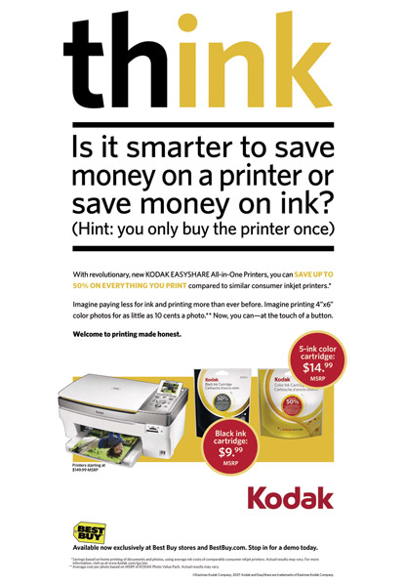
Pricing Strategies
Topic Outline
New-Product Pricing Strategies
Product Mix Pricing Strategies
Price Adjustment Strategies
Price Changes
Public Policy and Marketing
Copyright ©2014 by Pearson Education, Inc. All rights reserved
Notes:
Price is an important marketing mix tool for both creating and capturing customer value. You explored the three main pricing strategies—customer value-based, cost-based, and competition-based pricing—and the many internal and external factors that affect a firm’s pricing decisions. In this chapter, we’ll look at some additional pricing considerations: new-product pricing, product mix pricing, price adjustments, and initiating and reacting to prices changes. We close the chapter with a discussion of public policy and pricing.

Slide 3
New-Product Pricing Strategies
Market-skimming pricing is a strategy with high initial prices to “skim” revenue layers from the market
Product quality and image must support the price
Buyers must want the product at the price
Costs of producing the product in small volume should not cancel the advantage of higher prices
Competitors should not be able to enter the market easily
Copyright ©2014 by Pearson Education, Inc. All rights reserved
Notes:
Pricing strategies usually change as the product passes through its life cycle. The introductory stage is especially challenging. Companies bringing out a new product face the challenge of setting prices for the first time. They can choose between two broad strategies: market-skimming pricing and market-penetration pricing.
Market-Skimming Pricing
Many companies that invent new products set high initial prices to skim revenues layer by layer from the market. Apple frequently uses this strategy, called market-skimming pricing (or price skimming). When Apple first introduced the iPhone, its initial price was as much as $599 per phone. The phones were purchased only by customers who really wanted the sleek new gadget and could afford to pay a high price for it. Six months later, Apple dropped the price to $399 for an 8GB model and $499 for the 16GB model to attract new buyers. Within a year, it dropped prices again to $199 and $299, respectively, and you can now buy a basic 8GB model for $49. In this way, Apple has skimmed the maximum amount of revenue from the various segments of the market.
Market skimming makes sense only under certain conditions. First, the product’s quality and image must support its higher price, and enough buyers must want the product at that price. Second, the costs of producing a smaller volume cannot be so high that they cancel the advantage of charging more. Finally, competitors should not be able to enter the market easily and undercut the high price.

Slide 4
New-Product Pricing Strategies
Market-penetration pricing sets a low initial price in order to penetrate the market quickly and deeply to attract a large number of buyers quickly to gain market share
Price sensitive market
Inverse relationship of production and distribution cost to sales growth
Low prices must keep competition out of the market
Copyright ©2014 by Pearson Education, Inc. All rights reserved
Notes:
Market-Penetration Pricing
Rather than setting a high initial price to skim off small but profitable market segments, some companies use market-penetration pricing. Companies set a low initial price to penetrate the market quickly and deeply—to attract a large number of buyers quickly and win a large market share. The high sales volume results in falling costs, allowing companies to cut their prices even further.
Example of IKEA in China:
When IKEA first opened stores in China in 2002, people crowded to take advantage of the freebies—air conditioning, clean toilets, and even decorating ideas.
Chinese consumers are famously frugal. When it came time to actually buy, they shopped instead at local stores just down the street that offered knockoffs of IKEA’s designs at a fraction of the price.
So IKEA slashed its prices in China to the lowest in the world.
The penetration pricing strategy worked. IKEA now captures a 43 percent market share of China’s fast-growing home wares market.
Several conditions must be met for this low-price strategy to work. First, the market must be highly price sensitive so that a low price produces more market growth. Second, production and distribution costs must decrease as sales volume increases. Finally, the low price must help keep out the competition, and the penetration pricer must maintain its low-price position. Otherwise, the price advantage may be only temporary.

Slide 5
Product Mix Pricing Strategies
Product line pricing
Optional- product pricing
Captive- product pricing
By-product pricing
Product bundle pricing
Copyright ©2014 by Pearson Education, Inc. All rights reserved
Notes:
The strategy for setting a product’s price often has to be changed when the product is part of a product mix. In this case, the firm looks for a set of prices that maximizes its profits on the total product mix. Pricing is difficult because the various products have related demand and costs and face different degrees of competition. We now take a closer look at the five product mix pricing situations summarized in Table 11.1: product line pricing, optional product pricing, captive product pricing, by-product pricing, and product bundle pricing.

Slide 6
Product Mix Pricing Strategies
Product line pricing takes into account the cost differences between products in the line, customer evaluation of their features, and competitors’ prices
Optional-product pricing takes into account optional or accessory products along with the main product
Copyright ©2014 by Pearson Education, Inc. All rights reserved
Notes:
Product Line Pricing
Companies usually develop product lines rather than single products. For example, Rossignol offers seven different collections of alpine skis of all designs and sizes, at prices that range from $150 for its junior skis, such as Fun Girl, to more than $1,100 for a pair from its Radical racing collection. It also offers lines of Nordic and backcountry skis, snowboards, and ski-related apparel. In product line pricing, management must determine the price steps to set between the various products in a line.
The price steps should take into account cost differences between products in the line. More importantly, they should account for differences in customer perceptions of the value of different features.
Optional Product Pricing
Many companies use optional product pricing—offering to sell optional or accessory products along with the main product. For example, a car buyer may choose to order a navigation system and premium entertainment system. Refrigerators come with optional ice makers. And when you order a new computer, you can select from a bewildering array of processors, hard drives, docking systems, software options, and service plans. Pricing these options is a sticky problem. Companies must decide which items to include in the base price and which to offer as options.

Slide 7
Product Mix Pricing Strategies
Captive-product pricing involves products that must be used along with the main product
By-product pricing refers to products with little or no value produced as a result of the main product. Producers will seek little or no profit other than the cost to cover storage and delivery.
Copyright ©2014 by Pearson Education, Inc. All rights reserved
Notes:
Note to Instructor
Captive Product Pricing
Discussion Question: Students will quickly realize this is what their cell phone bill might be. Ask them how they feel about this pricing.
Companies that make products that must be used along with a main product are using captive product pricing. Examples of captive products are razor blade cartridges, videogames, printer cartridges, and e-books. Producers of the main products (razors, videogame consoles, printers, and tablet computers) often price them low and set high markups on the supplies. For example, Amazon introduced its Kindle Fire tablet for as low as $199, a loss of an estimated $10 per machine. It hoped to more than make up for the loss through sales of digital books, music, and movies to be viewed on the devices.
However, companies that use captive product pricing must be careful. Finding the right balance between the main product and captive product prices can be tricky. Even more, consumers trapped into buying expensive captive products may come to resent the brand that ensnared them. Just ask about any customer how he feels after buying a Gillette Fusion ProGlide razor at a giveaway price only to learn later how expensive the replacements cartridge are. The cartridges are so pricy that they’ve become a high-value target for professional thieves for black-market resale. Moreover, Gillette’s captive pricing strategy has invited direct price challenges from competitors such as Schick and the Dollar Shave Club. Recent Schick ads proclaimed that the Schick Hydro 5 is “Preferred over Fusion ProGlide at a better price.” And the direct-response Dollar Shave Club asks, “Do you like spending $20 a month on brand-name razors?” As an alternative, it offers twin-blade razors for $1a month ($3, including shipping and handling), and four- and six-blade models for $6 to $9, shipping and handling included.
In the case of services, captive product pricing is called two-part pricing. The price of the service is broken into a fixed fee plus a variable usage rate. Thus, at Six Flags and other amusement parks, you pay a daily ticket or season pass charge plus additional fees for food and other in-park features.
By-Product Pricing
Producing products and services often generates by-products. If the by-products have no value and if getting rid of them is costly, this will affect pricing of the main product. Using by-product pricing, the company seeks a market for these by-products to help offset the costs of disposing of them and help make the price of the main product more competitive.
The by-products themselves can even turn out to be profitable—turning trash into cash.

Slide 8
Price Mix Pricing Strategies
Product bundle pricing combines several products at a reduced price
Copyright ©2014 by Pearson Education, Inc. All rights reserved
Notes:
Product Bundle Pricing
Using product bundle pricing, sellers often combine several products and offer the bundle at a reduced price. For example, fast-food restaurants bundle a burger, fries, and a soft drink at a “combo” price. Bath & Body Works offers “three-fer” deals on its soaps and lotions (such as three antibacterial soaps for $10). And Comcast, Time Warner, Verizon, and other telecommunications companies bundle TV service, phone service, and high-speed Internet connections at a low combined price. Price bundling can promote the sales of products consumers might not otherwise buy, but the combined price must be low enough to get them to buy the bundle.

Slide 9
Price-Adjustment Strategies
Discount and allowance pricing
Segmented pricing
Psychological pricing
Promotional pricing
Geographic pricing
Dynamic pricing
International pricing
Copyright ©2014 by Pearson Education, Inc. All rights reserved
Notes:
Price Adjustment Strategies
Companies usually adjust their basic prices to account for various customer differences and changing situations. Here we examine the seven price adjustment strategies summarized in Table 11.2: discount and allowance pricing, segmented pricing, psychological pricing, promotional pricing, geographical pricing, dynamic pricing, and international pricing.

Slide 10
Price-Adjustment Strategies
Discount and allowance pricing reduces prices to reward customer responses such as paying early or promoting the product
Discounts—cash, quantity, trade, seasonal
Allowances—trade-in, promotional
Copyright ©2014 by Pearson Education, Inc. All rights reserved
Notes:
Note to Instructor
Discounts are either cash discount for paying promptly, quantity discount for buying in large volume, or functional (trade) discount for selling, storing, distribution, and record keeping.
Allowances include trade-in allowance for turning in an old item when buying a new one and promotional allowance to reward dealers for participating in advertising or sales support programs.
One form of discount is a cash discount, a price reduction to buyers who pay their bills promptly. A typical example is “2/10, net 30,” which means that although payment is due within 30 days, the buyer can deduct 2 percent if the bill is paid within 10 days. A quantity discount is a price reduction to buyers who buy large volumes. A seller offers a functional discount (also called a trade discount) to trade-channel members who perform certain functions, such as selling, storing, and record keeping. A seasonal discount is a price reduction to buyers who buy merchandise or services out of season.
Allowances are another type of reduction from the list price. For example, trade-in allowances are price reductions given for turning in an old item when buying a new one. Trade-in allowances are most common in the automobile industry but are also given for other durable goods. Promotional allowances are payments or price reductions that reward dealers for participating in advertising and sales support programs.

Slide 11
Price-Adjustment Strategies
Segmented pricing is used when a company sells a product at two or more prices even though the difference is not based on cost
Copyright ©2014 by Pearson Education, Inc. All rights reserved
Notes:
Segmented Pricing
Companies will often adjust their basic prices to allow for differences in customers, products, and locations. In segmented pricing, the company sells a product or service at two or more prices, even though the difference in prices is not based on differences in costs.

Slide 12
Price-Adjustment Strategies
Segmented Pricing
Customer-segment pricing
Product-form pricing
Location-based pricing
Time-based pricing
Copyright ©2014 by Pearson Education, Inc. All rights reserved
Notes:
Segmented pricing takes several forms. Under customer-segment pricing, different customers pay different prices for the same product or service. Museums and movie theaters, for example, may charge a lower admission for students and senior citizens. Under product-form pricing, different versions of the product are priced differently but not according to differences in their costs. For instance, a round trip economy seat on a flight from New York to London might cost $1,000, whereas a business class seat on the same flight might cost $4,500 or more. Although business class customers receive roomier, more comfortable seats and higher quality food and service, the differences in costs to the airlines are much less than the additional prices to passengers. However, to passengers who can afford it, the additional comfort and services are worth the extra charge.
Using location-based pricing, a company charges different prices for different locations, even though the cost of offering each location is the same. For instance, state universities charge higher tuition for out-of-state students, and theaters vary their seat prices because of audience preferences for certain locations. Finally, using time-based pricing, a firm varies its price by the season, the month, the day, and even the hour. For example, movie theaters charge matinee pricing during the daytime, and resorts give weekend and seasonal discounts.

Slide 13
Price-Adjustment Strategies
Segmented Pricing
To be effective:
Market must be segmentable
Segments must show different degrees of demand
Costs of segmenting and reaching the market cannot exceed the extra revenue obtained from the price difference
Must be legal
Copyright ©2014 by Pearson Education, Inc. All rights reserved
Notes:
Note to Instructor
Discussion Question
How have you benefited from price segmentation?
Most likely they have had student discounts. Ask them why that is effective given the criteria above.
For segmented pricing to be an effective strategy, certain conditions must exist. The market must be segmentable, and segments must show different degrees of demand. The costs of segmenting and reaching the market cannot exceed the extra revenue obtained from the price difference. Of course, the segmented pricing must also be legal.
Most importantly, segmented prices should reflect real differences in customers’ perceived value. Consumers in higher price tiers must feel that they’re getting their extra money’s worth for the higher prices paid. By the same token, companies must be careful not to treat customers in lower price tiers as second-class citizens. Otherwise, in the long run, the practice will lead to customer resentment and ill will. For example, in recent years, the airlines have incurred the wrath of frustrated customers at both ends of the airplane. Passengers paying full fare for business or first class seats often feel that they are being gouged. At the same time, passengers in lower-priced coach seats feel that they’re being ignored or treated poorly.

Slide 14
Price-Adjustment Strategies
Psychological pricing occurs when sellers consider the psychology of prices and not simply the economics
Reference prices are prices that buyers carry in their minds and refer to when looking at a given product
Noting current prices
Remembering past prices
Assessing the buying situations
Copyright ©2014 by Pearson Education, Inc. All rights reserved
Notes:
Note to Instructor
Discussion Question
How well do you carry prices of coffee, pizza, and milk in your head?
It might be interesting to collect the prices of items sold near or on campus including coffee, pizza, and sandwiches. Ask them how well they know these prices, have them write down the price of these items and then check themselves. You will often find that people do NOT know prices as well as they think they do.
Psychological Pricing
Price says something about the product. For example, many consumers use price to judge quality. A $100 bottle of perfume may contain only $3 worth of scent, but some people are willing to pay the $100 because this price indicates something special.
In using psychological pricing, sellers consider the psychology of prices, not simply the economics. For example, consumers usually perceive higher-priced products as having higher quality. When they can judge the quality of a product by examining it or by calling on past experience with it, they use price less to judge quality. But when they cannot judge quality because they lack the information or skill, price becomes an important quality signal. For instance, who’s the better lawyer, one who charges $50 per hour or one who charges $500 per hour? You’d have to do a lot of digging into the respective lawyers’ credentials to answer this question objectively; even then, you might not be able to judge accurately. Most of us would simply assume that the higher-priced lawyer is better.
Another aspect of psychological pricing is reference prices—prices that buyers carry in their minds and refer to when looking at a given product. The reference price might be formed by noting current prices, remembering past prices, or assessing the buying situation. Sellers can influence or use these consumers’ reference prices when setting price. For example, a grocery retailer might place its store brand of bran flakes and raisins cereal priced at $1.89 next to Kellogg’s Raisin Bran priced at $3.20. Or a company might offer more expensive models that don’t sell very well to make their less expensive but still-high-priced models look more affordable by comparison. For example, Williams-Sonoma once offered a fancy bread maker at the steep price of $279. However, it then added a $429 model. The expensive model flopped but sales of the cheaper model doubled.
For most purchases, consumers don’t have all the skill or information they need to figure out whether they are paying a good price. They don’t have the time, ability, or inclination to research different brands or stores, compare prices, and get the best deals. Instead, they may rely on certain cues that signal whether a price is high or low. Interestingly, such pricing cues are often provided by sellers, in the form of sales signs, price-matching guarantees, loss-leader pricing, and other helpful hints. Even small differences in price can signal product differences. For example, in one study, people were asked how likely they were to choose among LASIK eye surgery providers based only on the prices they charged: $299 or $300. The actual price difference was only $1, but the study found that the psychological difference was much greater. Preference ratings for the providers charging $300 were much higher. Subjects perceived the $299 price as significantly less, but the lower price also raised stronger concerns about quality and risk. Some psychologists even argue that each digit has symbolic and visual qualities that should be considered in pricing. Thus, eight (8) is round and even and creates a soothing effect, whereas seven (7) is angular and creates a jarring effect.

Slide 15
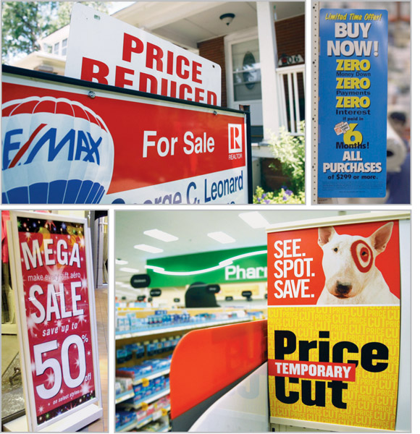
Price-Adjustment Strategies
Promotional pricing is when prices are temporarily priced below list price or cost to increase demand
Loss leaders
Special event pricing
Cash rebates
Low-interest financing
Longer warranties
Free maintenance
Copyright ©2014 by Pearson Education, Inc. All rights reserved
Notes:
Promotional Pricing
With promotional pricing, companies will temporarily price their products below list price—and sometimes even below cost—to create buying excitement and urgency. Promotional pricing takes several forms. A seller may simply offer discounts from normal prices to increase sales and reduce inventories. Sellers also use special-event pricing in certain seasons to draw more customers. Thus, TVs and other consumer electronics are promotionally priced in November and December to attract holiday shoppers into the stores. Limited-time offers, such as online flash sales, can create buying urgency and make buyers feel lucky to have gotten in on the deal.
<ex11.07>
Manufacturers sometimes offer cash rebates to consumers who buy the product from dealers within a specified time; the manufacturer sends the rebate directly to the customer. Rebates have been popular with automakers and producers of mobile phones and small appliances, but they are also used with consumer packaged goods. Some manufacturers offer low-interest financing, longer warranties, or free maintenance to reduce the consumer’s “price.” This practice has become another favorite of the auto industry.

Slide 16
Price-Adjustment Strategies
Risks of promotional pricing
Used too frequently, and copied by competitors, can create “deal-prone” customers who will wait for promotions and avoid buying at regular price
Can erode brand value in eyes of customers
Creates price wars
Copyright ©2014 by Pearson Education, Inc. All rights reserved
Notes:
Promotional pricing, however, can have adverse effects. During most holiday seasons, for example, it’s an all-out bargain war. Marketers carpet-bomb consumers with deals, causing buyer wear-out and pricing confusion. Used too frequently, price promotions can create “deal-prone” customers who wait until brands go on sale before buying them. In addition, constantly reduced prices can erode a brand’s value in the eyes of customers.
Marketers sometimes become addicted to promotional pricing, especially in difficult economic times. They use price promotions as a quick fix instead of sweating through the difficult process of developing effective longer-term strategies for building their brands. For example, as we learned in JC Penney story at the beginning of Chapter 10, before announcing its turnaround pricing strategy, Penney’s developed an unhealthy reliance on coupons, markdowns, and nonstop sales, which accounted for the vast majority of its revenues. But companies must be careful to balance short-term sales incentives against long-term brand building. Some promotional pricing can be an effective means of generating sales in certain circumstances. But as JC Penney learned, a steady diet of promotional pricing can be destructive to a brand’s image and profitability.

Slide 17
Price-Adjustment Strategies
Geographical pricing is used for customers in different parts of the country or the world
FOB-origin pricing
Uniform-delivered pricing
Zone pricing
Basing-point pricing
Freight-absorption pricing
Copyright ©2014 by Pearson Education, Inc. All rights reserved
Notes:
Geographical Pricing
A company also must decide how to price its products for customers located in different parts of the United States or the world. Should the company risk losing the business of more-distant customers by charging them higher prices to cover the higher shipping costs? Or should the company charge all customers the same prices regardless of location? There are five geographical pricing strategies.

Slide 18
Price-Adjustment Strategies
FOB-origin (free on board) pricing means that the goods are delivered to the carrier and the title and responsibility passes to the customer
Uniform-delivered pricing means the company charges the same price plus freight to all customers, regardless of location
Copyright ©2014 by Pearson Education, Inc. All rights reserved
Notes:
FOB-origin pricing, this practice means that the goods are placed free on board (hence, FOB) a carrier. At that point the title and responsibility pass to the customer, who pays the freight from the factory to the destination. Because each customer picks up its own cost, supporters of FOB pricing feel that this is the fairest way to assess freight charges. The disadvantage, however, is that Peerless will be a high-cost firm to distant customers.
Uniform-delivered pricing is the opposite of FOB pricing. Here, the company charges the same price plus freight to all customers, regardless of their location. The freight charge is set at the average freight cost.

Slide 19
Price-Adjustment Strategies
Zone pricing means that the company sets up two or more zones where customers within a given zone pay a single total price
Basing-point pricing means that a seller selects a given city as a “basing point” and charges all customers the freight cost associated from that city to the customer location, regardless of the city from which the goods are actually shipped
Copyright ©2014 by Pearson Education, Inc. All rights reserved
Notes:
Zone pricing falls between FOB-origin pricing and uniform-delivered pricing. The company sets up two or more zones. All customers within a given zone pay a single total price; the more distant the zone, the higher the price. For example, Peerless might set up an East Zone and charge $100 freight to all customers in this zone, a Midwest Zone in which it charges $150, and a West Zone in which it charges $250. In this way, the customers within a given price zone receive no price advantage from the company. The customers within a given price zone receive no price advantage from the company.
Using basing-point pricing, the seller selects a given city as a “basing point” and charges all customers the freight cost from that city to the customer location, regardless of the city from which the goods are actually shipped. If all sellers used the same basing-point city, delivered prices would be the same for all customers, and price competition would be eliminated.

Slide 20
Price-Adjustment Strategies
Freight-absorption pricing means the seller absorbs all or part of the actual freight charge as an incentive to attract business in competitive markets
Copyright ©2014 by Pearson Education, Inc. All rights reserved
Notes:
The seller who is anxious to do business with a certain customer or geographical area might use freight-absorption pricing. Using this strategy, the seller absorbs all or part of the actual freight charges to get the desired business. The seller might reason that if it can get more business, its average costs will decrease and more than compensate for its extra freight cost. Freight-absorption pricing is used for market penetration and to hold on to increasingly competitive markets.

Slide 21
Price-Adjustment Strategies Dynamic and Internet Pricing
Dynamic pricing is when prices are adjusted continually to meet the characteristics and needs of the individual customer and situations
Copyright ©2014 by Pearson Education, Inc. All rights reserved
Notes:
Dynamic and Internet Pricing
Throughout most of history, prices were set by negotiation between buyers and sellers. Fixed price policies—setting one price for all buyers—is a relatively modern idea that arose with the development of large-scale retailing at the end of the nineteenth century. Today, most prices are set this way. However, some companies are now reversing the fixed pricing trend. They are using dynamic pricing—adjusting prices continually to meet the characteristics and needs of individual customers and situations.
Dynamic pricing is especially prevalent online, where the Internet seems to be taking us back to a new age of fluid pricing. Such pricing offers many advantages for marketers. For example, Internet sellers such as L.L.Bean, Amazon.com, or Dell can mine their databases to gauge a specific shopper’s desires, measure his or her means, instantaneously tailor offers to fit that shopper’s behavior, and price products accordingly. Services ranging from airlines and hotels to sports teams change prices on the fly according to changes in demand or costs, adjusting what they charge for specific items on a day-by-day or even hour-by-hour basis. And many direct marketers monitor inventories, costs, and demand at any given moment and adjust prices instantly.
In the extreme, some companies customize their offers and prices based on the specific characteristics and behaviors of individual customers, mined from online browsing and purchasing histories. These days, online offers and prices might well be based on what specific customers search for and buy, how much they pay for other purchases, and whether they might be willing and able to spend more. Consider this example:
Gazing online at that BMW might end up costing you. If, for example, you’ve recently completed online customization of a new BMW, searched for and purchased first class airfare to Paris, surfed for a new Bose Wave Radio, or visited Tiffany & Co.’s website, you could later get a somewhat pricier quote for a new sofa. By comparison, your cousin Ralph, who doesn’t have a similar upscale online search and purchase history, might get a fire-sale quote when he goes after the same sofa. Or if he considers splurging on that Bose radio, the audio giant might induce him with an offer of five percent off and free shipping.
Although such dynamic pricing practices seem legally questionable, they’re not. Dynamic pricing is legal as long as companies do not discriminate based on age, sex, location, or other similar characteristics. Dynamic pricing makes sense in many contexts—it adjusts prices according to market forces and consumer preferences. But marketers need to be careful not to use dynamic pricing to take advantage of certain customer groups, thereby damaging important customer relationships.
The practice of online pricing, however, goes both ways, and consumers often benefit from the online and dynamic pricing. Thanks to the Internet, the centuries-old art of haggling is suddenly back in vogue. For example, consumers can negotiate prices at online auction sites and exchanges. Want to sell that antique pickle jar that’s been collecting dust for generations? Post it on eBay or Craigslist. Want to name your own price for a hotel room or rental car? Visit Priceline.com or another reverse auction site. Want to bid on a ticket to a Katy Perry concert? Check out Ticketmaster.com, which offers an online auction service for concert tickets.
Also thanks to the Internet, consumers can get instant product and price comparisons from thousands of vendors at price comparison sites such as Yahoo! Shopping, Epinions.com, PriceGrabber.com, and PriceScan.com, or using mobile apps such as TheFind, eBay’s RedLaser, Google’s Barcode Scanner, or Amazon.com’s PriceCheck. For example, the RedLaser mobile app lets customers scan barcodes or QR codes (or search by voice or image) while shopping in stores. It then searches online and at nearby stores to provide thousands of reviews and comparison prices, and even offers buying links for immediate online purchasing. Armed with this information, consumers can often negotiate better in-store prices.
In fact, many retailers are finding that ready online access to comparison prices is giving consumers too much of an edge. Store retailers ranging from Target and Best Buy to Brookstone and GNC are now devising strategies to combat the consumer practice of showrooming. Increasing, consumers armed with smartphones come to stores to see an item, compare prices online while in the store, and then buy the item online at a lower price. Such behavior is called showrooming because consumers use store retailers as de facto “showrooms” for online resellers such as Amazon.com. In fact, Amazon.com encourages showrooming: It recently ran a promotion on its PriceCheck shopping app that gave customers discounts on qualifying items if they checked the prices for those items at Amazon.com while browsing at a physical store. To counter showrooming, store retailers must either match online prices or work with manufacturers to develop exclusive or store-branded merchandise on which price comparisons cannot be made.

Slide 22
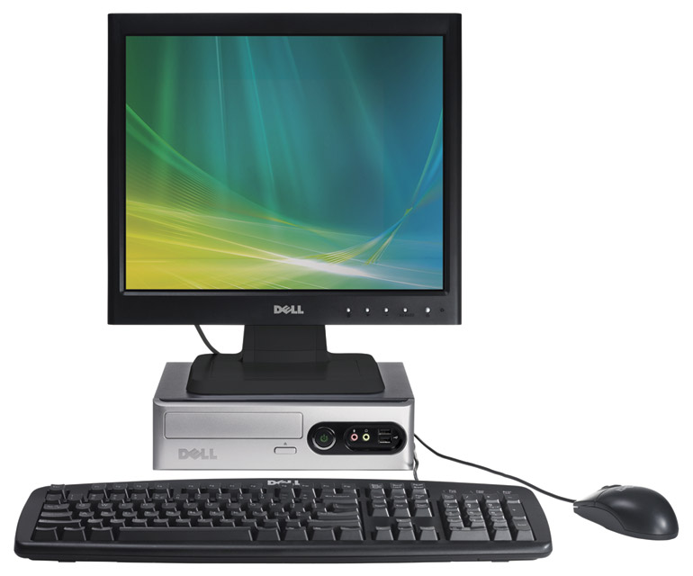
Price-Adjustment Strategies
International pricing is when prices are set in a specific country based on country-specific factors
Economic conditions
Competitive conditions
Laws and regulations
Infrastructure
Company marketing
objective
Copyright ©2014 by Pearson Education, Inc. All rights reserved
Notes:
International Pricing
Companies that market their products internationally must decide what prices to charge in different countries. In some cases, a company can set a uniform worldwide price. For example, Boeing sells its jetliners at about the same price everywhere, whether the buyer is in the United States, Europe, or a third-world country. However, most companies adjust their prices to reflect local market conditions and cost considerations.
The price that a company should charge in a specific country depends on many factors, including economic conditions, competitive situations, laws and regulations, and the nature of the wholesaling and retailing system. Consumer perceptions and preferences also may vary from country to country, calling for different prices. Or the company may have different marketing objectives in various world markets, which require changes in pricing strategy. For example, Nokia might introduce sophisticated, feature-rich mobile phones into carefully segmented mature markets in highly developed countries—this would call for a market-skimming pricing strategy. By contrast, it might enter sizable but less affluent markets in developing countries with more basic phones, supported by a penetration-pricing strategy.
Costs play an important role in setting international prices. Travelers abroad are often surprised to find that goods that are relatively inexpensive at home may carry outrageously higher price tags in other countries. A pair of Levi’s selling for $30 in the United States might go for $63 in Tokyo and $88 in Paris. A McDonald’s Big Mac selling for a modest $3.79 in the United States might cost $6.80 in Switzerland, and an Oral-B toothbrush selling for $2.49 at home may cost $10 in China. Conversely, a Gucci handbag going for only $140 in Milan, Italy, might fetch $240 in the United States. In some cases, such price escalation may result from differences in selling strategies or market conditions. In most instances, however, it is simply a result of the higher costs of selling in another country—the additional costs of operations, product modifications, shipping and insurance, import tariffs and taxes, exchange-rate fluctuations, and physical distribution.
Price has become a key element in the international marketing strategies of companies attempting to enter emerging markets. Typically, entering such markets has meant targeting the exploding middle classes in developing countries such as China, India, Russia, and Brazil, whose economies have been growing by double-digits annually. More recently, however, as the weakened global economy has slowed growth in both domestic and emerging markets, many companies are shifting their sights to include a new target—the so-called “bottom of the pyramid,” the vast untapped market consisting of the world’s poorest consumers. In this market, price is a major consideration. Consider Unilever’s pricing strategy for developing countries:
There used to be one way to sell a product in developing markets, if you bothered to sell there at all: Slap on a local label and market at premium prices to the elite. Unilever—the maker of such brands as Dove, Lipton, and Vaseline—changed that. Instead, it built a following among the world’s poorest consumers by shrinking packages to set a price that even consumers living on $2 a day could afford. The strategy was forged when Unilever’s Indian subsidiary found its products out of reach for millions of Indians. To lower the price while making a profit, Unilever developed single-use packages of its shampoo, laundry detergent, and other products and sold them for just pennies a pack. The small, affordable packages put the company’s premier brands within reach of the world’s poor. As a result, today, more than 50 percent of Unilever’s revenues come from emerging economies.
Although this strategy has been successful for Unilever, most companies are learning that selling profitably to the bottom of the pyramid requires more than just repackaging or stripping down existing products and selling them at low prices. Just like more well-to-do consumers, low-income consumers want products that are both functional and aspirational. Thus, companies today are innovating to create products that not only sell at very low prices but also give bottom-of-the-pyramid consumers more for their money, not less

Slide 23
Price Changes
Initiating Pricing Changes
Price cuts occur due to:
Excess capacity
Price increase from:
Cost inflation
Increased market share
Increased demand
Lack of supply
Copyright ©2014 by Pearson Education, Inc. All rights reserved
Notes:
Initiating Price Cuts
Several situations may lead a firm to consider cutting its price. One such circumstance is excess capacity. Another is falling demand in the face of strong price competition or a weakened economy. In such cases, the firm may aggressively cut prices to boost sales and market share. But as the airline, fast-food, automobile, and other industries have learned in recent years, cutting prices in an industry loaded with excess capacity may lead to price wars as competitors try to hold onto market share.
A company may also cut prices in a drive to dominate the market through lower costs. Either the company starts with lower costs than its competitors, or it cuts prices in the hope of gaining market share that will further cut costs through larger volume. For example, Lenovo uses an aggressive low-cost, low-price strategy to increase its share of the PC market in developing countries.
Initiating Price Increases
A successful price increase can greatly improve profits. For example, if the company’s profit margin is 3 percent of sales, a 1 percent price increase will boost profits by 33 percent if sales volume is unaffected. A major factor in price increases is cost inflation. Rising costs squeeze profit margins and lead companies to pass cost increases along to customers. Another factor leading to price increases is overdemand: When a company cannot supply all that its customers need, it may raise its prices, ration products to customers, or both. Consider today’s worldwide oil and gas industry.
When raising prices, the company must avoid being perceived as a price gouger. For example, when gasoline prices rise rapidly, angry customers often accuse the major oil companies of enriching themselves at the expense of consumers. Customers have long memories, and they will eventually turn away from companies or even whole industries that they perceive as charging excessive prices. In the extreme, claims of price gouging may even bring about increased government regulation.
There are some techniques for avoiding these problems. One is to maintain a sense of fairness surrounding any price increase. Price increases should be supported by company communications telling customers why prices are being raised.
Wherever possible, the company should consider ways to meet higher costs or demand without raising prices. For example, it might consider more cost-effective ways to produce or distribute its products. It can shrink the product or substitute less-expensive ingredients instead of raising the price, as ConAgra did in an effort to hold its Banquet frozen dinner prices at $1. Or it can “unbundle” its market offering, removing features, packaging, or services and separately pricing elements that were formerly part of the offer.

Slide 24
Price Changes
Buyer Reactions to Pricing Changes
Price increases
Product is “hot”
Company greed
Price cuts
New models will be available
Models are not selling well
Quality issues
Copyright ©2014 by Pearson Education, Inc. All rights reserved
Notes:
Buyer Reactions to Price Changes
Customers do not always interpret price changes in a straightforward way. A price increase, which would normally lower sales, may have some positive meanings for buyers. For example, what would you think if Rolex raised the price of its latest watch model? On the one hand, you might think that the watch is even more exclusive or better made. On the other hand, you might think that Rolex is simply being greedy by charging what the traffic will bear.
Similarly, consumers may view a price cut in several ways. For example, what would you think if Rolex were to suddenly cut its prices? You might think that you are getting a better deal on an exclusive product. More likely, however, you’d think that quality had been reduced, and the brand’s luxury image might be tarnished. A brand’s price and image are often closely linked. A price change, especially a drop in price, can adversely affect how consumers view the brand.

Slide 25
Price Changes
Responding to Price Changes
Questions
Why did the competitor change the price?
Is the price cut permanent or temporary?
What is the effect on market share and profits?
Will competitors respond?
Copyright ©2014 by Pearson Education, Inc. All rights reserved
Notes:
Responding to Price Changes
Here we reverse the question and ask how a firm should respond to a price change by a competitor. The firm needs to consider several issues: Why did the competitor change the price? Is the price change temporary or permanent? What will happen to the company’s market share and profits if it does not respond? Are other competitors going to respond? Besides these issues, the company must also consider its own situation and strategy and possible customer reactions to price changes.
Figure 11.1 shows the ways a company might assess and respond to a competitor’s price cut. Suppose the company learns that a competitor has cut its price and decides that this price cut is likely to harm its sales and profits. It might simply decide to hold its current price and profit margin. The company might believe that it will not lose too much market share, or that it would lose too much profit if it reduced its own price. Or it might decide that it should wait and respond when it has more information on the effects of the competitor’s price change. However, waiting too long to act might let the competitor get stronger and more confident as its sales increase.

Slide 26
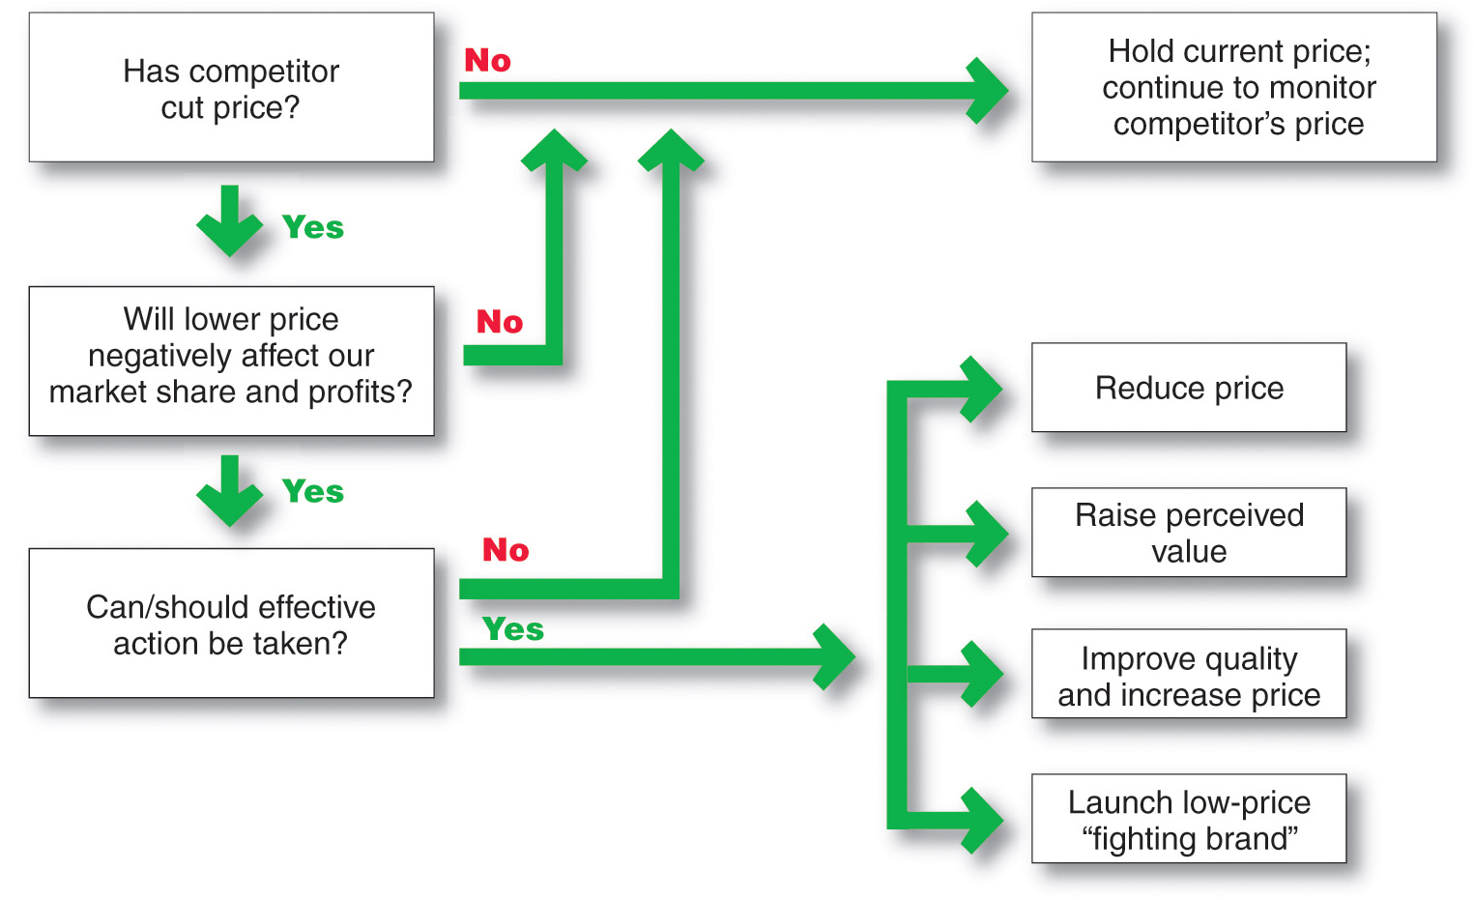
Price Changes
Responding to Price Changes
Copyright ©2014 by Pearson Education, Inc. All rights reserved
Notes:
Figure 11.1 shows the ways a company might assess and respond to a competitor’s price cut. Suppose the company learns that a competitors has cut its price and decides that this price cut is likely to harm its sales and profits. It might simply decide to hold its current price and profit margin. The company might believe that it will not lose too much market share, or that it would lose too much profit if it reduced its own price. Or it might decide that it should wait and respond when it has more information on the effects of the competitor’s price change. However, waiting too long to act might let the competitor get stronger and more confident as its sales increase.
If the company decides that effective action can and should be taken, it might make any of the four responses: reduce price, raise perceived value, improve quality and increase price, launch low-price “fighting brand.”

Slide 27
Price Changes
Responding to Price Changes
Solutions
Reduce price to match competition
Maintain price but raise the perceived value through communications
Improve quality and increase price
Launch a lower-price “fighting” brand
Copyright ©2014 by Pearson Education, Inc. All rights reserved
Notes:
If the company decides that effective action can and should be taken, it might make any of four responses. First, it could reduce its price to match the competitor’s price. It may decide that the market is price sensitive and that it would lose too much market share to the lower-priced competitor. However, cutting the price will reduce the company’s profits in the short run. Some companies might also reduce their product quality, services, and marketing communications to retain profit margins, but this will ultimately hurt long-run market share. The company should try to maintain its quality as it cuts prices.
Alternatively, the company might maintain its price but raise the perceived value of its offer. It could improve its communications, stressing the relative value of its product over that of the lower-price competitor. The firm may find it cheaper to maintain price and spend money to improve its perceived value than to cut price and operate at a lower margin. Or, the company might improve quality and increase price, moving its brand into a higher price-value position. The higher quality creates greater customer value, which justifies the higher price. In turn, the higher price preserves the company’s higher margins.
Finally, the company might launch a low-price “fighter brand”—adding a lower-price item to the line or creating a separate lower-price brand. This is necessary if the particular market segment being lost is price sensitive and will not respond to arguments of higher quality.

Slide 28
Public Policy and Pricing
Pricing Within Channel Levels
Price fixing: Sellers must set prices without talking to competitors
Predatory pricing: Selling below cost with the intention of punishing a competitor or gaining higher long-term profits by putting competitors out of business
Copyright ©2014 by Pearson Education, Inc. All rights reserved
Copyright ©2014 by Pearson Education, Inc. All rights reserved
Notes:
Price competition is a core element of our free-market economy. In setting prices, companies usually are not free to charge whatever prices they wish. Many federal, state, and even local laws govern the rules of fair play in pricing. In addition, companies must consider broader societal pricing concerns. In setting their prices, for example, pharmaceutical firms must balance their development costs and profit objectives against the sometimes life-and-death needs of drug consumers.
The most important pieces of legislation affecting pricing are the Sherman Act, the Clayton Act, and the Robinson-Patman Act, initially adopted to curb the formation of monopolies and regulate business practices that might unfairly restrain trade. Because these federal statutes can be applied only to interstate commerce, some states have adopted similar provisions for companies that operate locally.
Figure 11.2 shows the major public policy issues in pricing. These include potentially damaging pricing practices within a given level of the channel (price-fixing and predatory pricing) and across levels of the channel (retail price maintenance, discriminatory pricing, and deceptive pricing).
Pricing within Channel Levels
Federal legislation on price-fixing states that sellers must set prices without talking to competitors. Otherwise, price collusion is suspected. Price-fixing is illegal per se—that is, the government does not accept any excuses for price-fixing. As such, companies found guilty of these practices can receive heavy fines. Recently, governments at the state and national levels have been aggressively enforcing price-fixing regulations in industries ranging from gasoline, insurance, and concrete to credit cards, CDs, and computer chips. Price-fixing is also prohibited in many international markets.
Federal legislation on price-fixing states that sellers must set prices without talking to competitors. Otherwise, price collusion is suspected. Price-fixing is illegal per se—that is, the government does not accept any excuses for price-fixing. As such, companies found guilty of these practices can receive heavy fines. Recently, governments at the state and national levels have been aggressively enforcing price-fixing regulations in industries ranging from gasoline, insurance, and concrete to credit cards, CDs, and computer chips. Price-fixing is also prohibited in many international markets. For example, European Union regulators recently fined consumer products giants Unilever and P&G a combined $456 million for fixing laundry detergent prices in eight EU countries. France also fined the two consumer products giants, along with competitors Colgate and Henkel. It claimed that officials from the four companies met regularly at hotels and restaurants in Paris to agree to limits on the size of discounts and on prices differences between their laundry detergent brands.
Sellers are also prohibited from using predatory pricing—selling below cost with the intention of punishing a competitor or gaining higher long-run profits by putting competitors out of business. This protects small sellers from larger ones who might sell items below cost temporarily or in a specific locale to drive them out of business. The biggest problem is determining just what constitutes predatory pricing behavior. Selling below cost to unload excess inventory is not considered predatory; selling below cost to drive out competitors is. Thus, a given action may or may not be predatory depending on intent, and intent can be very difficult to determine or prove.
In recent years, several large and powerful companies have been accused of predatory pricing. However, turning an accusation into a lawsuit can be difficult. For example, many publishers and booksellers have expressed concerns about Amazon.com’s predatory practices, especially book pricing.

Slide 29
Public Policy and Pricing
Pricing Across Channel Levels
Robinson-Patman Act prevents unfair price discrimination by ensuring that the seller offer the same price terms to customers at a given level of trade
Price discrimination is allowed:
If the seller can prove that costs differ when selling to different retailers
If the seller manufactures different qualities of the same product for different retailers
Copyright ©2014 by Pearson Education, Inc. All rights reserved
Notes:
Pricing across Channel Levels
The Robinson-Patman Act seeks to prevent unfair price discrimination by ensuring that sellers offer the same price terms to customers at a given level of trade. For example, every retailer is entitled to the same price terms from a given manufacturer, whether the retailer is REI or your local bicycle shop. However, price discrimination is allowed if the seller can prove that its costs are different when selling to different retailers—for example, that it costs less per unit to sell a large volume of bicycles to REI than to sell a few bicycles to the local dealer.
The seller can also discriminate in its pricing if the seller manufactures different qualities of the same product for different retailers. The seller has to prove that these differences are proportional. Price differentials may also be used to “match competition” in “good faith,” provided the price discrimination is temporary, localized, and defensive rather than offensive

Slide 30
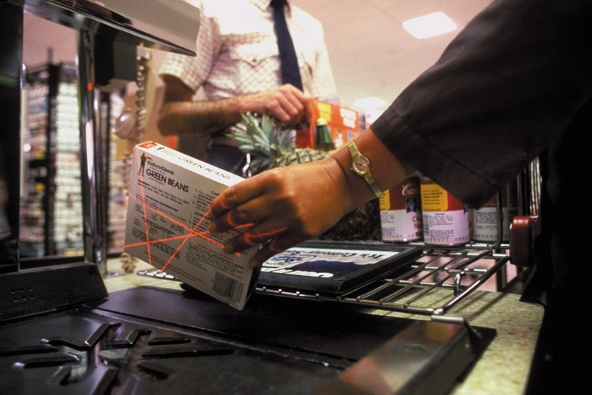
Public Policy and Pricing
Pricing Across Channel Levels
Retail (or resale) price maintenance is when a manufacturer requires a dealer to charge a specific retail price for its products. Laws prohibit this.
Copyright ©2014 by Pearson Education, Inc. All rights reserved
Notes:
Laws also prohibit retail (or resale) price maintenance—a manufacturer cannot require dealers to charge a specified retail price for its product. Although the seller can propose a manufacturer’s suggested retail price to dealers, it cannot refuse to sell to a dealer that takes independent pricing action nor can it punish the dealer by shipping late or denying advertising allowances. For example, the Florida attorney general’s office investigated Nike for allegedly fixing the retail price of its shoes and clothing. It was concerned that Nike might be withholding items from retailers who were not selling its most expensive shoes at prices the company considered suitable.

Slide 31
Public Policy and Pricing
Pricing Across Channel Levels
Deceptive pricing occurs when a seller states prices or price savings that mislead consumers or are not actually available to consumers
Scanner fraud failure of the seller to enter current or sale prices into the computer system
Price confusion results when firms employ pricing methods that make it difficult for consumers to understand what price they are really paying
Copyright ©2014 by Pearson Education, Inc. All rights reserved
Notes:
Deceptive pricing occurs when a seller states prices or price savings that mislead consumers or are not actually available to consumers. This might involve bogus reference or comparison prices, as when a retailer sets artificially high “regular” prices and then announces “sale” prices close to its previous everyday prices. For example, Overstock.com recently came under scrutiny for inaccurately listing manufacturer’s suggested retail prices, often quoting them higher than the actual price. Such comparison pricing is widespread.
Although comparison pricing claims are legal if they are truthful, the FTC’s Guides Against Deceptive Pricing warn sellers not to advertise (1) a price reduction unless it is a savings from the usual retail price, (2) “factory” or “wholesale” prices unless such prices are what they are claimed to be, and (3) comparable value prices on imperfect goods.
Other deceptive pricing issues include scanner fraud and price confusion. The widespread use of scanner-based computer checkouts has led to increasing complaints of retailers overcharging their customers. Most of these overcharges result from poor management, such as a failure to enter current or sale prices into the system. Other cases, however, involve intentional overcharges.
Many federal and state statutes regulate against deceptive pricing practices. For example, the Automobile Information Disclosure Act requires automakers to attach a statement on new vehicle windows stating the manufacturer’s suggested retail price, the prices of optional equipment, and the dealer’s transportation charges. However, reputable sellers go beyond what is required by law. Treating customers fairly and making certain that they fully understand prices and pricing terms is an important part of building strong and lasting customer relationships.
“FTC Guides Against Deceptive Pricing,” www.ftc.gov/bcp/guides/decptprc.htm, accessed June 2012.

