Slide 1
Chapter Thirteen
Retailing and Wholesaling
Copyright ©2014 by Pearson Education, Inc. All rights reserved

Slide 2
Retailing and Wholesaling
Topic Outline
Retailing
Retailer Marketing Decisions
Retailing Trends and Developments
Wholesaling
Copyright ©2014 by Pearson Education, Inc. All rights reserved

Slide 3
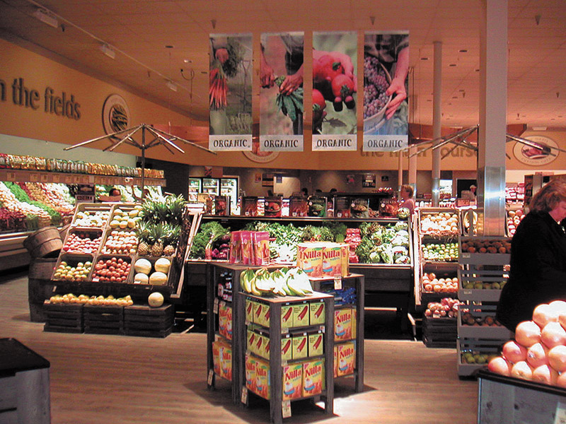
Retailing
Retailing includes all the activities in selling products or services directly to final consumers for their personal, non-business use
Retailers are businesses whose sales come primarily from retailing
Copyright ©2014 by Pearson Education, Inc. All rights reserved
Notes:
Retailing includes all the activities involved in selling products or services directly to final consumers for their personal, nonbusiness use. Many institutions—manufacturers, wholesalers, and retailers—do retailing. But most retailing is done by retailers, businesses whose sales come primarily from retailing.
Retailing plays a very important role in most marketing channels. Last year, retailers accounted for more than $4.6 trillion of sales to final consumers. They play an important role in connecting brands to consumers in what marketing agency OgilvyAction calls “the last mile”—the final stop in the consumer’s path to purchase. It’s the “distance a consumer travels between an attitude and an action,” explains OgilvyAction’s CEO. Some 40 percent of all consumer decisions are made in or near the store. Thus, retailers “reach consumers at key moments of truth, ultimately [influencing] their actions at the point of purchase.”
In fact, many marketers are now embracing the concept of shopper marketing, using point-of-purchase promotions and advertising to extend brand equity to “the last mile” and encourage favorable point-of-purchase decisions. Shopper marketing involves focusing the entire marketing process—from product and brand development to logistics, promotion, and merchandising—toward turning shoppers into buyers at the point of sale.
Of course, every well-designed marketing effort focuses on customer buying behavior. What differentiates the concept of shopper marketing is the suggestion that these efforts should be coordinated around the shopping process itself. For example, P&G follows a “store back” concept, in which all marketing ideas need to be effective at the store-shelf level and work back from there. The strategy builds around what P&G calls the “First Moment of Truth”—the critical 3 to 7 seconds that a shopper considers a product on a store shelf. “We are now brand-building from the eyes of the consumer toward us,” says a P&G executive.

Slide 4
Retailing
First Moment of Truth
No longer takes place only in stores
Growth of digital shopping
Combining in-store and digital shopping
Shopping mobile
Copyright ©2014 by Pearson Education, Inc. All rights reserved
Notes:
The dramatic growth of digital shopping, or combined digital and in-store shopping, has added a new dimension to shopper marketing. The “last mile” or “first moment of truth” no longer takes place only in stores. Most consumers now make at least some of their purchases online, without even setting foot into a retail store. Alternatively, they may research a purchase on the Internet before—or even during—a store visit. For example, it’s not uncommon to see a consumer looking at new TVs in a Best Buy while at the same time using a mobile app to check product reviews and prices at Amazon.com. Thus, shopper marketing isn’t just about in-store buying these days. Influencing consumers’ buying decisions as they shop involves efforts aimed at in-store, online, and mobile shopping .
Although most retailing is still done in retail stores, in recent years direct and online retailing have been growing much faster than store retailing.

Slide 5
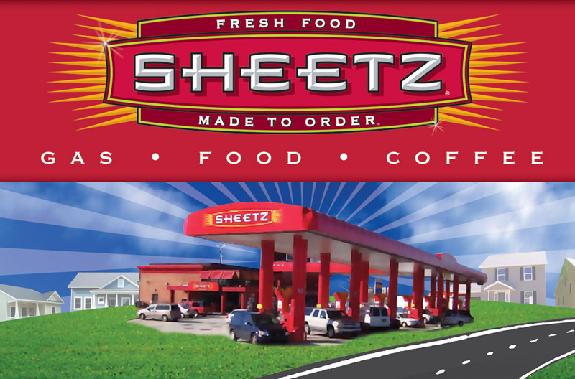
Retailing
Types of Retailers
Are classified by
Amount of service
Self-service
Limited service
Full service
Copyright ©2014 by Pearson Education, Inc. All rights reserved
Notes:
Retail stores come in all shapes and sizes—from your local hairstyling salon or family-owned restaurant to national specialty chain retailers such as REI or Williams-Sonoma to megadiscounters such as Costco or Walmart. The most important types of retail stores are described in Table 13.1 and discussed in the following sections. They can be classified in terms of several characteristics, including the amount of service they offer, the breadth and depth of their product lines, the relative prices they charge, and how they are organized.
Self-service retailers serve customers who are willing to perform their own locate-compare-select process to save money. They include: Wal-Mart and Supermarkets.
Limited service retailers provide more sales assistance because they carry more shopping goods about which customers need more information. Examples include Sears and JC Penney.
Full-service retailers assist customers in every phase of the shopping process, resulting in higher costs that are passed on to the customer as higher prices. Includes department stores and specialty stores

Slide 6
Retailing
Product Line
Specialty stores
Narrow product line with deep assortment
Department stores
Wide variety of product lines
Convenience stores
Limited line of high-turnover goods
Superstores
Food and non-food goods
Category killers
Deep in category with sales staff
Copyright ©2014 by Pearson Education, Inc. All rights reserved
Notes:
Discussion Question
What are examples of these types of stores?
It might be difficult, depending on their geographic region, to find examples of superstores. Ask them where they would rather shop for a computer, a department store like Wal-Mart or a category killer like Best Buy? Why?
Product Line
Retailers can also be classified by the length and breadth of their product assortments. Some retailers, such as specialty stores, carry narrow product lines with deep assortments within those lines. Today, specialty stores are flourishing. The increasing use of market segmentation, market targeting, and product specialization has resulted in a greater need for stores that focus on specific products and segments.
By contrast, department stores carry a wide variety of product lines. In recent years, department stores have been squeezed between more focused and flexible specialty stores on the one hand and more efficient, lower-priced discounters on the other. In response, many have added promotional pricing to meet the discount threat. Others have stepped up the use of store brands and single-brand designer shops to compete with specialty stores. Still others are trying catalog, telephone, and online selling. Service remains the key differentiating factor. Retailers such as Nordstrom, Saks, Neiman Marcus, and other high-end department stores are doing well by emphasizing exclusive merchandise and high-quality service.
Supermarkets are the most frequently visited type of retail store. Today, however, they are facing slow sales growth because of slower population growth and an increase in competition from discounters (Walmart, Costco, and Dollar General) on the one hand and specialty food stores (Whole Foods Market, Trader Joe’s, Sprouts) on the other. Supermarkets also have been hit hard by the rapid growth of out-of-home eating over the past two decades. In fact, supermarkets’ share of the groceries and food market plunged from 66 percent in 2002 to less than 62 percent in 2009. Meanwhile, during the same time period, supercenters boosted their market share from 15.6 percent to 20.6 percent.
In the battle for “share of stomachs,” some supermarkets have moved upscale, providing improved store environments and higher-quality food offerings, such as from-scratch bakeries, gourmet deli counters, natural foods, and fresh seafood departments. Others, however, are attempting to compete head-on with food discounters such as Costco and Walmart by cutting costs, establishing more-efficient operations, and lowering prices. Publix, the nation’s largest employee-owned supermarket chain, has done this successfully:
Despite recent belt-tightening by consumers, while other Southeast grocery chains have struggled, Publix has grown steadily and profitably. The $27 billion chain has opened and acquired more new stores than any other supermarket during the past five years, and it boasts the second-highest annualized sales per square foot in the industry, behind only Whole Foods. Publix’s success comes from its focus on helping customers get the most out of today’s tighter food budgets. Even as its own costs soared due to higher commodity and transportation costs, the grocer launched Publix Essentials, a program that lowered prices by as much as 20 percent on staples such as milk, bread, and laundry detergent. In addition, Publix began a Savings Made Easy program that offers Meal Deal and Thrifty Tips advice to customers trying to stretch their shopping dollars. “In today’s economy, Publix is working hard to help,” says the chain. “In addition to lowering prices on groceries you need most, we’re giving you simple strategies for saving.” Says one retail consultant, “Publix is always at its best when the economy is at its worst.” Customers seem to agree. According to the American Customer Satisfaction Index (ACSI), for the 18th consecutive year, Publix is the highest-ranking supermarket for customer satisfaction.
Convenience stores are small stores that carry a limited line of high-turnover convenience goods. After several years of stagnant sales, these stores are now experiencing growth. Many convenience store chains have tried to expand beyond their primary market of young, blue-collar men by redesigning their stores to attract female shoppers. They are shedding the image of a “truck stop” where men go to buy gas, beer, cigarettes, or shriveled hotdogs on a roller grill and are instead offering freshly prepared foods and cleaner, safer, more-upscale environments.
Whether it’s for road warriors, construction workers, or soccer moms, Sheetz offers “a mecca for people on the go”—fast, friendly service and quality products in clean and convenient locations. “We really care about our customers,” says the company. “If you need to refuel your car or refresh your body, . . . Sheetz has what you need, when you need it. And, we’re here 24/7/365.” Sheetz certainly isn’t your run-of-the-mill convenience store operation. The average Sheetz store is nearly twice the size of the average 7-Eleven. Stores offer up a menu of made-to-order cold and toasted subs, sandwiches, and salads, along with hot fries, onion rings, chicken fingers, and burgers—all ordered through touch-screen terminals. Locations feature Sheetz Bros. Coffeez, a full-service espresso bar staffed by a trained barista. Frozen fruit smoothies round out the menu. To help make paying easier, Sheetz was the first chain in the nation to install system-wide MasterCard PayPass, allowing customers to quickly tap their credit cards and go. Sheetz also partnered with M&T Bank to offer ATM services at any Sheetz without a surcharge. Some analysts say that Sheetz aims to become the Walmart of convenience stores, and it just might get there.
Superstores are much larger than regular supermarkets and offer a large assortment of routinely purchased food products, nonfood items, and services. Walmart, Target, Meijer, and other discount retailers offer supercenters, very large combination food and discount stores. Whereas a traditional grocery store brings in about $466,000 a week in sales, a supercenter brings in about $1.5 million a week. Walmart, which opened its first supercenter in 1988, now has more than 3,000 supercenters in North America and is opening new ones at a rate of about 140 per year.
Recent years have also seen the rapid growth of superstores that are actually giant specialty stores, the so-called category killers (for example, Best Buy, Home Depot, and PetSmart). They feature stores the size of airplane hangars that carry a very deep assortment of a particular line. Category killers are found in a wide range of categories, including electronics, home-improvement products, books, baby gear, toys, linens and towels, party goods, sporting goods, and even pet supplies.
Finally, for many retailers, the product line is actually a service. Service retailers include hotels and motels, banks, airlines, restaurants, colleges, hospitals, movie theaters, tennis clubs, bowling alleys, repair services, hair salons, and dry cleaners. Service retailers in the United States are growing faster than product retailers. /.

Slide 7
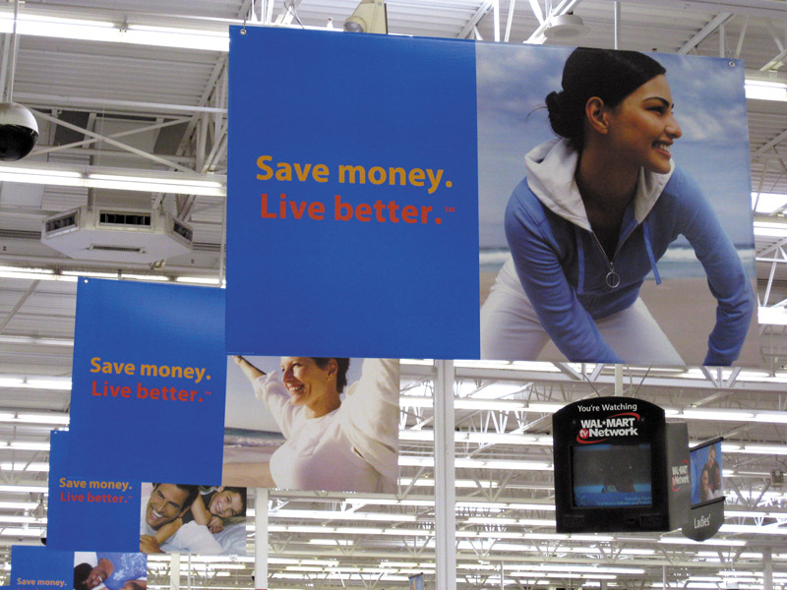
Retailing
Types of Retailers
Relative Prices
Discount stores
Off-price retailers
Factory outlets
Warehouse clubs
Copyright ©2014 by Pearson Education, Inc. All rights reserved
Notes:
Note to Instructor
Relative Prices
Retailers can also be classified according to the prices they charge (see Table 13.1). Most retailers charge regular prices and offer normal-quality goods and customer service. Others offer higher-quality goods and service at higher prices. Retailers that feature low prices are discount stores and “off-price” retailers.
Discount Stores. A discount store (for example, Target, Kmart, or Walmart) sells standard merchandise at lower prices by accepting lower margins and selling higher volume. The early discount stores cut expenses by offering few services and operating in warehouse-like facilities in low-rent, heavily traveled districts. Today’s discounters have improved their store environments and increased their services, while at the same time keeping prices low through lean, efficient operations.
Leading “big-box” discounters, such as Walmart, Costco, and Target, now dominate the retail scene. However, even “small-box” discounters are thriving in the current economic environment. For example, dollar stores are now today’s fastest-growing retail format. Back in the day, dollar stores sold mostly odd-lot assortments of novelties, factory overruns, closeouts, and outdated merchandise—most priced at $1. Not anymore. Dollar General, the nation’s largest small-box discount retailer, makes a powerful value promise for the times: “Save time. Save money. Every day”:
Dollar General’s slogan isn’t just for show. It’s a careful statement of the store’s value promise. “Our goal is to provide our customers a better life, and we think our customers are best served when we keep it real and keep it simple. We make shopping for everyday needs simpler and hassle-free by offering a carefully edited assortment of the most popular brands at low everyday prices in small, convenient locations.”
Dollar General’s slimmed-down product line and smaller stores (you could fit more than 25 Dollar General stores inside the average Walmart supercenter) add up to a quick trip—the average customer is in and out of the store in less than 10 minutes. And its prices on the popular brand-name products it carries are an estimated 20 to 40 percent lower than grocery store prices. Put it all together, and things are sizzling right now at Dollar General. Moreover, the fast-growing retailer is well positioned for the future. We “see signs of a new consumerism,” says Dollar General’s CEO, as people shift where they shop, switch to lower-cost brands, and stay generally more frugal.” Convenience and low prices, it seems, never go out of style.
Off-Price Retailers. As the major discount stores traded up, a new wave of off-price retailers moved in to fill the ultralow-price, high-volume gap. Ordinary discounters buy at regular wholesale prices and accept lower margins to keep prices down. By contrast, off-price retailers buy at less-than-regular wholesale prices and charge consumers less than retail. Off-price retailers can be found in all areas, from food, clothing, and electronics to no-frills banking and discount brokerages.
The three main types of off-price retailers are independents, factory outlets, and warehouse clubs. Independent off-price retailers either are independently owned and run or are divisions of larger retail corporations. Although many off-price operations are run by smaller independents, most large off-price retailer operations are owned by bigger retail chains. Examples include store retailers such as TJ Maxx and Marshalls, which are owned by TJX Companies, and online sellers such as Overstock.com.
Factory outlets—manufacturer-owned and operated stores by firms such as J. Crew, Gap, Levi Strauss, and others—sometimes group together in factory outlet malls and value-retail centers. At these centers, dozens of outlet stores offer prices as much as 50 percent below retail on a wide range of mostly surplus, discounted, or irregular goods. Whereas outlet malls consist primarily of manufacturers’ outlets, value-retail centers combine manufacturers’ outlets with off-price retail stores and department store clearance outlets.
The malls in general are now moving upscale—and even dropping factory from their descriptions. A growing number of outlet malls now feature luxury brands such as Coach, Polo Ralph Lauren, Dolce&Gabbana, Giorgio Armani, Burberry, and Versace. As consumers become more value-minded, even upper-end retailers are accelerating their factory outlet strategies, placing more emphasis on outlets such as Nordstrom Rack, Neiman Marcus Last Call, Bloomingdale’s Outlets, and Saks Off 5th. Many companies now regard outlets not simply as a way of disposing of problem merchandise but as an additional way of gaining business for fresh merchandise. The combination of highbrow brands and lowbrow prices found at outlets provides powerful shopper appeal, especially in thriftier times.
Warehouse clubs (also known as wholesale clubs or membership warehouses), such as Costco, Sam’s Club, and BJ’s, operate in huge, drafty, warehouse-like facilities and offer few frills. However, they offer ultralow prices and surprise deals on selected branded merchandise. Warehouse clubs have grown rapidly in recent years. These retailers appeal not only to low-income consumers seeking bargains on bare-bones products but also to all kinds of customers shopping for a wide range of goods, from necessities to extravagances.
Web link goes to premiumoutlets.com. Review the list of stores, the different kinds of companies using this type of outlet for selling product.

Slide 8
Retailing
Types of Retailers
Organizational Approach
Corporate chains
Voluntary chains
Retailer cooperatives
Franchise organizations
Merchandising conglomerates
Copyright ©2014 by Pearson Education, Inc. All rights reserved
Notes:
Organizational Approach
Although many retail stores are independently owned, others band together under some form of corporate or contractual organization. Table 13.2 describes four major types of retail organizations—corporate chains, voluntary chains, retailer cooperatives, and franchise organizations.

Slide 9
Retailing
Types of Retailers
Organizational Approach
Corporate chains are two or more outlets that are commonly owned and controlled
Size allows them to buy in large quantities at lower prices and gain promotional economies
Sears
CVS
Copyright ©2014 by Pearson Education, Inc. All rights reserved
Notes:
Corporate chains are two or more outlets that are commonly owned and controlled. They have many advantages over independents. Their size allows them to buy in large quantities at lower prices and gain promotional economies. They can hire specialists to deal with areas such as pricing, promotion, merchandising, inventory control, and sales forecasting.

Slide 10
Retailing
Types of Retailers
Organizational Approach
Voluntary chains are wholesale-sponsored groups of independent retailers that engage in group buying and common merchandising
IGA
Western Auto
Copyright ©2014 by Pearson Education, Inc. All rights reserved
Notes:
The great success of corporate chains caused many independents to band together in one of two forms of contractual associations. One is the voluntary chain—a wholesaler-sponsored group of independent retailers that engages in group buying and common merchandising. Examples include the Independent Grocers Alliance (IGA), Western Auto, and Do-It Best hardwares.

Slide 11
Retailing
Types of Retailers
Organizational Approach
Retailer cooperatives is a group of independent retailers that band together to set up a joint-owned, central wholesale operation and conduct joint merchandising and promotion effort
Ace Hardware
Associated Grocers
Copyright ©2014 by Pearson Education, Inc. All rights reserved
Notes:
The other type of contractual association is the retailer cooperative—a group of independent retailers that bands together to set up a jointly owned, central wholesale operation and conduct joint merchandising and promotion efforts. Examples are Associated Grocers and Ace Hardware. These organizations give independents the buying and promotion economies they need to meet the prices of corporate chains.

Slide 12
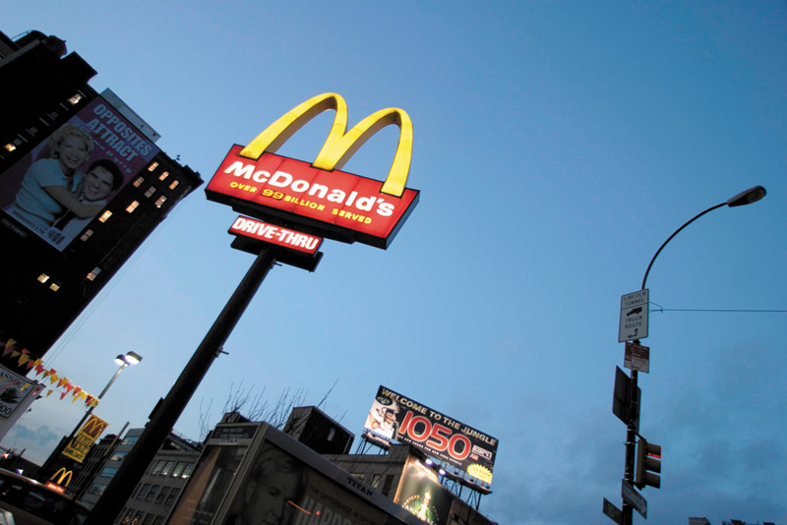
Retailing
Types of Retailers
Organizational Approach
Franchise organizations are based on some unique product or service; on a method of doing business; or on the trade name, good will, or patent that the franchisor has developed
Copyright ©2014 by Pearson Education, Inc. All rights reserved
Notes:
Another form of contractual retail organization is a franchise. The main difference between franchise organizations and other contractual systems (voluntary chains and retail cooperatives) is that franchise systems are normally based on some unique product or service; a method of doing business; or the trade name, goodwill, or patent that the franchisor has developed. Franchising has been prominent in fast-food restaurants, motels, health and fitness centers, auto sales and service dealerships, and real estate agencies.
However, franchising covers a lot more than just burger joints and fitness centers. Franchises have sprung up to meet just about any need. For example, Mad Science Group franchisees put on science programs for schools, scout troops, and birthday parties. And Mr. Handyman provides repair services for homeowners while Merry Maids tidies up their houses.
Franchises now command 40 percent of all retail sales in the United States. These days, it’s nearly impossible to stroll down a city block or drive on a city street without seeing a McDonald’s, Subway, Jiffy Lube, or Holiday Inn. One of the best-known and most successful franchisers, McDonald’s, now has more than 33,000 stores in 119 countries, including almost 14,000 in the United States. It serves 68 million customers a day and racks up more than $85 billion in annual systemwide sales. More than 80 percent of McDonald’s restaurants worldwide are owned and operated by franchisees. Gaining fast is Subway, one of the fastest-growing franchise restaurants, with systemwide sales of $16.2 billion and more than 36,000 shops in 99 countries, including nearly 25,000 in the United States.

Slide 13
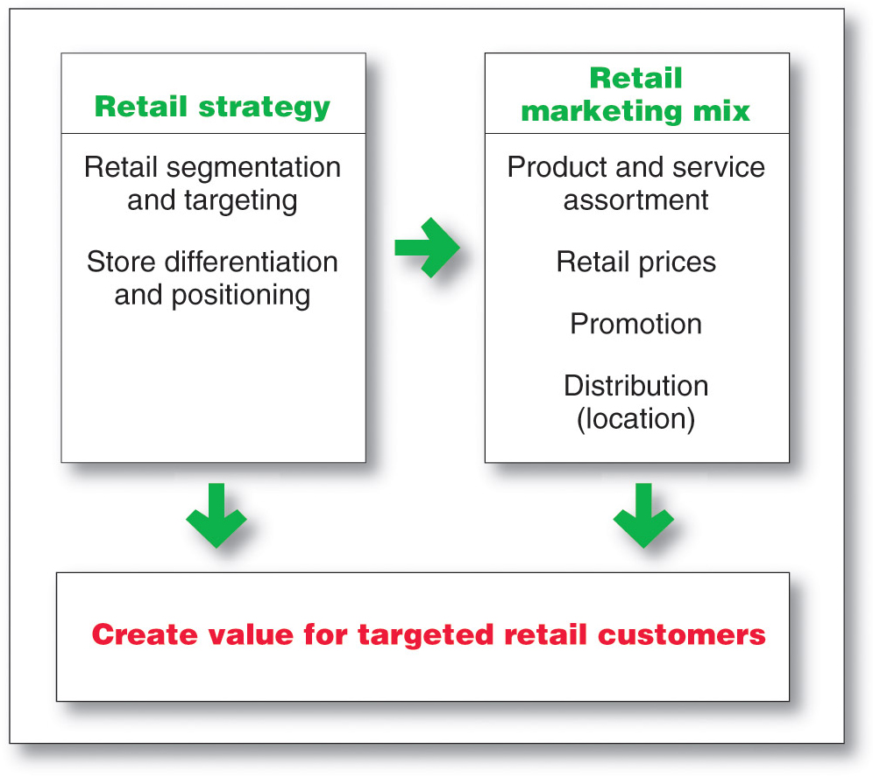
Retailing
Retailer Marketing Decisions
Copyright ©2014 by Pearson Education, Inc. All rights reserved
Notes:
Retailers are always searching for new marketing strategies to attract and hold customers. In the past, retailers attracted customers with unique product assortments and more or better services. Today, the assortments and services of various retailers are looking more and more alike. You can find most consumer brands not only in department stores but also in mass-merchandise discount stores, off-price discount stores, and all on the Internet. Thus, it’s now more difficult for any one retailer to offer exclusive merchandise.
Service differentiation among retailers has also eroded. Many department stores have trimmed their services, whereas discounters have increased theirs. In addition, customers have become smarter and more price sensitive. They see no reason to pay more for identical brands, especially when service differences are shrinking. For all these reasons, many retailers today are rethinking their marketing strategies.
As shown in Figure 13.1, retailers face major marketing decisions about segmentation and targeting, store differentiation and positioning, and the retail marketing mix.

Slide 14
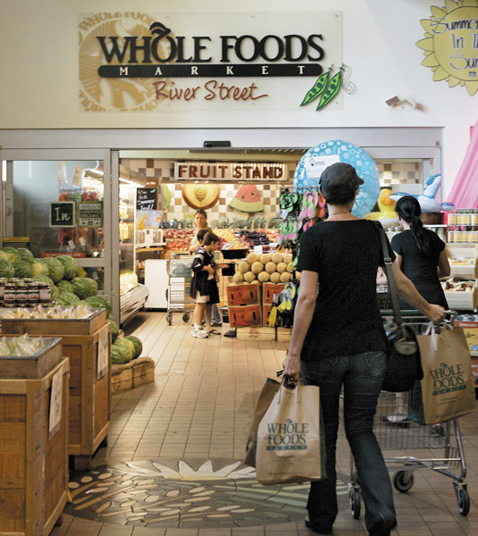
Retailing
Retailer Marketing Decisions
Segmentation targeting, differentiation, and positioning involves the definition and profile of the market so the other retail marketing decisions can be made
Copyright ©2014 by Pearson Education, Inc. All rights reserved
Notes:
Segmentation, Targeting, Differentiation, and Positioning Decisions
Retailers must first segment and define their target markets and then decide how they will differentiate and position themselves in these markets. Should the store focus on upscale, midscale, or downscale shoppers? Do target shoppers want variety, depth of assortment, convenience, or low prices? Until they define and profile their markets, retailers cannot make consistent decisions about product assortment, services, pricing, advertising, store décor, or any of the other decisions that must support their positions.
Too many retailers, even big ones, fail to clearly define their target markets and positions. For example, what market does Sears target? For what is the department store known? What is its value proposition versus, say, Walmart on one hand and Macy’s or Nordstrom on the other? If you’re having trouble answering those questions, you’re not alone—so is Sears’ management
By contrast, successful retailers define their target markets well and position themselves strongly. For example, Trader Joe’s positions itself strongly with its “cheap gourmet” value proposition. Walmart is strongly positioned on low prices and what those always low prices mean to its customers. And highly successful outdoor products retailer Bass Pro Shops positions itself powerfully as being “as close to the Great Outdoors as you can get indoors!”
With solid targeting and positioning, a retailer can compete effectively against even the largest and strongest competitors. For example, compare little Five Guys Burger and Fries to giant McDonald’s. Five Guys has less than 1,000 stores and $1 billion in sales; McDonald’s has more than 33,000 stores worldwide and sales of $85 billion. How does this smaller burger chain compete with Big Mac? It doesn’t—at least not directly. Five Guys succeeds by carefully positioning itself away from McDonald’s:
Five Guys’ menu is limited—really limited. Aside from hamburgers, the chain has only hot dogs and grilled cheese or veggie sandwiches (which hardly anyone buys). You won’t find salads or breakfasts or Chicken McBites at Five Guys, or even a chocolate milk shake. But what you can get at Five Guys you simply can’t get at McDonald’s—such as a mouthwatering Five Guys cheeseburger consisting of two patties and 840 gluttonous calories, piled high with cheese, lettuce, tomatoes, pickles, jalapenos, grilled mushrooms, or any of 11 free toppings, made to order with all-fresh ingredients and buried under an absurdly large serving of just-cooked hand-cut fries. The chain claims that there are more than 250,000 ways to order a Five Guys burger, recently crowned Zagat’s “Best Burger.” What’s more it’s all very fresh—there are no freezers in any Five Guys locations, just coolers. The small burger joint’s unique offerings and generous portions set it apart, allowing it to charge more than regular fast-food places.
Five Guys can’t match McDonald’s massive economies of scale, incredible volume purchasing power, ultraefficient logistics, diverse menu, and low prices. But then again, it doesn’t even try. By positioning itself away from McDonald’s and other large competitors, Five Guys has become one of the nation’s fastest-growing fast-casual restaurant chains.

Slide 15
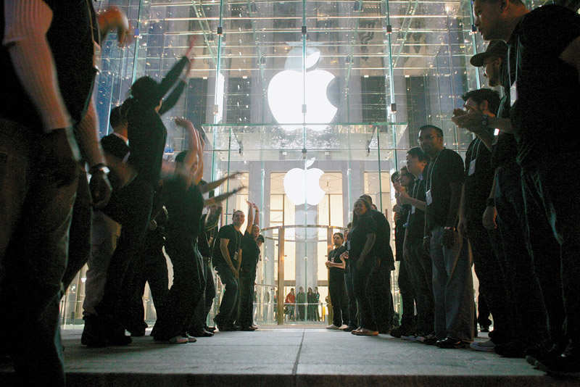
Retailing
Retailer Marketing Decisions
Product Assortment and Service
Product assortment and service decisions include:
Product assortment
Services mix
Store atmosphere
Copyright ©2014 by Pearson Education, Inc. All rights reserved
Notes:
Note to Instructor
Product assortment should differentiate the retailer while matching target shoppers’ expectations. Offers merchandise that no other competitor carries:
Private or national brands
Merchandising events
Highly targeted product assortment
Services mix should also serve to differentiate the retailer from the competition with customer support.
Store atmosphere is the physical layout that makes moving around the store hard or easy.
The retailer’s product assortment should differentiate it while matching target shoppers’ expectations. One strategy is to offer merchandise that no other competitor carries, such as store brands or national brands on which it holds exclusive rights. For example, Saks gets exclusive rights to carry a well-known designer’s labels. It also offers its own private-label lines—the Saks Fifth Avenue Signature, Classic, and Sport collections. Alternatively, a retailer can differentiate itself by offering a highly targeted product assortment: Lane Bryant carries plus-size clothing; Brookstone offers an unusual assortment of gadgets and gifts; and BatteryDepot.com offers about every imaginable kind of replacement battery.
The services mix can also help set one retailer apart from another. For example, some retailers invite customers to ask questions or consult service representatives in person or via phone or keyboard. Nordstrom promises to “take care of the customer, no matter what it takes.” Home Depot offers a diverse mix of services to do-it-yourselfers, from “how-to” classes and “do-it-herself” and kid workshops to a proprietary credit card.
The store’s atmosphere is another important element in the reseller’s product arsenal. Retailers want to create a unique store experience, one that suits the target market and moves customers to buy. Many retailers practice experiential retailing. For example, outdoor goods retailer Cabela’s stores are as much natural history museums for outdoor enthusiasts as they are retail outlets.
Despite Cabela’s often remote locations, customers flock to its 34 superstores to buy hunting, fishing, and outdoor gear. A typical Cabela’s store draws 4.4 million customers a year; half of Cabela’s customers drive 100 miles or more to get there. What is it that attracts these hordes of shoppers to Cabela’s stores? Part of the answer lies in all the stuff the stores sell. Cabela’s huge superstores house a vast assortment of quality merchandise at reasonable prices. But Cabela’s real magic lies in the experiences it creates for those who visit. “This is more than a place to go get fishhooks,” says a Cabela’s spokesperson. “We want to create a sense of wonder” for those who visit.
Mission accomplished! Each Cabela’s store creates what amounts to a natural history theme park. Take the store near Fort Worth, Texas, for example. Dominating the center of the store is Conservation Mountain, a two-story mountain replica with two waterfalls and cascading streams. The mountain is divided into four ecosystems and five bioregions: a Texas prairie, an Alaskan habitat, an Arctic icecap, an American woodland, and an Alpine mountaintop. Each bioregion is populated by lifelike, museum-quality taxidermy animals in action poses—everything from prairie dogs, deer, elk, and caribou to brown bears, polar bears, musk oxen, and mountain goats. Getting hungry? Drop by the Mesquite Grill café for an elk, ostrich, or wild boar sandwich—no Big Macs here! The nearby General Store offers old-fashioned candy and snacks. Put it all together and Cabela’s is creating total experiences that delight the senses as well as the wallets of its carefully targeted customers.
Today’s successful retailers carefully orchestrate virtually every aspect of the consumer store experience. The next time you step into a retail store—whether it sells consumer electronics, hardware, or high fashion—stop and carefully consider your surroundings. Think about the store’s layout and displays. Listen to the background sounds. Smell the smells. Chances are good that everything in the store, from the layout and lighting to the music and even the smells, has been carefully orchestrated to help shape the customers’ shopping experiences—and open their wallets. For example, most large retailers have developed signature scents that you smell only in their stores:
Luxury shirtmaker Thomas Pink pipes the smell of clean, pressed shirts into its stores—its signature “line-dried linen” scent. Sheraton Hotels employs Welcoming Warmth, a mix of fig, Jasmine, and freesia; whereas Westin Hotel & Resorts disperses White Tea, which attempts to provide the indefinable “Zen-retreat” experience. Bloomingdale’s uses different essences in different departments: the soft scent of baby powder in the baby store, coconut in the swimsuit area, lilacs in intimate apparel, and sugar cookies and evergreen scent during the holiday season. At Abercrombie and Fitch, it’s a “woody” aroma—a combination of orange, fir resin, and Brazilian rosewood, among others. Theme park operators send popcorn aromas wafting down the midway—they don’t pop the corn there, but the aroma puts visitors in a snacking mood. Such scents can increase customer “dwell times” and, in turn, buying. Says the founder of ScentAir, a company that produces such scents, “Developing a signature fragrance is much like [developing] a message in print or radio: What do you want to communicate to consumers and how often?”
Such experiential retailing confirms that retail stores are much more than simply assortments of goods. They are environments to be experienced by the people who shop in them. In fact, retail establishments sometimes become small communities in themselves—places where people get together. For example, women’s sports and fitness chain Title Nine is part women’s active apparel shop and part women’s gathering spot. Beyond selling apparel for everything from running to rock climbing, it sponsors local fitness events, in-store get-togethers, and an online community for women on the move—called timeout with Title Nine—all announced via each store’s individual Facebook page. The Portland, Oregon, Title Nine hosts moonlight snowshoe outings, in-store yoga classes, and a weekend cycling series.

Slide 16
Retailing
Retailer Marketing Decisions
Price Decision
Price policy must fit the target market and positioning, product and service assortment, and competition
High markup on lower volume
Low markup on higher volume
Copyright ©2014 by Pearson Education, Inc. All rights reserved
Notes:
Price Decision
A retailer’s price policy must fit its target market and positioning, product and service assortment, the competition, and economic factors. All retailers would like to charge high markups and achieve high volume, but the two seldom go together. Most retailers seek either high markups on lower volume (most specialty stores) or low markups on higher volume (mass merchandisers and discount stores).
Thus, 110-year-old Bergdorf Goodman caters to the upper crust by selling apparel, shoes, and jewelry created by designers such as Chanel, Prada, and Hermes. The up-market retailer pampers its customers with services such as a personal shopper and in-store showings of the upcoming season’s trends with cocktails and hors d’oeuvres. By contrast, TJ Maxx sells brand-name clothing at discount prices aimed at Middle Americans. As it stocks new products each week, the discounter provides a treasure hunt for bargain shoppers.

Slide 17
Retailing
Retailer Marketing Decisions
Price Decision
High-low pricing involves charging higher prices on an everyday basis, coupled with frequent sales and other price promotions
Everyday low price (EDLP) involves charging constant, everyday low prices with few sales or discounts
Copyright ©2014 by Pearson Education, Inc. All rights reserved
Notes:
Discussion Question
Why would a retailer engage in high-low pricing?
In most cases it is to increase store traffic, clear out unsold merchandise, create a low price image, or attract customers who will buy other goods at full price.
Retailers must also decide on the extent to which they will use sales and other price promotions. Some retailers use no price promotions at all, competing instead on product and service quality rather than on price. For example, it’s difficult to imagine Bergdorf Goodman holding a two-for-the-price-of-one sale on Chanel handbags, even in a tight economy. Other retailers—such as Walmart, Costco, and Family Dollar—practice everyday low pricing (EDLP), charging constant, everyday low prices with few sales or discounts.
Still other retailers practice high-low pricing—charging higher prices on an everyday basis, coupled with frequent sales and other price promotions, to increase store traffic, create a low-price image, or attract customers who will buy other goods at full prices. The recent economic downturn caused a rash of high-low pricing, as retailers poured on price cuts and promotions to coax bargain-hunting customers into their stores. Which pricing strategy is best depends on the retailer’s overall marketing strategy, the pricing approaches of its competitors, and the economic environment.

Slide 18
Retailing
Retailer Marketing Decisions
Promotion Decision
Advertising
Personal selling
Sales promotion
Public relations
Direct marketing
Copyright ©2014 by Pearson Education, Inc. All rights reserved
Notes:
Note to Instructor
Ask students for examples of retailers that advertise heavily. They might even be able to mention a local retailer whose ads they seem to constantly see on television. Local furniture stores and car dealers invest heavily on local television.
Promotion Decision
Retailers use any or all of the five promotion tools—advertising, personal selling, sales promotion, public relations (PR), and direct marketing—to reach consumers. They advertise in newspapers and magazines and on radio, television, and the Internet. Advertising may be supported by newspaper inserts and catalogs. Store salespeople greet customers, meet their needs, and build relationships. Sales promotions may include in-store demonstrations, displays, sales, and loyalty programs. PR activities, such as new-store openings, special events, newsletters and blogs, store magazines, and public service activities, are also available to retailers. Most retailers have also created websites and mobile apps that offer customers information and other features while selling merchandise directly.

Slide 19
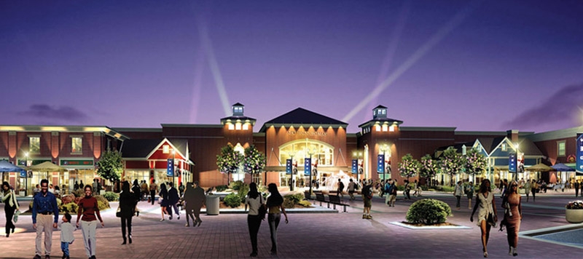
Retailing
Retailer Marketing Decisions - Place Decision
Central business districts are located in cities and include department and specialty stores, banks, and movie theaters
Shopping center is a group of retail businesses planned, developed, owned, and managed as a unit
Copyright ©2014 by Pearson Education, Inc. All rights reserved
Notes:
Note to Instructor
Discussion Question: What makes a good retail location?
Central business districts are declining. Students might even be able to cite examples in their home town where shopping centers are being built but central business districts are failing to thrive. Shopping centers can be:
Regional shopping centers
Community shopping centers
Neighborhood shopping centers
Power center
Lifestyle centers
Place Decision
Retailers often point to three critical factors in retailing success: location, location, and location! It’s very important that retailers select locations that are accessible to the target market in areas that are consistent with the retailer’s positioning. For example, Apple locates its stores in high-end malls and trendy shopping districts—such as the “Magnificent Mile” on Chicago’s Michigan Avenue or Fifth Avenue in Manhattan—not low-rent strip malls on the edge of town. By contrast, Trader Joe’s places its stores in low-rent, out-of-the-way locations to keep costs down and support its “cheap gourmet” positioning. Small retailers may have to settle for whatever locations they can find or afford. Large retailers, however, usually employ specialists who use advanced methods to select store locations.
Most stores today cluster together to increase their customer pulling power and give consumers the convenience of one-stop shopping. Central business districts were the main form of retail cluster until the 1950s. Every large city and town had a central business district with department stores, specialty stores, banks, and movie theaters. When people began moving to the suburbs, however, these central business districts, with their traffic, parking, and crime problems, began to lose business. In recent years, many cities have joined with merchants to revive downtown shopping areas, generally with only mixed success.
A shopping center is a group of retail businesses built on a site that is planned, developed, owned, and managed as a unit. A regional shopping center, or regional shopping mall, the largest and most dramatic shopping center, has from 50 to more than 100 stores, including two or more full-line department stores. It is like a covered mini-downtown and attracts customers from a wide area. A community shopping center contains between 15 and 50 retail stores. It normally contains a branch of a department store or variety store, a supermarket, specialty stores, professional offices, and sometimes a bank. Most shopping centers are neighborhood shopping centers or strip malls that generally contain between 5 and 15 stores. These centers, which are close and convenient for consumers, usually contain a supermarket, perhaps a discount store, and several service stores—dry cleaner, drugstore, hardware store, local restaurant, or other stores.
A newer form of shopping center is the so-called power center. Power centers are huge unenclosed shopping centers consisting of a long strip of retail stores, including large, freestanding anchors such as Walmart, Home Depot, Costco, Best Buy, Michaels, PetSmart, and OfficeMax. Each store has its own entrance with parking directly in front for shoppers who wish to visit only one store.
In contrast, lifestyle centers are smaller, open-air malls with upscale stores, convenient locations, and nonretail activities, such as a playground, skating rink, hotel, dining establishments, and a movie theater. “Think of lifestyle centers as part Main Street and part Fifth Avenue,” comments an industry observer. In fact, the original power center and lifestyle center concepts are now morphing into hybrid lifestyle-power centers. “The idea is to combine the hominess and community of an old-time village square with the cachet of fashionable urban stores; the smell and feel of a neighborhood park with the brute convenience of a strip center.” In all, today’s centers are more about “creating places to be rather than just places to buy.”
The past few years have brought hard times for shopping centers. With more than 100,000 centers in the United States, many experts suggest that the country has been “overmalled.” Not surprisingly, the recent Great Recession hit shopping malls hard. Consumer spending cutbacks forced many retailers—small and large—out of business, increasing mall vacancy rates. Power centers were especially hard hit as their big-box retailer tenants suffered during the downturn. Some of the pizzazz has also gone out of lifestyle centers, whose upper-middle-class shoppers suffered most during the recession. Many lifestyle centers are even adding lower-price retailers to replace classier tenants that have folded. “We’ve learned that lifestyle centers have to adapt to a changing environment to survive,” says one mall developer.

Slide 20
Retailing
Retailing Trends and Developments
New Retail Forms and Shortening Retail Life Cycles
Wheel-of-retailing concept states that many new types of retailing forms begin as low-margin, low-price, low-status operations, and challenge established retailers.
As they succeed they upgrade their facilities and offer more services, increasing their costs and forcing them to increase prices, eventually becoming the retailers they replaced.
Copyright ©2014 by Pearson Education, Inc. All rights reserved
Notes:
New Retail Forms, Shortening Retail Life Cycles, and Retail Convergence
New retail forms continue to emerge to meet new situations and consumer needs, but the life cycle of new retail forms is getting shorter. Department stores took about 100 years to reach the mature stage of the life cycle; more recent forms, such as warehouse stores, reached maturity in about 10 years. In such an environment, seemingly solid retail positions can crumble quickly. Of the top 10 discount retailers in 1962 (the year that Walmart and Kmart began), not one exists today. Even the most successful retailers can’t sit back with a winning formula. To remain successful, they must keep adapting.
Many retailing innovations are partially explained by the wheel-of-retailing concept. According to this concept, many new types of retailing forms begin as low-margin, low-price, and low-status operations. They challenge established retailers that have become “fat” by letting their costs and margins increase. The new retailers’ success leads them to upgrade their facilities and offer more services. In turn, their costs increase, forcing them to increase their prices. Eventually, the new retailers become like the conventional retailers they replaced. The cycle begins again when still newer types of retailers evolve with lower costs and prices. The wheel-of-retailing concept seems to explain the initial success and later troubles of department stores, supermarkets, and discount stores and the recent success of dollar stores and off-price retailers.

Slide 21
Retailing
Retailing Trends and Developments
New Retail Forms and Shortening Retail Life Cycles
Retail convergence involves the merging of consumers, producers, prices, and retailers, creating greater competition for retailers and greater difficulty differentiating offerings
Copyright ©2014 by Pearson Education, Inc. All rights reserved
Notes:
Today’s retail forms appear to be converging. Increasingly, different types of retailers now sell the same products at the same prices to the same consumers. For example, you can buy brand-name home appliances at department stores, discount stores, home improvement stores, off-price retailers, electronics superstores, and a slew of online sites that all compete for the same customers. If you can’t find the microwave oven you want at Sears, you can step across the street and find one for a better price at Lowe’s or Best Buy—or just order one online from Amazon.com or even RitzCamera.com. This merging of consumers, products, prices, and retailers is called retail convergence. Such convergence means greater competition for retailers and greater difficulty in differentiating the product assortments of different types of retailers.

Slide 22
Retailing
The Future of Retailing
New Retail Forms and Shortening Retail Life Cycles
The rise of mega-retailers involves the rise of mass merchandisers and specialty superstores, the formation of vertical marketing systems, and a rash of retail mergers and acquisitions
Superior information systems
Buying power
Large selection
Copyright ©2014 by Pearson Education, Inc. All rights reserved
Notes:
The Rise of Megaretailers
The rise of huge mass merchandisers and specialty superstores, the formation of vertical marketing systems, and a rash of retail mergers and acquisitions have created a core of superpower megaretailers. With their size and buying power, these giant retailers can offer better merchandise selections, good service, and strong price savings to consumers. As a result, they grow even larger by squeezing out their smaller, weaker competitors.
The megaretailers have shifted the balance of power between retailers and producers. A small handful of retailers now control access to enormous numbers of consumers, giving them the upper hand in their dealings with manufacturers. For example, you may never have heard of specialty coatings and sealants manufacturer RPM International, but you’ve probably used one or more of its many familiar do-it-yourself brands—such as Rust-Oleum paints, Plastic Wood and Dap fillers, Mohawk and Watco finishes, and Testors hobby cements and paints—all of which you can buy at your local Home Depot store. Home Depot is a very important customer to RPM, accounting for a significant share of its consumer sales. However, Home Depot’s sales of $70 billion are 20 times RPM’s sales of $3.3 billion. As a result, the giant retailer can, and often does, use this power to wring concessions from RPM and thousands of other smaller suppliers.

Slide 23
Retailing
Retailing Trends and Developments
Growth of Non-store Retailing
Direct
Online
Mobile
Copyright ©2014 by Pearson Education, Inc. All rights reserved
Notes:
Note to Instructor
Discussion Question
What percent of your purchases are online? Why is it low for some types of products?
It might be surprising to see that for certain categories it is very high but for others it remains low. You can ask why they differ by category. It might include shipping costs, need to try the product, size, impulse purchase, etc.
Growth of Direct and Online Retailing
Most consumers still make a majority of their purchases the old-fashioned way: They go to the store, find what they want, wait patiently in line to plunk down their cash or credit cards, and bring home the goods. However, consumers now have a broad array of nonstore alternatives, including direct and online shopping. As we’ll discuss in Chapter 17, direct and online marketing are currently the fastest-growing forms of marketing.
Today, thanks to advanced technologies, easier-to-use and enticing online sites and mobile apps, improved online services, and the increasing sophistication of search technologies, online retailing is thriving. In fact, although it currently accounts for only about 8 percent of total U.S. retail sales, online buying is growing at a much brisker pace than retail buying as a whole. Last year’s U.S. online retail sales reached an estimated $194.3 billion, up 16 percent over the previous year, and will reach an estimated $279 billion by 2015.
Retailer online sites and mobile apps also influence a large amount of in-store buying. One recent survey revealed that more than 60 percent of shoppers say they look for deals online before at least half of all shopping trips. What’s more, to the dismay of store retailers, many shoppers now check out merchandise at brick-and-mortar store showrooms before buying it online—a process called showrooming. Today, half of shoppers who buy products online first check them out at a traditional store. Large retailers such as Target, Walmart, and Best Buy have been hardest hit by showrooming and are busy devising strategies designed to thwart such shopping behavior (see Real Marketing 13.2).
Thus, it’s no longer a matter of customers deciding whether to shop in the store or shop online. Increasingly, customers are merging store, online, and mobile outlets into a single shopping process. The Internet and digital devices have spawned a whole new breed of shopper and way of shopping. Whether shopping for cars, homes, electronics, consumer products, or medical care, many people just can’t buy anything unless they first look it up online and get the lowdown. And they’ve gotten used to buying anywhere, anytime—whether it’s in the store, online, or even online while in the store.
All types of retailers now employ direct and online channels. The Web and mobile online sales of large brick-and-mortar retailers, such as Walmart, Target, Staples, and Best Buy, are increasing rapidly. Many large online-only retailers—Amazon.com, Zappos.com, online travel companies such as Travelocity.com and Expedia.com, and others—have made it big on the Internet. At the other extreme, hordes of niche marketers have used the Internet to reach new markets and expand their sales.
Still, much of the anticipated growth in online sales will go to multichannel retailers—the click-and-brick marketers who can successfully merge the virtual and physical worlds. In a recent ranking of the top-20 online retail sites, 70 percent were owned by store-based retail chains. For example, thanks largely to rapid growth in online sales, upscale home products retailer Williams-Sonoma now captures more than 40 percent of its total revenues from its direct-to-consumer channel. Like many retailers, Williams-Sonoma has discovered that many of its best customers visit and shop both online and offline. Beyond just offering online shopping, the retailer engages customers through online communities, social media, mobile apps, a blog, and special online programs.

Slide 24
Retailing
Retailing Trends and Developments
New Retail Forms and Shortening Retail Life Cycles
Growing importance of retail technology provides better forecasts, inventory control, electronic ordering, transfer of information, scanning, online transaction processing, improved merchandise handling systems, and the ability to connect with customers
Copyright ©2014 by Pearson Education, Inc. All rights reserved
Notes:
Growing Importance of Retail Technology
Retail technologies have become critically important as competitive tools. Progressive retailers are using advanced IT and software systems to produce better forecasts, control inventory costs, interact electronically with suppliers, send information between stores, and even sell to customers within stores. They have adopted sophisticated systems for checkout scanning, RFID inventory tracking, merchandise handling, information sharing, and customer interactions.
Perhaps the most startling advances in retail technology concern the ways in which retailers are connecting with consumers. Today’s customers have gotten used to the speed and convenience of buying online and to the control that the Internet gives them over the buying process. The Internet lets consumers shop when they like and where they like, with instant access to gobs of information about competing products and prices. No real-world store can do all that.
Increasingly, however, retailers are attempting to meet these new consumer expectations by bringing online-style technologies into their stores. Many retailers now routinely use technologies ranging from touch-screen kiosks, mobile hand-held shopping assistants, and customer-loyalty apps to interactive dressing-room mirrors and virtual sales associates. For example, Eastern Mountain Sports uses an iPad app to assist in outfitting shoppers for their next adventure with items available both in the store and on the company’s website. “No longer are we constrained by square footage as to what we can sell,” says an EMS marketer.
According to one retailing executive, the future of technology in retailing lies in merging the online and offline shopping experiences. “It’s not as though there’s a physical retail world and an online retail world, and as one grows, the other declines,” he says. “They’re increasingly integrated.” For example, consider this futuristic shopping scenario.
It’s a snowy Saturday in Chicago, but Amy, age 28, needs resort wear for an upcoming Caribbean vacation. She starts shopping from her couch via videoconference with her personal concierge at Danella, one of her favorite retailers. Based their conversation and on Amy’s past buying at the store, the concierge recommends several items, superimposing photos of them onto Amy’s avatar. Amy toggles to another browser tab to research customer reviews and prices, returns to buy one item from Danella online, and then drives to the store to try on other selected items. At the store, a sales associate greets Amy by name and walks her to a dressing room stocked with her online choices—plus some matching shoes. She likes the shoes, so she scans the bar code into her smartphone and finds the same pair for $30 less at another store. The sales associate quickly offers to match the price.
As Amy tries things on, she uses an interactive mirror that lets her scan matching items and project them onto her body. Finally, selections in hand, she checks out using her smartphone. As she heads for the door, a life-size screen recognizes her and shows a special offer on an irresistible summer-weight top. Amy checks her budget online, smiles, and uses her phone to scan the customized QR code on the screen. The item will be shipped to her home overnight.
This functional scenario is neither as futuristic nor as fanciful as it might seem. All the technology is already available and will soon be found everywhere. The future belongs to retailers who can blend various in-store and online technologies into a seamless shopping experience.

Slide 25
Retailing
Trends and Developments
Green Retailing
Environmentally sustainable practices
Store design, construction, operations
Product assortment
Recycling made easier
Package and distribution
Copyright ©2014 by Pearson Education, Inc. All rights reserved
Notes:
Green Retailing
Today’s retailers are increasingly adopting environmentally sustainable practices. They are greening up their stores and operations, promoting more environmentally responsible products, launching programs to help customers be more responsible, and working with channel partners to reduce their environmental impact.
At the most basic level, most large retailers are making their stores more environmentally friendly through sustainable building design, construction, and operations. For example, all new Kohl’s stores are constructed with recycled and regionally sourced building materials, water-efficient landscaping and plumbing fixtures, and ENERGY STAR-rated roofs that reduce energy usage. Inside, new stores use occupancy sensor lighting for stockrooms, dressing rooms, and offices; energy management systems to control heating and cooling; and a recycling program for cardboard boxes, packaging, hangers. “Kohl’s cares,” says the store. “From large-scale initiatives like constructing environmentally friendly buildings to everyday practices like recycling hangers, we’re taking big steps to ensure we leave a smaller footprint.”
Retailers are also greening up their product assortments. For example, Safeway offers its own Bright Green line of home care products, featuring cleaning and laundry soaps made with biodegradable and naturally derived ingredients, energy-efficient light bulbs, and paper products made from 100 percent recycled content. Such products can both boost sales and lift the retailer’s image as a responsible company.
Many retailers have also launched programs that help consumers make more environmentally responsible decisions. Staples’ EcoEasy program “makes it easier to make a difference” by helping to customers identify green products sold in its stores and to recycle printer cartridges, mobile phones, computers, and other office technology products. Staples recycles some 30 million printer cartridges and ten million pounds of old technology each year.
Finally, many large retailers are joining forces with suppliers and distributors to create more sustainable products, packaging, and distribution systems. For example, Amazon.com works closely with the producers of many of the products it sells to reduce and simplify their packaging. And beyond its own substantial sustainability initiatives, Walmart wields its huge buying power to urge its army of suppliers to improve their environmental impact and practices. The retailer has even developed a worldwide Sustainable Product Index, by which it rates suppliers. It plans to translate the index into a simple rating for consumers to help them make more sustainable buying choices.
Green retailing yields both top- and bottom-line benefits. Sustainable practices lift a retailer’s top line by attracting consumers looking to support environmentally friendly sellers and products. They also help the bottom line by reducing costs. For example, Amazon.com’s reduced-packaging efforts increase customer convenience and eliminate “wrap rage” while at the same time saving packaging costs. And Kohl’s earth-friendly environmentally friendly buildings not only appeal to customers and helps save the planet but also cost less to operate.

Slide 26
Retailing
Trends and Developments
Global Expansion
U.S. retailers moving into other countries with unique formats and strong brands
U.S. behind Asian and European companies in global expansion
Challenges in meeting needs of local markets
Copyright ©2014 by Pearson Education, Inc. All rights reserved
Notes:
Global Expansion of Major Retailers
Retailers with unique formats and strong brand positions are increasingly moving into other countries. Many are expanding internationally to escape saturated home markets. Over the years, some giant U.S. retailers, such as McDonald’s, have become globally prominent as a result of their marketing prowess. Others, such as Walmart, are rapidly establishing a global presence. Walmart, which now operates more than 5,600 stores in 26 non-U.S. markets, sees exciting global potential. Its international division alone last year racked up sales of more than $126 billion, 80 percent more than rival Target’s total sales of $69.8 billion.
However, most U.S retailers are still significantly behind Europe and Asia when it comes to global expansion. Although nine of the world’s top 20 retailers are U.S. companies, only four of these retailers have set up stores outside North America (Walmart, Home Depot, Costco, and Best Buy). Of the 11 non-U.S. retailers in the world’s top 20, eight have stores in at least ten countries. Foreign retailers that have gone global include France’s Carrefour and Auchan chains, Germany’s Metro and Aldi chains, Britain’s Tesco, and Japan’s Seven & I.
International retailing presents challenges as well as opportunities. Retailers can face dramatically different retail environments when crossing countries, continents, and cultures. Simply adapting the operations that work well in the home country is usually not enough to create success abroad. Instead, when going global, retailers must understand and meet the needs of local markets.

Slide 27
Wholesaling
Wholesaling includes all activities involved in selling goods and services to those buying for resale or business use
Selling and promoting
Buying assortment building
Bulk breaking
Warehousing
Transportation
Financing
Risk bearing
Market information
Management services and advice
Copyright ©2014 by Pearson Education, Inc. All rights reserved
Notes:
includes all the activities involved in selling goods and services to those buying them for resale or business use. Firms engaged primarily in wholesaling activities are called wholesalers.
Wholesalers buy mostly from producers and sell mostly to retailers, industrial consumers, and other wholesalers. As a result, many of the nation’s largest and most important wholesalers are largely unknown to final consumers. For example, you may never have heard of Grainger, even though it’s very well known and much valued by its more than 2 million business and institutional customers in 157 countries. Wholesalers add value by performing one or more of the these channel functions.

Slide 28
Wholesaling
Wholesaling
Selling and promoting involves the wholesaler’s sales force helping the manufacturer reach many smaller customers at lower cost
Buying assortment building involves the selection of items and building of assortments needed by their customers, saving the customers work
Copyright ©2014 by Pearson Education, Inc. All rights reserved
Notes:
Selling and promoting: Wholesalers’ sales forces help manufacturers reach many small customers at a low cost. The wholesaler has more contacts and is often more trusted by the buyer than the distant manufacturer.
Buying and assortment building: Wholesalers can select items and build assortments needed by their customers, thereby saving much work.

Slide 29
Wholesaling
Wholesaling
Bulk breaking involves the wholesaler buying in larger quantity and breaking into smaller lots for its customers
Warehousing involves the wholesaler holding inventory, reducing its customers’ inventory cost and risk
Copyright ©2014 by Pearson Education, Inc. All rights reserved
Notes:
Bulk breaking: Wholesalers save their customers money by buying in carload lots and breaking bulk (breaking large lots into small quantities).
Warehousing: Wholesalers hold inventories, thereby reducing the inventory costs and risks of suppliers and customers.

Slide 30
Wholesaling
Wholesaling
Transportation involves the wholesaler providing quick delivery due to its proximity to the buyer
Financing involves the wholesaler providing credit and financing suppliers by ordering earlier and paying on time
Copyright ©2014 by Pearson Education, Inc. All rights reserved
Notes:
Transportation: Wholesalers can provide quicker delivery to buyers because they are closer to buyers than are producers.
Financing: Wholesalers finance their customers by giving credit, and they finance their suppliers by ordering early and paying bills on time.

Slide 31
Wholesaling
Wholesaling
Risk bearing involves the wholesaler absorbing risk by taking title and bearing the cost of theft, damage, spoilage, and obsolescence
Market information involves the wholesaler providing information to suppliers and customers about competitors, new products, and price developments
Copyright ©2014 by Pearson Education, Inc. All rights reserved
Notes:
Risk bearing: Wholesalers absorb risk by taking title and bearing the cost of theft, damage, spoilage, and obsolescence.
Market information: Wholesalers give information to suppliers and customers about competitors, new products, and price developments.

Slide 32
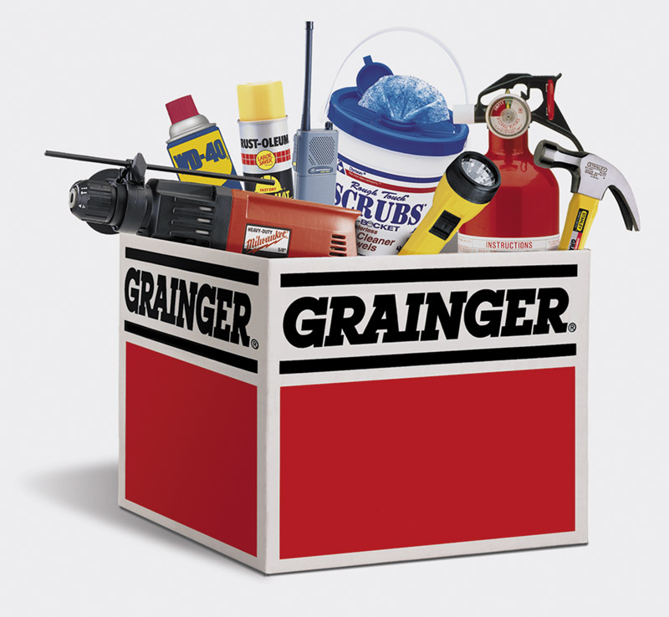
Wholesaling
Wholesaling
Management services and advice involves wholesalers helping retailers train their sales clerks, improve store layouts, and set up accounting and inventory control systems
Copyright ©2014 by Pearson Education, Inc. All rights reserved
Notes:
Management services and advice: Wholesalers often help retailers train their salesclerks, improve store layouts and displays, and set up accounting and inventory control systems.

Slide 33
Wholesaling
Types of Wholesalers
Merchant wholesalers
Agents and brokers
Manufacturers’ sales branches and offices
Copyright ©2014 by Pearson Education, Inc. All rights reserved
Notes:
Types of Wholesalers
Wholesalers fall into three major groups (see Table 13.3): merchant wholesalers, brokers and agents, and manufacturers’ and retailers’ branches and offices.

Slide 34
Wholesaling
Types of Wholesalers
Merchant wholesalers is the largest group of wholesalers and include:
Full-service wholesalers who provide a full set of services
Limited service wholesalers who provide few services and specialized functions
Copyright ©2014 by Pearson Education, Inc. All rights reserved
Notes:
Types of Wholesalers
Merchant wholesalers are the largest single group of wholesalers, accounting for roughly 50 percent of all wholesaling. Merchant wholesalers include two broad types: full-service wholesalers and limited-service wholesalers. Full-service wholesalers provide a full set of services, whereas the various limited-service wholesalers offer fewer services to their suppliers and customers. The different types of limited-service wholesalers perform varied specialized functions in the distribution channel.

Slide 35
Wholesaling
Types of Wholesalers
Brokers and agents do not take title, perform a few functions, and specialize by product line or customer type
Brokers bring buyers and sellers together and assist in negotiations
Agents represent buyers or sellers
Copyright ©2014 by Pearson Education, Inc. All rights reserved
Notes:
Brokers and agents differ from merchant wholesalers in two ways: They do not take title to goods, and they perform only a few functions. Like merchant wholesalers, they generally specialize by product line or customer type. A broker brings buyers and sellers together and assists in negotiation. Agents represent buyers or sellers on a more permanent basis. Manufacturers’ agents (also called manufacturers’ representatives) are the most common type of agent wholesaler.

Slide 36
Wholesaling
Types of Wholesalers
Manufacturers’ sales branches and offices is a form of wholesaling by sellers or buyers themselves rather than through independent wholesalers
Copyright ©2014 by Pearson Education, Inc. All rights reserved
Notes:
The third major type of wholesaling is that done in manufacturers’ sales branches and offices by sellers or buyers themselves rather than through independent wholesalers.

Slide 37
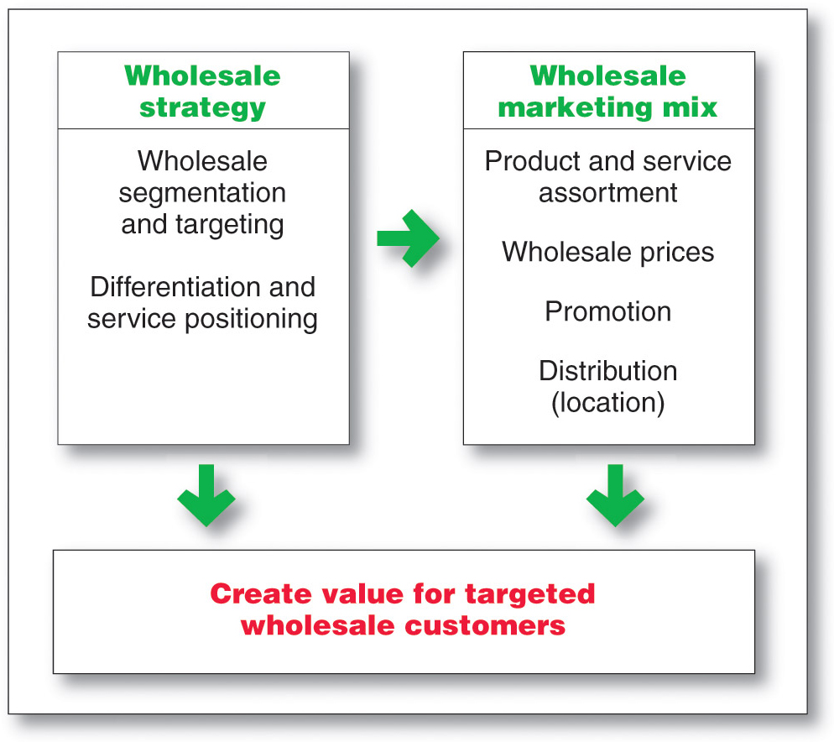
Wholesaling
Wholesaler Marketing Decisions
Copyright ©2014 by Pearson Education, Inc. All rights reserved
Notes:
Wholesaler Marketing Decisions
Wholesalers now face growing competitive pressures, more-demanding customers, new technologies, and more direct-buying programs on the part of large industrial, institutional, and retail buyers. As a result, they have taken a fresh look at their marketing strategies. As with retailers, their marketing decisions include choices of segmentation and targeting, differentiation and positioning, and the marketing mix—product and service assortments, price, promotion, and distribution

Slide 38
Wholesaling
Wholesaler Marketing Decisions
Segmentation, targeting, differentiation, positioning decisions
Size of customer
Type of customer
Need for service
Copyright ©2014 by Pearson Education, Inc. All rights reserved
Notes:
Segmentation, Targeting, Differentiation, and Positioning Decisions
Like retailers, wholesalers must segment and define their target markets and differentiate and position themselves effectively—they cannot serve everyone. They can choose a target group by size of customer (for example, large retailers only), type of customer (convenience stores only), the need for service (customers who need credit), or other factors. Within the target group, they can identify the more profitable customers, design stronger offers, and build better relationships with them. They can propose automatic reordering systems, establish management-training and advisory systems, or even sponsor a voluntary chain. They can discourage less-profitable customers by requiring larger orders or adding service charges to smaller ones.

Slide 39
Wholesaling
Wholesaler Marketing Mix Decisions
Marketing mix decisions
Product
Price
Promotion
Place
Copyright ©2014 by Pearson Education, Inc. All rights reserved
Notes:
Marketing Mix Decisions
Like retailers, wholesalers must decide on product and service assortments, prices, promotion, and place. Wholesalers add customer value though the products and services they offer. They are often under great pressure to carry a full line and stock enough for immediate delivery. But this practice can damage profits. Wholesalers today are cutting down on the number of lines they carry, choosing to carry only the more-profitable ones. They are also rethinking which services count most in building strong customer relationships and which should be dropped or paid for by the customer. The key for companies is to find the mix of services most valued by their target customers.
Price is also an important wholesaler decision. Wholesalers usually mark up the cost of goods by a standard percentage—say, 20 percent. Expenses may run 17 percent of the gross margin, leaving a profit margin of 3 percent. In grocery wholesaling, the average profit margin is often less than 2 percent. The recent recession put heavy pressure on wholesalers to cut their costs and prices. As their retail and industrial customers face sales and margin declines, these customers turn to wholesalers looking for lower prices. Wholesalers may, in turn, cut their margins on some lines to keep important customers. They may also ask suppliers for special price breaks in cases when they can turn them into an increase in the supplier’s sales.
Although promotion can be critical to wholesaler success, most wholesalers are not promotion minded. They use largely scattered and unplanned trade advertising, sales promotion, personal selling, and public relations. Many are behind the times in personal selling; they still see selling as a single salesperson talking to a single customer instead of as a team effort to sell, build, and service major accounts. Wholesalers also need to adopt some of the nonpersonal promotion techniques used by retailers. They need to develop an overall promotion strategy and make greater use of supplier promotion materials and programs.
Finally, distribution (location) is important. Wholesalers must choose their locations, facilities, and Web locations carefully. There was a time when wholesalers could locate in low-rent, low-tax areas and invest little money in their buildings, equipment, and systems. Today, however, as technology zooms forward, such behavior results in outdated systems for material handling, order processing, and delivery.
Instead, today’s large and progressive wholesalers have reacted to rising costs by investing in automated warehouses and IT systems. Orders are fed from the retailer’s information system directly into the wholesaler’s, and the items are picked up by mechanical devices and automatically taken to a shipping platform where they are assembled. Most large wholesalers use technology to carry out accounting, billing, inventory control, and forecasting. Modern wholesalers are adapting their services to the needs of target customers and finding cost-reducing methods of doing business. They are also transacting more business online. For example, e‑commerce is Grainger’s fastest growing sales channel, making Grainger the 15th largest e-tailer in the United States and Canada. Online purchasing now accounts for more than 27 percent of the wholesaler’s total sales.

Slide 40
Wholesaling
Trends in Wholesaling
Need for greater efficiency
Added- value customer relationships
Increase in customer demand for more services
Increase use of technology to boost productivity
Copyright ©2014 by Pearson Education, Inc. All rights reserved
Notes:
Trends in Wholesaling
Today’s wholesalers face considerable challenges. The industry remains vulnerable to one of its most enduring trends—the need for ever-greater efficiency. Recent economic conditions have led to demands for even lower prices and the winnowing out of suppliers who are not adding value based on cost and quality. Progressive wholesalers constantly watch for better ways to meet the changing needs of their suppliers and target customers. They recognize that their only reason for existence comes from adding value, which occurs by increasing the efficiency and effectiveness of the entire marketing channel.
As with other types of marketers, the goal is to build value-adding customer relationships. McKesson provides an example of progressive, value-adding wholesaling. The company is a diversified health care services provider and the nation’s leading wholesaler of pharmaceuticals, health and beauty care, home health care, and medical supply and equipment products. To survive, especially in a tight economic environment, McKesson has to be more cost effective than manufacturers’ sales branches. Thus, the company has built efficient automated warehouses, established direct computer links with drug manufacturers, and created extensive online supply management and accounts receivable systems for customers. It offers retail pharmacists a wide range of online resources, including supply-management assistance, catalog searches, real-time order tracking, and an account-management system. It has also created solutions such as automated pharmaceutical-dispensing machines that assist pharmacists by reducing costs and improving accuracy. Retailers can even use the McKesson systems to maintain prescription histories and medical profiles on their customers.

