Slide 1
Evaluate It- Lesson 1

Slide 2
Evaluate It- Lesson 1
Objective:
Identify factors to consider when reviewing Web-based information

Slide 3
Discussion
Why is it important to verify the content that you find on the web?
Anyone can post content to a Web site
Avoid false and outdated information
Use content from a reputable source
Make sure the content is current
Notes:
Start this lesson with a discussion before revealing the answers.

Slide 4
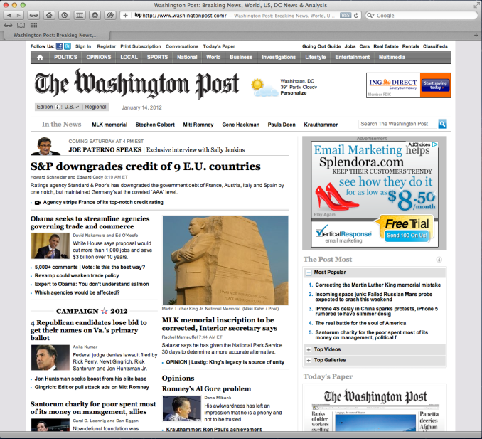
Reviewing Web Sites
A good Web site has information you can trust.
Consider the site's relevance, accuracy, authority, comprehensiveness, and bias to decide if the site is a reliable source of information.

Slide 5
Relevance
Considerations:
Clarity of information
Pictures, charts, sounds, video?
Useful new information
A Web site is relevant when it contains the information you need in a format that you can use.

Slide 6
Accuracy
Considerations:
Reliable
Verifiable
Current
When you check a site for Accuracy, consider the source of the information.

Slide 7
Authority
Considerations:
Contact information
Domain name (.edu, .org, and .gov domains carry the authority of the institution that they represent)
Anyone can make a Web site and claim to be an expert on a subject. Look for evidence that the individual author, organization or agency is recognized as knowledgeable and qualified.

Slide 8
Comprehensiveness
Considerations:
Purpose
Scope
Links
When you evaluate a site, check to see how completely it covers its intended topic.

Slide 9
Bias
Considerations:
Objectivity
Representation
Editorial opinions identified
Advertisements
Bias is presenting information to promote a specific point of view without including alternate views. On a Web site, distorted data, missing or incomplete information, emotional or inflammatory arguments, and personal attacks are examples of bias.

Slide 10
Evaluate It- Lesson 1
Summary:
Identify factors to consider when reviewing Web-based information

