Slide 1
Microsoft Office 2010 - Illustrated Fundamentals
Unit B:
Understanding File Management

Slide 2
Objectives
Understand folders and files
Create and save a file
Explore the files and folders on your computer
Change file and folder views

Slide 3
Objectives (cont.)
Open, edit, and save files
Copy files
Move and rename files
Search for files, folders, and programs
Delete and restore files

Slide 4
Unit B Introduction
To organize with files and folders you need to understand how your computer stores them
File management skills help you save a file in a place where you can find it later
To keep your computer files organized, you will need to copy, move, and rename them
When you have files you no longer need, it is a good idea to delete them so that you only have current files store on your computer

Slide 5
Understanding Folders and Files
File management refers to the strategy and tasks that you use to organize and maintain the folders and files on a disk
When you save files, you usually save them inside folders, which are storage areas on your computer
The files and folders on your computer are organized in a file hierarchy, a system that arranges files and folders in different levels

Slide 6
Understanding Folders and Files (cont.)
The following guidelines will help you to organize your files:
use the Start menu or double-click a folder to open Windows Explorer to view folders and subfolders, which are folders inside folders
view files in windows which are divided into sections
the Navigation pane on the left shows the folder structure
the File list on the right displays the contents of an open folder
the Details pane at the bottom provides information about selected files in the File list

Slide 7
Understanding Folders and Files (cont.)
understand file addresses
a window contains an Address bar which shows the location or address of the files in the File list
an address is a sequence of folder names that displays the path to a desired file or folder and displays all levels of the computer hierarchy

Slide 8
Understanding Folders and Files (cont.)
navigate upward and downward using the Address bar and File list
to navigate upward click a folder or subfolder in the Address bar
to navigate downward double-click a subfolder in the File list
you can also use the Navigation pane to navigate among folders

Slide 9
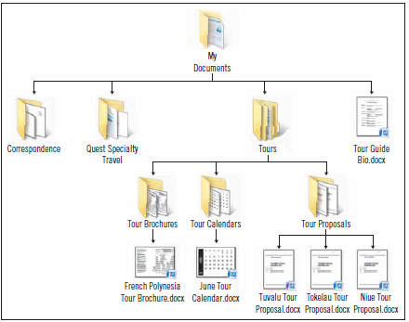
Understanding Folders and Files (cont.)
Sample folder and file hierarchy

Slide 10
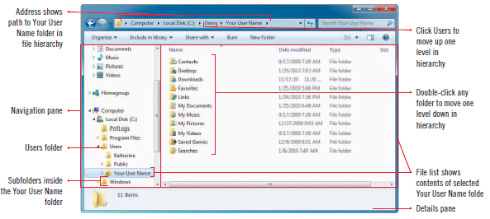
Understanding Folders and Files (cont.)
Windows Explorer window

Slide 11
Plan your file organization
First, identify the types of files you wish to work with, such as images, music, reports
Think of a folder organization that will help you find them later, such as use subfolders in the My Pictures folder to separate and group photos
In the My Documents folder you might group personal files in one subfolder and business files in another subfolder
Folder structures can be reevaluated and changes made if desired

Slide 12
Creating and Saving a File
When you create a new file it exists in your computer’s RAM (Random access memory) which is temporary storage
RAM only contains information when your computer is on
turning off your computer automatically clears the contents of RAM so files need to be saved if wanting to keep them
One important storage device is your computer’s hard disk
Another popular storing option is a USB flash drive, which is universal, small and portable

Slide 13
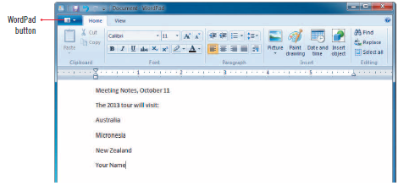
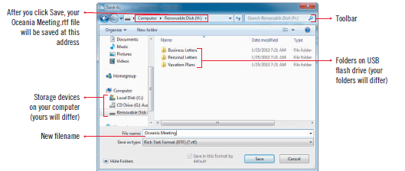
Creating and Saving a File (cont.)
Saving a document
Save As dialog box

Slide 14
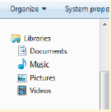
Using Windows 7 libraries
A library gathers files and folders from different locations on your computer and displays them in one location
Files stay in the same place but the file name appears in the library
A library is not a folder that stores files, but rather a way of viewing similar types of documents that are stored in multiple locations
Deleting a library does not delete the file
Libraries

Slide 15
Exploring the Files and Folders on Your Computer
Even if you are not saving a document, you will want to examine your computer and its existing folder and file structure
In a Windows Explorer window, you can navigate through your computer contents using the File list, the Address bar, and the Navigation pane

Slide 16
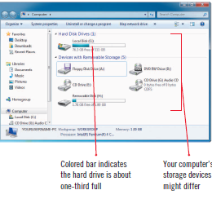
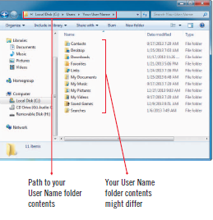
Exploring the Files and Folders on Your Computer (cont.)
Your User Name folder
Window showing storage devices

Slide 17
Exploring the Files and Folders on Your Computer (cont.)
Drive names and icons

Slide 18
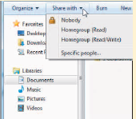
Sharing Information with homegroups and libraries
Windows 7 lets you create a homegroup, a named set of computer that can share information
If your computer is in a homegroup you can share libraries and printer
Sharing a library

Slide 19
Changing File and Folder Views
You can change the file and folder views to see as many files and folders at a time, or details about a file or folder
Windows 7 lets you choose eight different views
Each view provides different information about the files and folders
You can list files and folders by different size icons

Slide 20
Changing File and Folder Views (cont.)
You can sort files and folders to change the order in which the folders and files are listed
If you want to see what a file looks like, but don’t want to open it, you can see a preview of it in the Preview pane
the Preview pane is an area on the right side of a window
it is especially useful for document files so that you can see the first few paragraphs of a large document

Slide 21
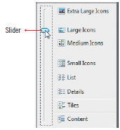
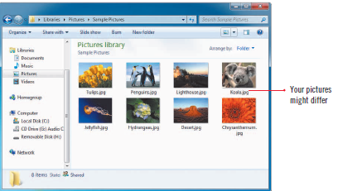
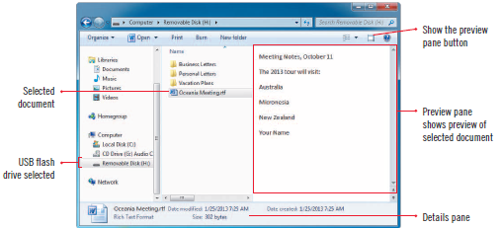
Changing File and Folder Views (cont.)
More options shortcut menu
Viewing in large icons
Preview of selected file

Slide 22
Opening, Editing, and Saving Files
Once a file is created and saved, you can easily open and edit, make changes to it
Examples of editing a file could be, adding to it, deleting text, or changing a color in a drawing
After completing the edits you want, you then save the file again and the “new” file with the edits replaces the existing file
When you save a file that you have changed you use the Save command

Slide 23
Comparing Save and Save As
The first time you save a file, the Save As dialog box opens whether you choose Save or Save As
in the Save As dialog box you choose the drive and folder where you want to save the file, and then enter its filename
If you edit a previously saved file, you can save the file using the Save command
The Save command updates the stored file
If wanting to save and name a copy of the file differently you use the Save As command

Slide 24
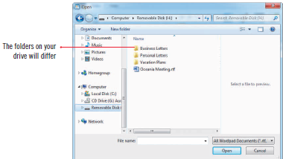
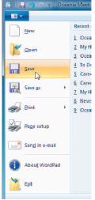
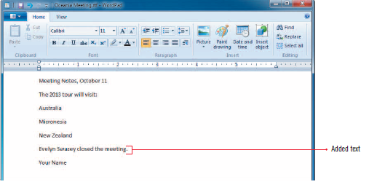
Opening, Editing, and Saving Files (cont.)
Navigating the Open dialog box
Saving a revised file
Edited document

Slide 25
Copying Files
At times you may want to put a copy of a file on a different storage device to share
Or you may want to create a copy as a backup, or replacement, in case something happens to your original file
Copying files and folders is easy using the Copy command and then place the copy in another location using the Paste command
Copying and pasting a file leaves the file in its original location

Slide 26
Copying Files (cont.)
When you use the Copy command, Windows 7 places a duplicate copy of the file in an area of RAM called the clipboard
The file, in the clipboard, is ready to copy to a new location
The file remains in the clipboard until you copy something else or end your Windows 7 session
You cannot have two copies of the file with the same name in the same folder

Slide 27
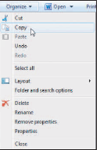
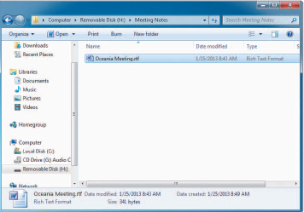
Copying Files (cont.)
Pasted duplicate file
Coping a file

Slide 28
Copying files using Send to
You can copy and paste a file to an external storage device using the Send to command
Selected Send to menu commands

Slide 29
Moving and Renaming Files
You can move files and folders to a different folder on the same drive or a different drive
When you move a file, the file is transferred to the new location
You can move a file using the Cut and Paste commands
After creating a file you may find that the original filename isn’t clear so you can rename it to make it more descriptive or accurate

Slide 30
Moving and Renaming Files (cont.)
Cutting a file
Pasted file in Documents library
Renaming a file

Slide 31
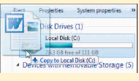
Using drag and drop to copy or move files to new locations
Drag and Drop is a technique in which you use your pointing device to drag a file or folder into a different location and then drop it
Using drag and drop does not copy your file to the clipboard
If you drag and drop a file to a folder on another drive, Windows copies the file
If you drag and drop a file to a folder on the same drive, Windows moves the file
Copying a file using drag and drop

Slide 32
Searching for Files, Folders, and Programs
Windows Search helps you quickly find any file, folder or program
You type one or more letter sequences, as your search criteria, to help Windows 7 identify the item you want to locate
Search criteria can be a filename, part of a filename, or any character you choose

Slide 33
Searching for Files, Folders, and Programs (cont.)
To search your entire computer, including its attached drives, you can use the Search box on the Start menu
To search within a particular folder, you can use the Search box in a Windows Explorer window
Your search results will differ, depending on the programs and files on your computer
File properties are details that Windows stores about a file

Slide 34
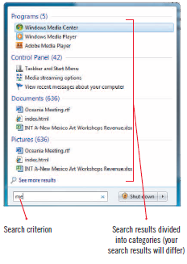
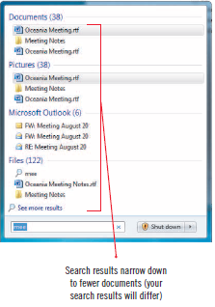
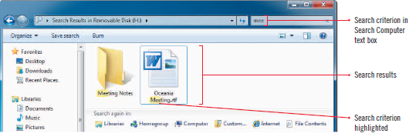
Searching for Files, Folders, and Programs (cont.)
Search Computer text box
Searching on criterion

Slide 35
Deleting and Restoring Files
If you delete a folder (all contents included) or file from the hard drive, Windows 7 places the folder or file in the Recycle Bin
If you delete a folder or file and then change your mind, you can open the Recycle Bin and restore the folder or file to its original location
Deleting files that are no longer needed keeps your computer uncluttered

Slide 36
Deleting and Restoring Files (cont.)
If you delete a folder or file from removable storage media, such as a USB flash drive, the folder or file is not placed in the Recycle Bin and they are permanently deleted and cannot be restored
Emptying the Recycle Bin permanently removes the deleted folders and files from your computer

Slide 37
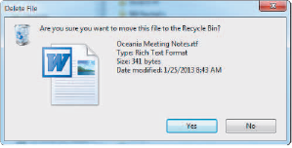
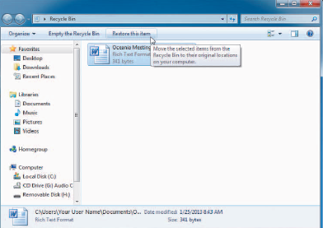
Deleting and Restoring Files
Delete file dialog box
Restoring a file

Slide 38
Selecting more than one file
To select a group of items that are next to each other, click the first item in the group, press and hold [Shift], then click the last item and the first, last and all items in between are selected
To select files that are not next to each other, click the first file, press and hold [Ctrl], then click the other items you want to select as a group

Slide 39
Summary
File Management skills help you work with the files and folders on your computer
File hierarchy is a system that arranges files and folders in different levels
Files exist in RAM when being created and then are saved to a permanent storage device
You can view your folders and files in eight different views depending on what you want to see

Slide 40
Summary
You can edit, or make changes to all files and when you resave the file it automatically replaces the original
Use Save As the first time you save a file, or to rename or to place a file in a different location
Copying a file makes a copy of the file and places it in a different location of your choice
Moving a file moves the files to a new location
You can enter search criteria in the Search box to help locate a file, folder, or program

