Slide 1
Microsoft Office 2010 - Illustrated Fundamentals
Unit C: Getting Started with
Microsoft Office 2010

Slide 2
Objectives
Understand Microsoft Office 2010 Professional
Start an Office program
Use the Ribbon and Zoom controls
Use the Quick Access toolbar

Slide 3
Objectives (cont.)
Save a file using Backstage view
Get Help
Exit an Office program

Slide 4
Unit Introduction
Microsoft Office 2010 is a collection (or suite) of programs that you can use to produce a wide variety of documents
Office 2010 Professional includes Word, Excel, Access, PowerPoint, Outlook, Publisher, and OneNote
One new benefit of Office 2010 is that it lets you work collaboratively with others no matter where they are

Slide 5
Understanding Office 2010 Professional
Office 2010 Professional Edition comes with a variety of programs and tools you can use
A powerful benefit of Office 2010 is Microsoft Office Web Apps:
a scaled down version of Microsoft Office applications that run over the internet
promotes a collaborative working environment even from different locations

Slide 6
Understanding Office 2010 Professional (cont.)
Microsoft Office 2010 Professional contains the following programs:
Microsoft Word - word processing
Microsoft Excel - spreadsheet
Microsoft Access – database management
Microsoft PowerPoint – presentation graphics
Microsoft Outlook – e-mail and info manager
Microsoft Publisher – desktop publishing
Microsoft OneNote – capture and store info
Examples of applications on the next 2 slides

Slide 7
Understanding Office 2010 Professional (cont.)
Report created in Word
Worksheet and chart in Excel

Slide 8
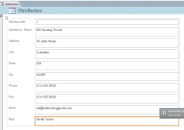
Understanding Office 2010 Professional (cont.)
Report created in Access
Presentation slide created in PowerPoint

Slide 9
Starting an Office Program
You can launch, or start the Office program many ways, such as using the Start button and All Programs
In the program window you will be working with a user interface, which is a collection of buttons and tools used to interact with software programs

Slide 10
Starting an Office Program (cont.)
Using Word as the example, there are several elements available including:
Title bar – located at the top of the program window containing the name of the document
Ribbon – contains commands in the form of buttons
Command is an instruction given to the computer
Tabs – contain different sets of commands
each tab is organized into groups of related commands

Slide 11
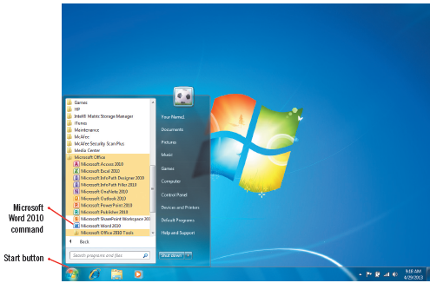
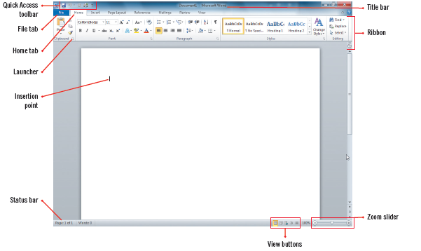
Starting an Office Program (cont.)
Start Menu
Word program window

Slide 12
Using the Ribbon and Zoom Controls
In all Office programs, you use the Ribbon to initiate commands
some commands are the same across Office programs and some vary depending on the application
The View tab has similar commands you can use to:
switch to predefined view
adjust the magnification level
Many Office programs also contain a Zoom slider on the status bar to adjust the magnification level as well as View shortcut buttons

Slide 13
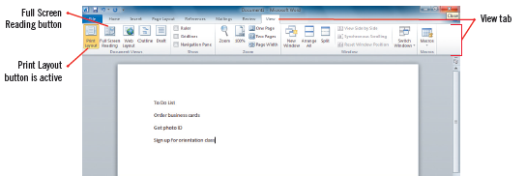
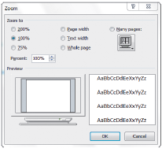
Using the Ribbon and Zoom Controls (cont.)
Document in Print Layout view
Full Screen Reading view
Zoom dialog box
Zoom set to 200%

Slide 14
Using the Quick Access Toolbar
The buttons on the Quick Access toolbar, located just above the Ribbon on the left side, are available anytime except when the File tab is active
Default buttons on the Quick Access Toolbar include:
Save a file
Undo your last action
Redo the last action you undid
these buttons are available on other tabs in the Ribbon but not all the time
The Quick Access toolbar lets you work faster
Buttons you frequently used can be added

Slide 15
Customizing the Quick Access Toolbar
To add buttons to the Quick Access toolbar:
click Customize Quick Access toolbar button and then select which commands you use frequently to add to the Quick Access toolbar
You can also remove any button from the Quick Access toolbar if you find you are not using as much as you did

Slide 16
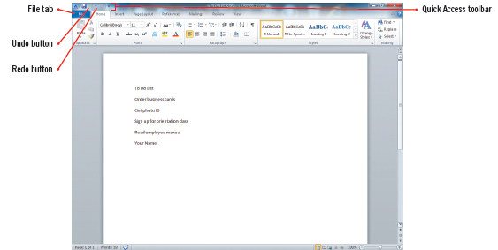
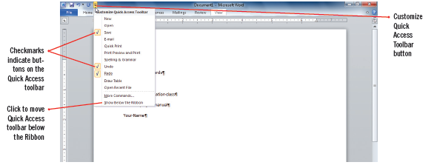
Using the Quick Access Toolbar (cont.)
Completed To Do List
Customize quick Access Toolbar

Slide 17
Saving a File Using Backstage view
To keep a document permanently it needs to be saved to a specific place, such as a folder, hard drive, removable flash drive, or network on the internet
Use the Save As to save a file for the first time when assigning a unique filename and file extension, which identifies the program used to create the document
you can access the Save As command in Backstage view, which provides commands and tools to help you work with files such as viewing, setting document properties and printing files
Access Backstage view by clicking the File tab on the Ribbon

Slide 18
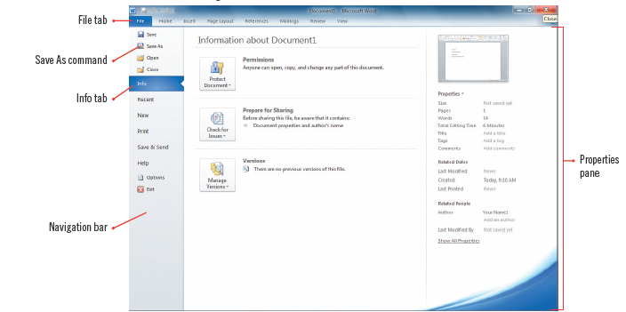
Saving a File Using Backstage view (cont.)
Backstage view with Info tab selected

Slide 19
Windows Live and Microsoft Office Web Apps
All Office programs include the capability to incorporate online collaboration-across the internet or a company network
Using cloud computing (work done and stored in a virtual environment) you can take advantage of Web programs, Microsoft Office Web Apps, which are simplified versions of the programs in Office 2010
The programs are online and take up no computer disk space
These programs are accessed using Windows Live SkyDrive, a free service from Microsoft Windows Live

Slide 20
Getting Help
Help is context-sensitive in that it displays topics and instructions geared to the specific task
The Help system is integrated with the Microsoft Office Online Web site
When pointing to a command on any tab, a Screen Tip opens displaying a description
many screen tips also direct you to press [F1] for additional information
If using the Search text box in Help it searches for a keyword, which is searchable word that is contained in Help

Slide 21
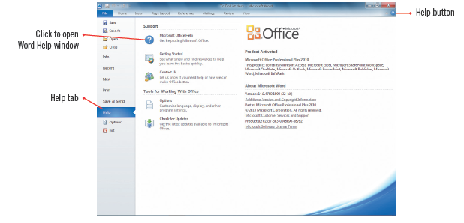
Getting Help (cont.)
Help tab/Backstage view

Slide 22
Exiting an Office Program
You can use Backstage view to close your document, and then quickly locate it again using the Recent tab
The Recent tab, opens by default in Backstage view when no documents are open and displays a list of recently opened documents
When you are finished working in an Office program, you use the File tab to exit the program

Slide 23
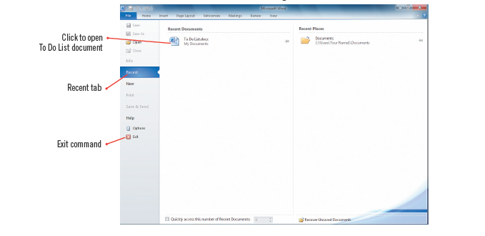
Exiting an Office Program (cont.)
Recent Documents tab and Exit command in Backstage View

Slide 24
E-mailing your saved documents
You can e-mail your saved documents easily from with Office using the Save & Send page in Backstage view
Attach the document to an e-mail message and send
If your file is already saved in a shared location, you can click the Send a Link button to create an e-mail containing a link to where the recipient can download the document

Slide 25
Summary
You can use Microsoft Office 2010 to create a wide variety of documents
Office 2010 Professional contains Microsoft Word, Excel, Access, PowerPoint, Outlook, and Publisher
Office programs share many common elements
You choose commands using buttons and commands on the Ribbon and Quick Access toolbar

Slide 26
Summary
You need to save any data you enter during an Office work session as a file with a unique filename
Microsoft Office comes with an extensive Help system
When you are finished working with a program, you should save your work and exit the program

