Slide 1
Microsoft Office 2010 - Illustrated Fundamentals
Unit D: Creating a Document

Slide 2
Objectives
Create a new document from an existing file
Enter text in a document
Select and edit text
Copy text
Move text

Slide 3
Objectives
Find and replace text
Format text using the Mini toolbar
Check spelling and grammar
Preview and print a document

Slide 4
Unit Introduction
You can create professional-looking documents using Microsoft Word 2010
You will learn the basic skills to create, edit, and print a document
Additional functions will include learning how to:
Copy and move text
Find and replace text
Check spelling and grammar
Preview a document before printing

Slide 5
Creating a New Document from an Existing File
At times it is useful to create a new document that uses content from an existing document
Open the existing document and before making any changes you can use the Save As command to save a copy of the document
This keeps the original file intact in case you want to use it again
Using an existing document saves time and trouble of creating a new document from scratch

Slide 6
Creating a new document from a template
Certain types of documents are easily created using a template in Word 2010
a template is a file that contains formatting and layouts for a business letter, a memo, reports, and more
there are several templates in the Available Templates section that can be used
after selecting a template, a new document based on that template, opens ready for you complete
You can find additional templates at the Office.com site

Slide 7
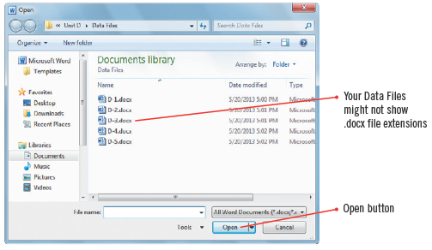
Creating a New Document from an Existing File (cont.)
Open dialog box

Slide 8
Entering Text in a Document
To add text to a document, click to position the insertion point, the blinking vertical line, where you want to insert text, and then start typing
Typing text is also called entering text
Before you start typing, check that you are viewing the document in a way suited to entering and editing text
Draft view is best for entering and editing text
in Draft view, several of the page elements are hidden
it is a good idea to turn on formatting marks to see the blank spaces and paragraph marks

Slide 9
Entering Text in a Document (cont.)
As you type the words move down, or wrap, to the next line automatically when the insertion point reaches the right margin
While entering text, if you type “teh” the AutoCorrect feature will automatically make the correction to “The”
You can work with Styles, which are settings that control how text and paragraphs are formatted
each document has its own set of styles which can be easily changed

Slide 10
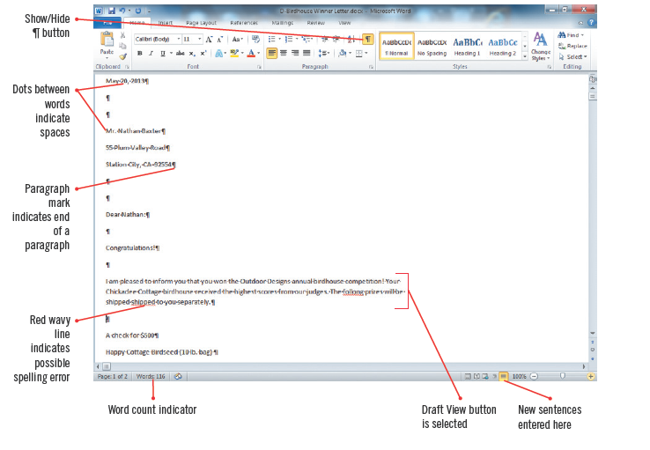
Entering Text in a Document (cont.)
Word document with additional added text

Slide 11
Using AutoCorrect
The AutoCorrect feature works automatically to catch and correct incorrect spelling of common words as you type them
You can change AutoCorrect settings in the AutoCorrect dialog box

Slide 12
Selecting and Editing Text
You can modify or edit text in many ways
click to the right of unwanted text, then press [Backspace]
click to the left of unwanted text, then press [Delete]
Select or highlight unwanted text, or paragraphs of text then type new text to replace it

Slide 13
Selecting and Editing Text (cont.)
To be able to edit text you need to move the Insertion point around the document; you can use:
Point and click
using the keyboard
place the mouse pointer in the selection bar, area to the left of the left margin to select entire lines

Slide 14
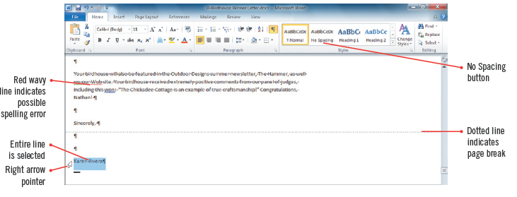
Selecting and Editing Text (cont.)
Selecting a line of text

Slide 15
Selecting and Editing Text (cont.)
Methods for selecting text

Slide 16
Copying Text
Copying leaves the text in the original location
Pasting moves a duplicate of it to a specified location
To copy and paste text, you first need to select the text to copy
The Copy command places a copy of the selected text on the Windows Clipboard, a temporary storage are in your computer’s memory
the Paste command inserts the copied text to a new location

Slide 17
Copying Text (cont.)
If you need to copy multiple items, you can use the Office Clipboard, which works with the Windows Clipboard
stores up to 24 terms at a time and is available only in Office programs
To use the Office Clipboard, you need to open the Clipboard task pane
To use drag and drop; select the text to copy, press and hold [Ctrl] then use the mouse to drag a copy of the selected text to the new location
items do not get placed on the Windows or Office Clipboard

Slide 18
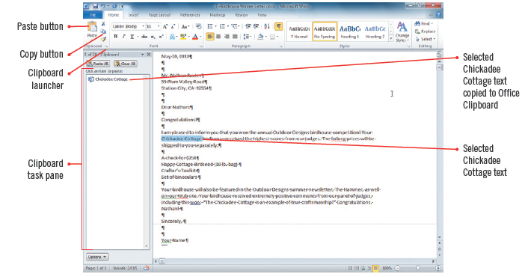
Copying Text (cont.)
Selected text copied in the office Clipboard

Slide 19
Moving Text
Moving text removes it from the original location and places it in a new specified location
You can move text from one location to another using these methods:
using the Cut command removes selected text and places it ion the Windows Clipboard
use the paste button to place the cut text in another location
Selecting and dragging selected text to a new location
items will not be copied to the Windows or Office Clipboard

Slide 20
Activating the Office Clipboard
The Office Clipboard stores multiple items only if it active
Opening the Clipboard task pane automatically makes it active
If wanting to activate the Office Clipboard without showing the task pane, click Options to set it not to Collect Without Showing Office Clipboard
If the Office Clipboard is not active, you can only copy one item at a time using the Windows Clipboard

Slide 21
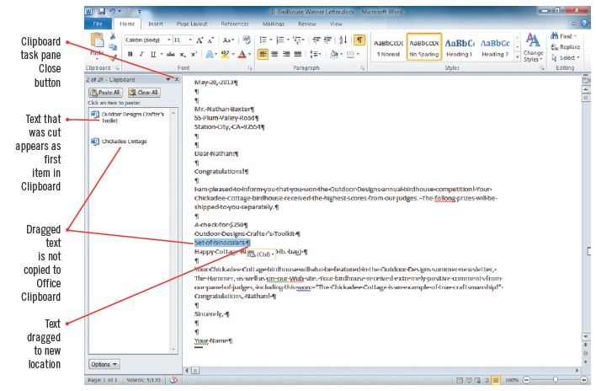
Moving Text (cont.)
Moving text by dragging it

Slide 22
Finding and Replacing Text
The Replace command helps you quickly and easily substitute a new word or phrase for one or more occurrences
Use the Find and Replace dialog box to specify the text you want to find and the text with which you want to replace it
You can replace every occurrence of the text in one action, or you can review each occurrence and choose to replace it or keep the text

Slide 23
Using the Navigation pane to find text
You can use the Navigation pane to quickly locate and highlight all instances of specified text
Use Find, type the text you want to find in the Search box
all instances of the text are highlighted in yellow in the document
the Navigation pane displays excerpts containing the text
click any excerpt in the Navigation pane to jump to the location of the instance of the text

Slide 24
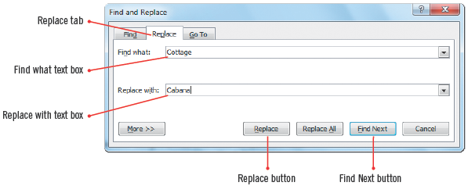
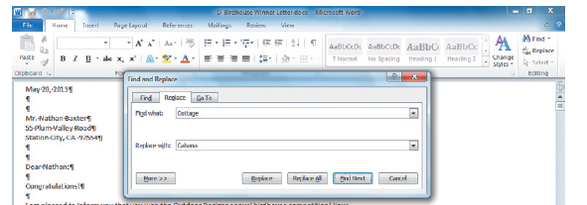
Finding and Replacing Text (cont.)
Find and Replace dialog box
Found text

Slide 25
Using the Research task pane
You have a powerful research tool in Office 2010, called the Research task pane
allows you look up information from several data sources provided by Microsoft and a growing number of partners
when the Research task pane opens on the right side of your screen providing the definition from Wikipedia, as well as additional information
you can also tap into many other data sources in the Research task pane, including a thesaurus, Bing, and several business and financial sites

Slide 26
Formatting Text Using the Mini Toolbar
The Mini toolbar contains only the most common formatting commands
Use the Mini toolbar to make quick formatting changes to selected text
change the font (the design of a set of characters) such as Arial or Times New Roman
change the font style (bold, underline, italic)
change font size of selected text so that it is larger or smaller

Slide 27
Formatting Text Using the Mini Toolbar (cont.)
You can format selected paragraphs as a bulleted list using the shortcut menu
the shortcut menu opens above or below the Mini toolbar when you right-click the selected text
All of the Mini toolbar buttons are also available on the Home tab

Slide 28
Formatting Text Using the Mini Toolbar (cont.)
Using the Mini toolbar to format text

Slide 29
Checking Spelling and Grammar
Word provides tools to ensure your documents are free of errors
AutoCorrect feature corrects errors as you type (changes “teh” to “the”)
Word identifies possible misspellings with red wavy underlines and possible grammatical errors with green wavy underlines
the program identifies possible misspelled words by comparing each word to its built-in dictionary
you can open the Spelling and Grammar dialog box or right-click flagged misspelled words to identify and correct errors

Slide 30
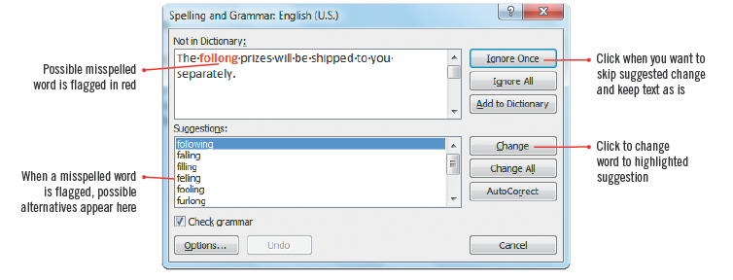
Checking Spelling and Grammar (cont.)
Spelling and Grammar dialog box

Slide 31
Translating words or documents into other languages
Word 2010 has the ability to translate any word in your document into more than 20 different languages
The Mini Translator displays a screen tip of any word your point to in a specified language
To use the Mini Translator you need to first specify the language to be used

Slide 32
Previewing and Printing a Document
When you finish creating and editing a document, you can print it using the Print tab in Backstage view
The Print tab tools specify various print settings, printer selection, how many copies or specific pages to print
On the Print tab a preview of the document can be seen so that you can see exactly how it will look when printed
using Print Preview can save paper

Slide 33
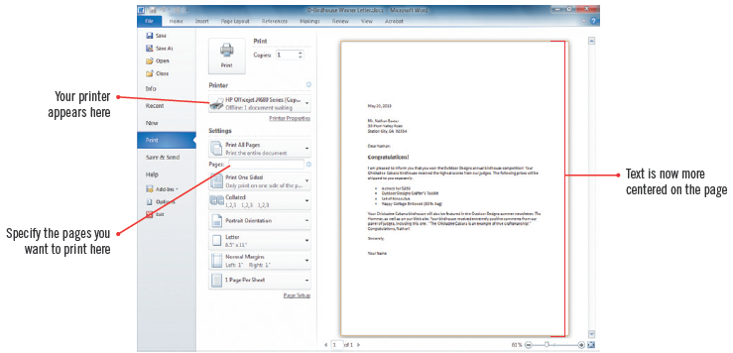
Previewing and Printing a Document (cont.)
Previewing the final document

Slide 34
Previewing and Printing a Document (cont.)
Available views in Word

Slide 35
Summary
Use Word to create documents
Use the Save As command to create a new document that’s based on an existing one
Edit text by placing the insertion point, and using the [Backspace] or [Delete] keys
Copy and move text in a document using Cut, Copy, and Paste commands or by dragging it

Slide 36
Summary
Use Find and Replace dialog box to replace unwanted text with new text
Use the Mini toolbar to make quick formatting changes
Use Spelling and Grammar checker to ensure error-free documents
Preview a document before printing it to ensure it looks the way you want and saves paper

