Slide 1
Microsoft Office 2010 - Illustrated Fundamentals
Unit E: Enhancing a Document

Slide 2
Objectives
Change font and font size
Change font color, style, and effects
Change alignment and line spacing
Change margin settings

Slide 3
Objectives
Set tabs
Set indents
Add bulleted and numbered lists
Apply Quick Styles

Slide 4
Unit Introduction
Microsoft Word provides a variety of tools to enhance the appearance of documents
changing formatting of character and paragraphs
using tools on the Ribbon and Mini toolbar
Quick Styles, a feature that helps to create great-looking documents efficiently

Slide 5
Changing Font and Font Size
Choosing an appropriate font is important when formatting a document
Fonts help communicate the tone of the document
You can use either the Home tab or the Mini toolbar to change font and font size
Fonts and font sizes can be set before typing or by selecting text and applying changes
Live Preview makes it possible to preview how a formatting option will look before actually choosing the option

Slide 6
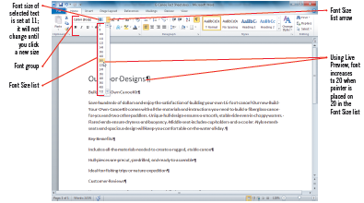
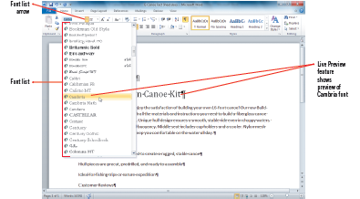
Changing Font and Font Size (cont’d)
Changing the font size using the Font Size list
Changing font type using the Font list

Slide 7
Changing Font and Font Size (cont’d)
Samples of fonts and font sizes

Slide 8
Changing Font Color, Style and Effects
Font attributes such as bold (darker type), italic (slanted type), and underline are used to emphasize certain words, or phrases
You can make certain words stand out by changing their color
Font effects, are special enhancements, such as shadow or strikethrough can be applied to selected text
You can use buttons in the Font group, or to save time you can use the Format Painter to copy formatting of selected text to other text

Slide 9
Changing Font Color, Style and Effects (cont.)
Themes, a predesigned set of formatting elements, including colors, can be used to coordinate the look of your document
Standard colors, are the basic hues red, orange, and so on
More Colors are used to specify a particular color shade

Slide 10
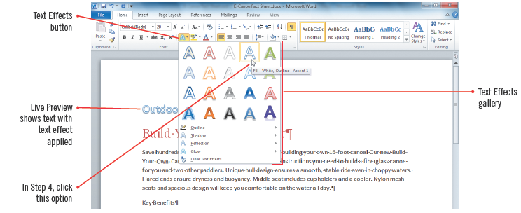
Changing Font Color, Style and Effects (cont.)
Applying a text effect

Slide 11
Changing Alignment and Line Spacing
A margin is the amount of space between the edge of the paper and the text
You can change the alignment, or position of text within a document’s margins
use the alignment buttons or specific buttons such as:
the Center button on the Mini toolbar as titles are often centered,
headings left-aligned and paragraphs justified (placed equally between the left and right margins)

Slide 12
Changing Alignment and Line Spacing (cont.)
Using the Line Spacing button adjusts the spacing between lines or between paragraphs
in Word, a paragraph is any text that ends with a hard return; it can be a one-word title or lengthy
Center-aligning text places the text equally between margins

Slide 13
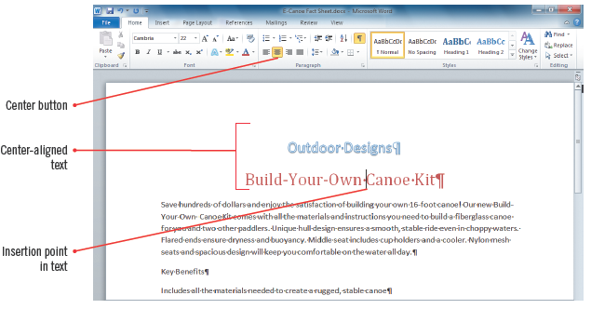
Changing Alignment and Line Spacing (cont.)
Center-aligned text

Slide 14
Changing Margin Settings
By default, Word sets margins at
one inch from the top and bottom of the page
one inch from the left and right sides of the page
Word provides a number of additional preset margin settings
If none of the preset margins work, you can specify custom settings
When you change margins, Word automatically adjusts line wrapping and repaginates (renumbers the document pages)

Slide 15
Changing Margin Settings (cont.)
To evaluate what margin settings to use in a document:
set the zoom level to One Page to work with the actual margins as they will appear on the page
The margins tab contains Margins text boxes, a Preview section, and a Default button (to restore default settings, or the settings that are automatic

Slide 16
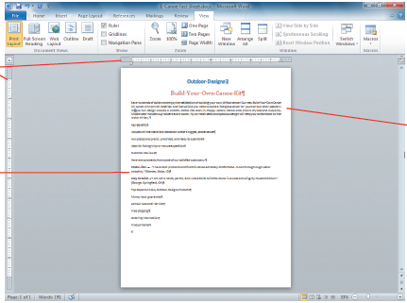
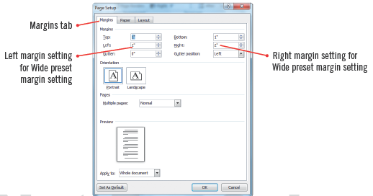
Changing Margin Settings (cont.)
Narrow margins setting
Margins tab

Slide 17
Setting Tabs
A tab is a set position where text following a tab character aligns
pressing [Tab] inserts a tab character, which appears as a right-facing arrow
The ruler makes it easy to set tab stops (locations the insertion point moves to when you press [Tab]
By default, Word sets left-aligned tab stops every –one-half inch
the default tab stops are marked as small black slashes in the thin gray bar below the ruler

Slide 18
Setting Tabs (cont.)
Tab stops added to the ruler appear as a tab icon and override the default tab stop setting to the left of it
By default, new tab stops that you set on the ruler are left-aligned
you can use the tab indicator on the ruler to align text differently such as to the right, or center
When you set tabs, they apply only to text you select, or if no text is selected, to the paragraph containing the insertion point

Slide 19
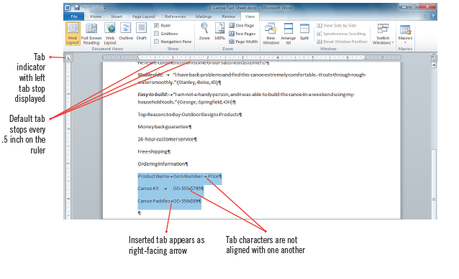
Setting Tabs (cont.)
Tabs inserted

Slide 20
Setting Indents
An indent is a set amount of space between the edge of paragraph and the right or left margin
a first line indent indents the first line of text in a paragraph
a left indent indents the left edge of an entire paragraph
a right indent indents the right edge of an entire paragraph
a hanging indent align the text below the first line of paragraph text

Slide 21
Setting Indents (cont.)
You can set indents using the sliding markers on the ruler, or
You can set left and right indents at one-half inch increments using the Increase Indent and Decrease Indent buttons on the Mini toolbar

Slide 22
Setting Indents (cont.)
Ruler markers used for setting indents

Slide 23
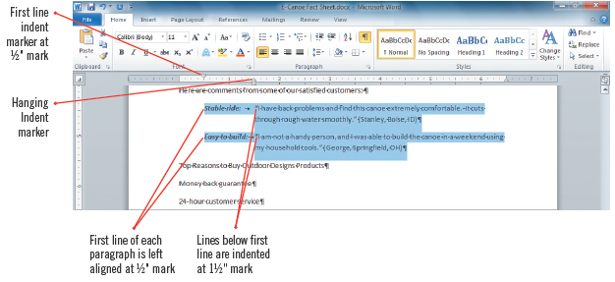
Setting Indents (cont.)
Setting a hanging indent

Slide 24
Adding Bulleted and Numbered Lists
You can organize paragraphs into bulleted or numbered lists
there are many bullet and numbering styles to choose, or you can create a custom style
Word sets off the paragraph with a bullet and automatically formats the text with a hanging indent
Use a numbered (ordered) list when you want to present items in a particular sequence
A bulleted (unordered) list is used when the items are of equal importance

Slide 25
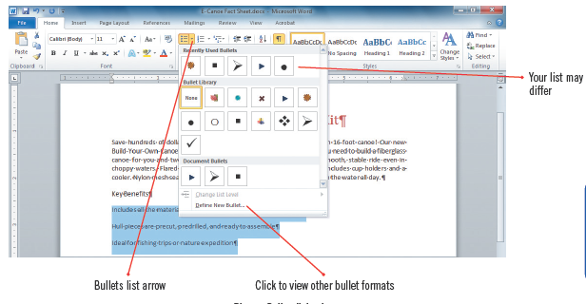
Adding Bulleted and Numbered Lists (cont.)
Bullet library

Slide 26
Applying Quick Styles
A style is a set of predefined formatting characteristics for characters or paragraphs
every new Word document has built-in styles such as the Normal style for paragraph text and the Heading 1 style for headings
you can use styles to easily format your documents
To apply a style, you can choose from Quick Styles, which are available in the Quick Styles gallery, or other styles available in the Style pane

Slide 27
Applying Quick Styles (cont.)
Once you apply styles to a document, you can then change the look of the entire document in one click by applying a new Quick Style set
A Quick Style set is a group of professionally coordinated styles
Changing a Quick Style set changes all the Quick Styles in the document

Slide 28
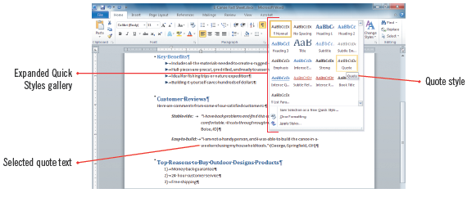
Applying Quick Styles (cont.)
Quick Styles gallery

Slide 29
Summary
You can enhance a document by choosing fonts, colors, styles, and effects to make text stand out
Live Preview lets you preview formatting options before choosing them
You can change alignment and line spacing
Margins are the space between text and the edge of the page

Slide 30
Summary (cont’d)
You can organize text using tabs, indents, and bulleted and numbered lists
Use Quick Styles to save time and ensure that your documents are formatted consistently

