Slide 1
Microsoft Office 2010 -
Illustrated Fundamentals
Unit F: Adding Special Elements
to a Document

Slide 2
Objectives
Create a table
Insert and delete table columns and rows
Format a table
Add clip art
Add footnotes and citations

Slide 3
Objectives (cont’d)
Insert a header or footer
Add borders and shading
Work with themes
Format a research paper

Slide 4
Unit Introduction
Word provides many tools to help in creating professional documents
You can insert a table, graphics, and other special elements
To add visual interest, Word provides a wide variety of clip art, which are ready-made art objects
If your document is multiple pages, using headers and footers on each page is a good idea
To verify sources, Word makes it easy to insert footnotes and citations

Slide 5
Creating a Table
A table is a grid of rows and columns
  the intersection of a row and column is called a cell
  cells can contain either text or graphics
When you create a table, you specify the number of rows and columns
  you can also add and delete rows and columns as you modify a table

Slide 6
Creating a Table (cont.)
You can use tabs to organize text into rows and columns, but working with tables can be easier
A benefit of using tables is that Word provides a wide range of professionally designed table styles that can be applied to your table
Working with tables you will encounter:
  Contextual tabs, meaning they appear only when a type of object is selected
  the symbol in each cell is an end-of-cell-mark
  the marks to the right of each row are end-of-row-marks

Slide 7
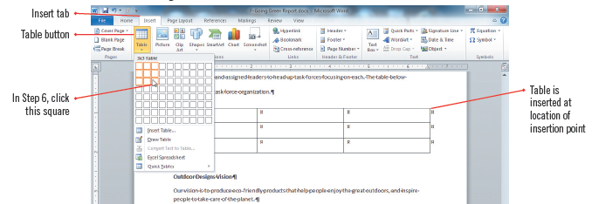
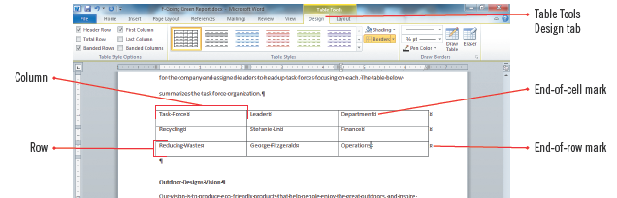
Creating a Table (cont.)
Inserting a 3 x 3 table
Table with information

Slide 8
Inserting and Deleting Table Columns and Rows
After you create a table, you might need to add more information or delete existing information
You can add rows to the top, bottom, or middle of a table; and you can add columns anywhere in a table
Use the commands on the Table Tools Layout tab to add or delete columns and rows

Slide 9
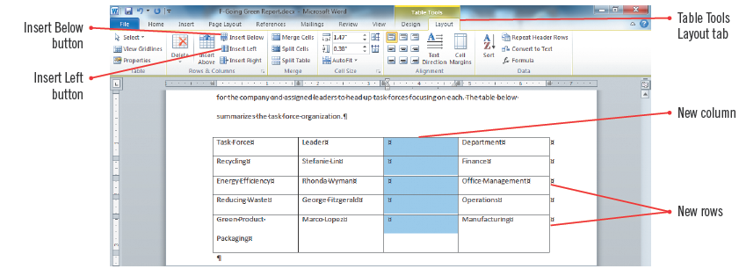
Inserting and Deleting Table Columns and Rows (cont.)
Table with new row and column

Slide 10
Creating a table with the Draw Table button
You can use the Draw Table command to create a table
Drawing a table or cells into an existing table gives you more freedom to create tables with unequal columns, rows, or merged cells

Slide 11
Formatting a Table
After creating a table, it can be quickly formatted by applying a built-in table style, a predefined set of formatting attributes, including:
  fonts, shading, border color
You can also format your table manually by choosing your own settings, but table styles are fast and professional looking
Once a table style is applied, you can further enhance and customize the table’s appearance using the Shading and Borders tools and adjusting column widths

Slide 12
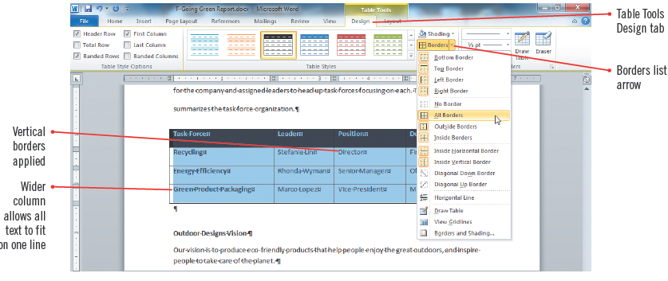
Formatting a Table (cont.)
Formatted table with table style/borders

Slide 13
Adding SmartArt
Microsoft Office 2010 offers many tools for adding graphics to your documents
SmartArt is a feature that lets you easily create professional-looking business diagrams, organizational charts, process diagrams, and time lines

Slide 14
Adding Clip Art
You can insert graphics in your document to add visual interest or illustrate a point
There are hundreds of ready-made images, called clip art, using the Clip Art task pane which allows you search for clip art, animations, videos, photographs which are referred to as clips

Slide 15
Adding Clip Art (cont.)
Word searches the clip art folders on your hard drive and searches the database of clips on the Office Web site, if connected to the Internet
Search results appear as small pictures, called thumbnails, in the task pane
After a clip is inserted into a document, you can enhance it by applying pictures styles, moving or resizing, or setting how the text wraps around it
  images have round sizing handles in the corners and square sizing handles on the side when the image is selected

Slide 16
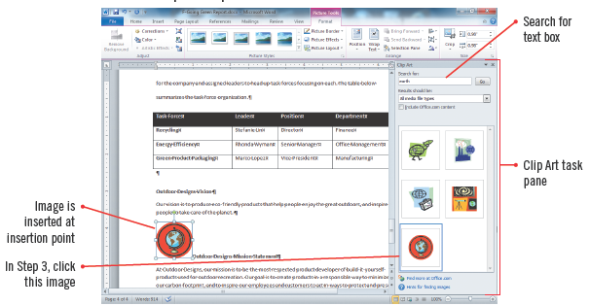
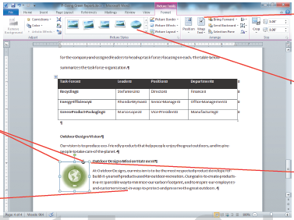
Adding Clip Art (cont.)
Clip Art task pane
Revised image with color and picture style

Slide 17
Adding Footnotes and
Citations
Documents may include quotes or paraphrased material from other sources which need to be given credit
A citation is a reference to a source which may include the author’s name and page number(s)
  there are difference styles for using citations-MLA style is often used for research papers
  citations that follow MLA guidelines appear in parentheses after a quote or paraphrase

Slide 18
Adding Footnotes and
Citations (cont.)
If a document contains citations, it must also include a bibliography, which is a listing of detailed source information for citations
The References tab in Word contains tools to manage sources, insert citations, and add a bibliography
You can use the References tab to add footnotes, a comment that appears at the bottom of a page
  it consists of two linked parts, the reference mark in the body of the document and the corresponding note text

Slide 19
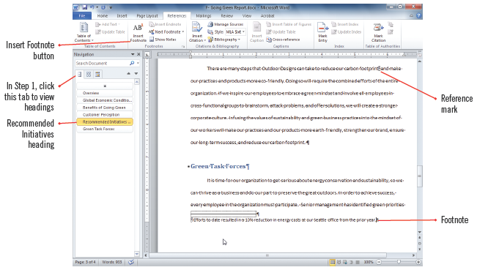
Adding Footnotes and
Citations (cont.)
Footnote added to document

Slide 20
Inserting a Header or Footer
You can easily add headers or footers to a document containing several pages
A header is text that appears in the top margin of each page
A footer is text that appears in the bottom margin of each page
Page numbers, the date, author’s name, or filename are the types of information that can be included
  headers and footers can be formatted as regular text, and add graphics

Slide 21
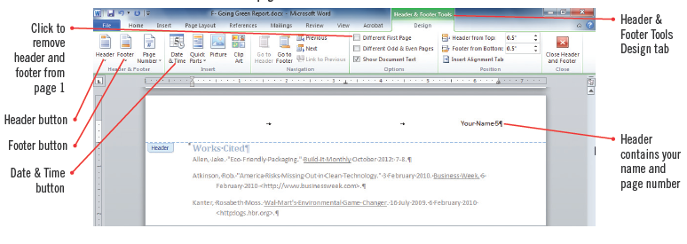
Inserting a Header or Footer
(cont.)
Header with name and page number

Slide 22
Adding Borders and Shading
To add visual interest, you can add borders and shading around text or entire pages
  set a block of text apart from the rest of the page
  apply background shading to words, paragraphs, or graphics
Borders can be added at the top, bottom, left, or right edges of text or graphics
  it is easiest to use the Shading and Borders buttons on the Home tab to add to a document

Slide 23
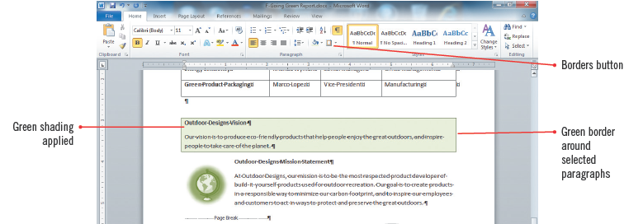
Adding Borders and Shading
(cont.)
Box border and shading applied

Slide 24
Working with Themes
A theme is a coordinated set of colors fonts and effects that are applied consistently throughout a document providing a professional look
You can vary a theme’s fonts and color by applying different sets of theme font and colors
When a theme is applied it updates any styles that had been previously applied
All themes are available in Word, Excel, Access, PowerPoint and Outlook

Slide 25
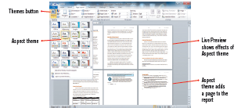
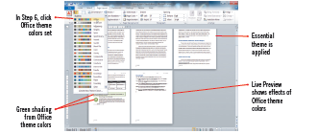
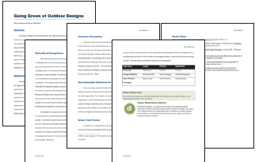
Working with Themes (cont.)
Themes galley showing Live Preview
Theme Colors gallery
Report with themes applied

Slide 26
Formatting a Research Paper
There are guidelines to follow when writing research papers
Modern Language Association (MLA) style is a popular standard for formatting academic research papers
Guidelines help, but for detailed information on MLA architecture, search online

Slide 27
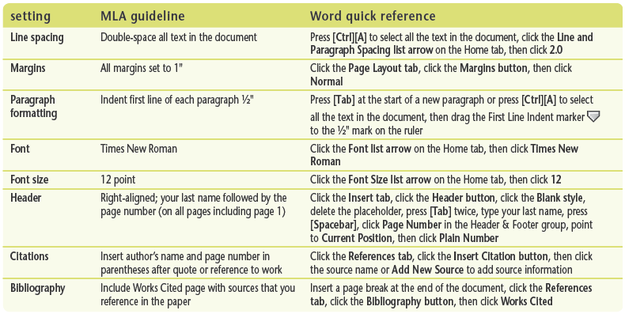
Formatting a Research Paper
(cont.)
MLA guidelines

Slide 28
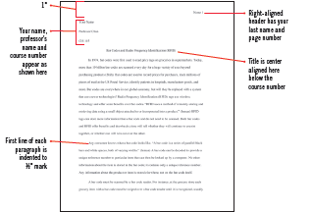
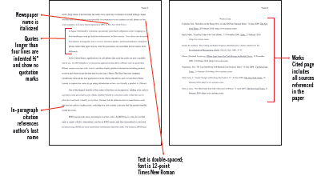
Formatting a Research Paper
(cont.)
First page with MLA style
2nd page and Works Cited page

Slide 29
Summary
Organize detailed information in tables
Choose from a wide-variety of professionally-designed Table Styles
Use the Clip Art task pane to add graphics to documents
Insert footnotes to add citations to documents
Insert a bibliography to display your sources in your document

Slide 30
Summary (cont.)
Add important information such as the date and page numbers to headers and footers
Add borders and shading to draw attention to words, paragraphs, or an entire page
Use themes to apply a coordinated set of fonts, colors, and effects across an entire document
MLA provides guidelines for formatting research papers

