Slide 1
Microsoft Office 2010 - Illustrated Fundamentals
Unit H: Using Complex Formulas,
Functions, and Tables

Slide 2
Objectives
Create complex formulas
Use absolute cell references
Understand functions
Use date and time functions
Use statistical functions

Slide 3
Objectives (cont.)
Apply conditional formatting
Sort rows in a table
Filter table data

Slide 4
Unit H Introduction
Excel includes power data analysis tools:
complex formulas, which perform more than on calculation at a time
Functions are prewritten formulas, many containing multiple operators
Excel tables let you quickly analyze rows of data that has the same kind of information

Slide 5
Unit H Introduction (cont.)
To analyze table data, you can automatically sort the information to change its order and filter it to display only the type of data you specify
Certain data can be made to stand out by applying conditional formatting

Slide 6
Creating Complex Formulas
Complex formulas are formulas that contain more than one operator
When a formula contains multiple operators, Excel uses standard algebraic rules to determine which calculations to perform first
Calculations are performed in this order: calculations in parentheses first, exponential calculations, multiplication, division, addition, subtraction
multiple calculations within parentheses are performed to this same order

Slide 7
Creating Complex Formulas (cont.)
Review of order of operations

Slide 8
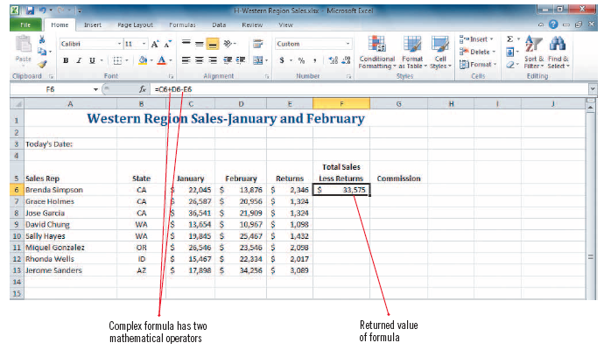
Creating Complex Formulas (cont.)
Complex formula with returned value

Slide 9
Using Absolute Cell References
When you copy a formula from one cell to another, Excel automatically adjusts the cell references
There may be times that you do not want the cell reference to change, in this case you use an absolute cell reference in the formula
An absolute cell reference is a cell reference that always stays the same, even when copying
absolute cell references contain a $ symbol before the column letter and row number (such as $A$1)
to insert an absolute reference, click the cell you want to use and then press [F4]

Slide 10
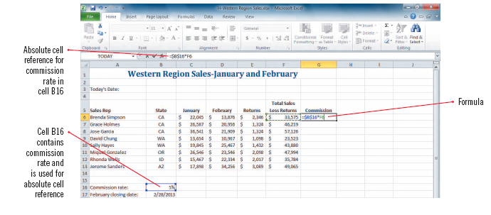
Using Absolute Cell References (cont.)
Using an absolute cell reference

Slide 11
Understanding Functions
Functions are prewritten formulas provided by Excel
You can use a function to compose the formula for you
save time
improve accuracy
can be simple or complex
Each Excel function has a name, usually written in capital letters
the SUM function adds values, the AVERAGE function calculates the average of a specified range

Slide 12
Understanding Functions (cont.)
There are four parts to each function:
equal sign,
function name,
a set of parentheses,
and arguments separated by commas and enclosed in parentheses
Arguments are all the information a function needs to perform a task

Slide 13
Understanding Functions (cont.)
Arguments can be values such as (100 or .02), cell references (such as B3), or range references (such as A9:G16)
Anytime you type an equal sign followed by a letter, a list of valid functions and names beginning with that letter appear which is called Formula AutoComplete

Slide 14
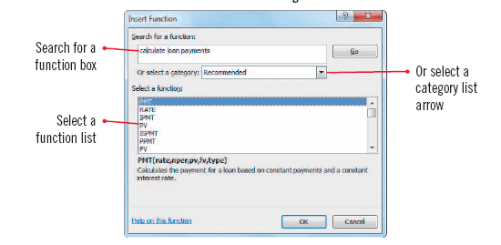
Understanding Functions (cont.)
Insert Function dialog box

Slide 15
Using Date and Time Functions
The Excel date and time functions let you display the current date and/or time in the worksheet
Help you calculate time between events
Some date and time functions produce recognizable text values that can easily be displayed in a worksheet
Other date and time functions produce values that require special formatting

Slide 16
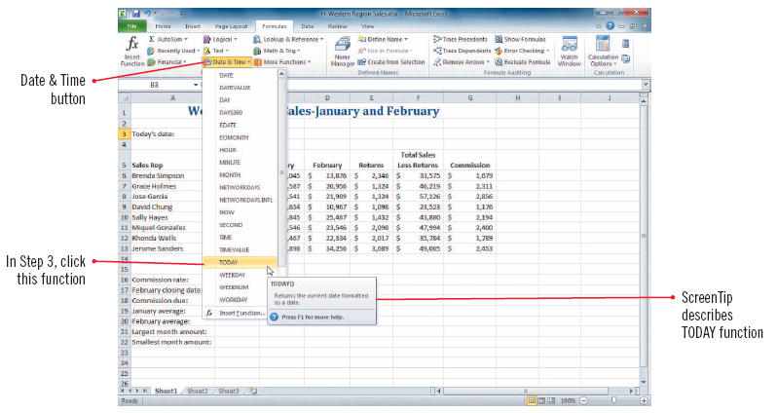
Using Date and Time Functions (cont.)
Inserting the TODAY function

Slide 17
Understanding how dates are calculated using serial values
Dates are stored as serial values (sequentially numbered since Jan. 1, 1900)
Dates are stored as serial values so that they can be used in calculations
Excel displays the serial value that represents the date and you can format the cell to display the date as you desire

Slide 18
Using Statistical Functions
Excel includes many statistical functions with the most popular being AVERAGE, MIN and MAX
Average - calculate the average of a range of cells
MIN/MAX – calculate the smallest or largest value in a range of cells
These functions are available either on the AutoSum list arrow or under Statistical in the More Functions category of the Functions Library or the Insert Functions dialog box

Slide 19
Using the status bar to view average and sum data
The status bar provides information on average and sum on any selected range
When a range of cells containing values is selected, the status bar displays data for the average of the selected cells and the sum of selected cells
The status bar also displays a value for Count, which represents the number of cells selected

Slide 20
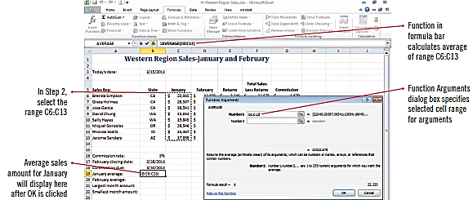
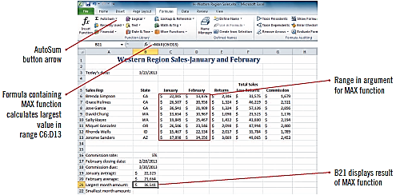
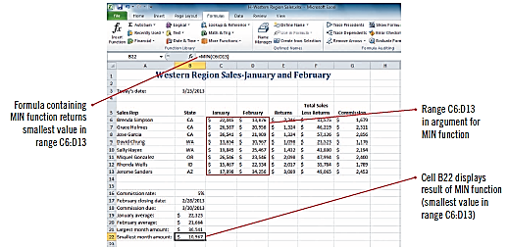
Using Statistical Functions (cont.)
Selecting a range using Function Arguments
Using MAX function
Using MIN function

Slide 21
Applying Conditional Formatting
Conditional formatting is used to highlight or emphasize certain information in a worksheet
you specify the conditions to be met for the data to be emphasized such as highest and lowest product revenues
Excel applies conditional formatting to cells when specified criteria are met
Color scales are shading patterns that use two or three colors to show the relative values of a range of cells
Data bars make it easy to quickly identify the large and small values in a range of cells

Slide 22
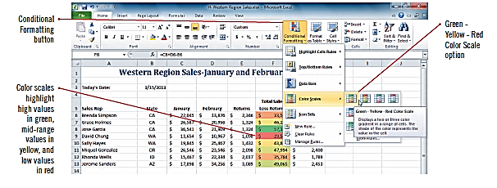
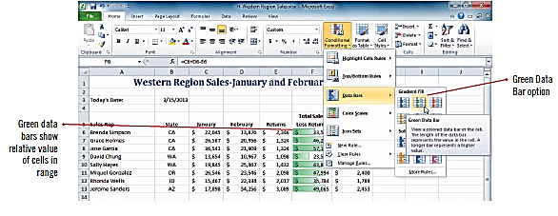
Applying Conditional Formatting (cont.)
Color scales applied
Data bar applied

Slide 23
Sorting Rows in a Table
A table in Excel consists of rows and columns of data with a similar structure
You can manage this data separately from the rest of the worksheet
You can sort, or change the order of the table rows,
You use the Format as Table button to specify the cell range for the table and the appropriate style

Slide 24
Sorting Rows in a Table (cont.)
An Excel table is similar to a table in a database because you can sort data in much the same way
Excel table columns are often called fields and rows of data are called records
In a table, the header row is the row at the top that contains column headings
A total row can be added at the bottom of a table when you want to add totals

Slide 25
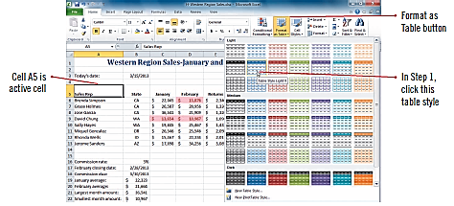
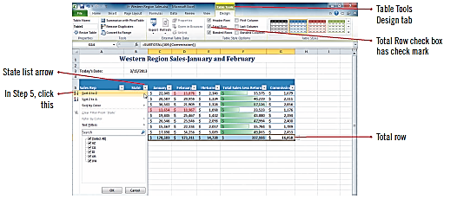
Sorting Rows in a Table (cont.)
Choosing a table style and range
Sorting a list from A to Z

Slide 26
Sorting Rows in a Table (cont.)
Table sorted by two sort criteria

Slide 27
Filtering Table Data
A filter displays only the data you need
You specify the data you need by setting criteria
You can apply a filer to a table by using the filter list arrows that appear to the right of each column heading
A filter does not change the order of the items in the table (like a sort); it temporarily hides data not meeting the specified criteria

Slide 28
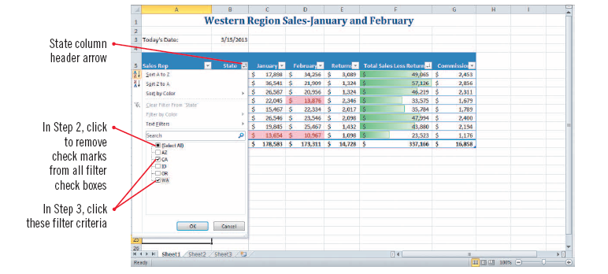
Filtering Table Data (cont.)
Applying filters to the State column

Slide 29
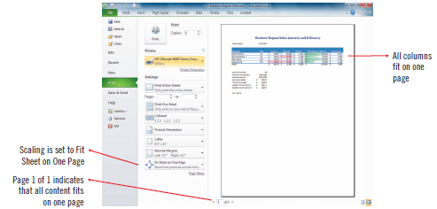
Filtering Table Data (cont.)
Worksheet with two filters applied
Worksheet in Print Preview

Slide 30
Summary
Excel provides powerful data analysis tools including:
Complex formulas
Functions
Tables
Sorting
Filtering

Slide 31
Summary
You can use built-in date/time and statistical functions
Conditional formatting is useful for emphasizing certain data according to conditions you specify

