Slide 1
Microsoft Office 2010 - Illustrated Fundamentals
Unit I: Working with Charts

Slide 2
Objectives
Understand and plan a chart
Create a chart
Move and reside a chart and chart objects
Apply chart layouts and styles

Slide 3
Objectives (cont’d)
Customize chart objects
Enhance a chart
Create a pie chart
Create sparklines

Slide 4
Unit I Introduction
An effective way to communicate worksheet information is to present the data as a chart
A chart is a visual representation of worksheet data
Excel provides many tools for creating charts to help you communicate key trends and facts about your worksheet data

Slide 5
Understanding and Planning a Chart
To create a chart you need to review some basic concepts
Understand the different parts of a chart
Horizontal axis (x-axis); horizontal line at the base of the chart displaying categories
Vertical axis (y-axis); vertical line at the left edge of the chart provides values
Axis titles; identify the values on each axis
Data series; sequence of related numbers that shows a trend
Data Marker; single chart symbol that represents one value in a data series

Slide 6
Understanding and Planning a Chart (cont.)
Legend; identifies what each data series represents
Gridlines; vertical and horizontal lines that help identify the value for each data series
Plot area; part of the chart contained within the horizontal and vertical axes
Chart area; entire chart and all the chart elements
Identify the purpose of the data and choose an appropriate chart type
Design the worksheet so that Excel creates the chart you want

Slide 7
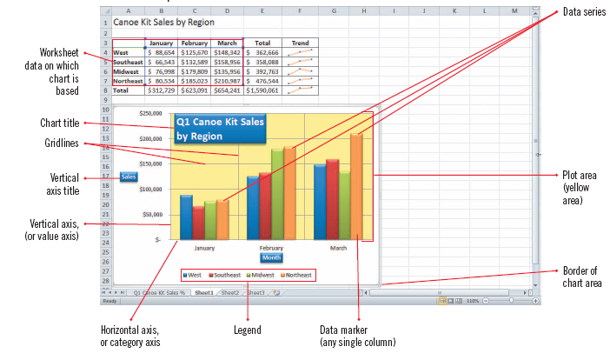
Understanding and Planning a Chart (cont.)
Column Chart

Slide 8
Understanding and Planning a Chart (cont.)
Sample folder and file hierarchy

Slide 9
Examples of Types of Charts
Line Chart
Column Chart
Pie Chart
Area Chart

Slide 10
Creating a Chart
You can create Excel charts from your worksheet data automatically
Select the cells containing data you want to place in a chart
Use commands in the Charts group (Insert tab) to specify the chart type
Changes to the worksheet data are automatically reflected in the chart
You can change the chart type to what will best illustrate the data

Slide 11
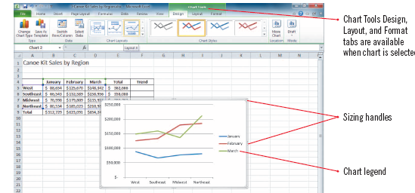
Creating a Chart (cont.)
Choosing a line chart type
Line chart

Slide 12
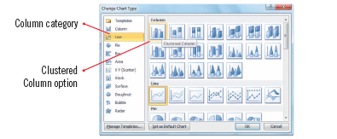
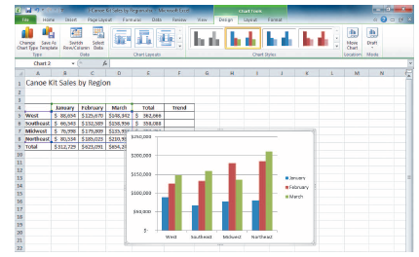
Creating a Chart (cont.)
Change Chart Type
Column chart in worksheet

Slide 13
Moving and Resizing a Chart and Chart Objects
Charts can be moved and sized so that they do not obscure your worksheet data
you can also move and resize many of the individual components, sometimes called chart objects such as the legend or background
Select and drag to move a chart to the desired location
Resize a chart by dragging one of the sizing handles
Note that some chart objects cannot be moved and that others cannot be resize by dragging

Slide 14
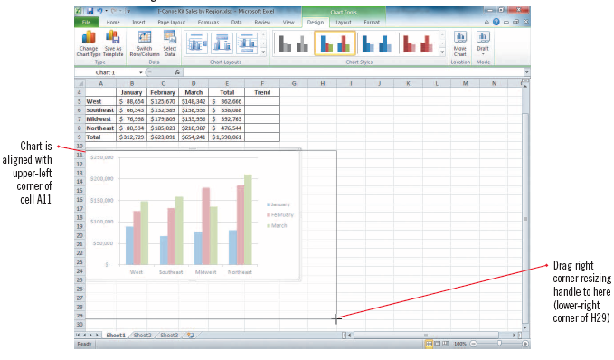
Moving and Resizing a Chart and Chart Objects (cont.)
Resizing a chart

Slide 15
Applying Chart Layouts and Styles
Chart layout: A built-in arrangement of chart elements such as the title and legend
Chart style: A pre-defined set of chart colors and fills
You can instantly change the way chart elements are positioned, displayed or hidden by choosing a different layout from the Chart Layouts gallery
You can change fill colors and textures using the Chart Styles

Slide 16
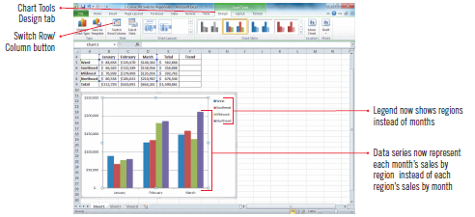
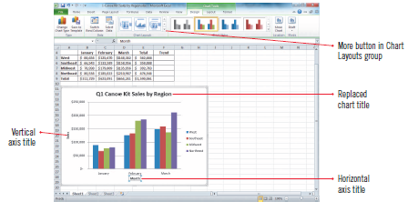
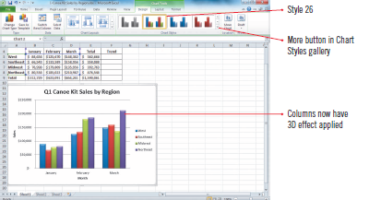
Applying Chart Layouts and Styles (cont.)
Chart with rows and columns switched
Customized chart
Applying a chart style

Slide 17
Customizing Chart Objects
Chart objects have default settings
Customizable chart objects are the chart title, axis titles, legend, data labels, axes, gridlines, plot area & data table
Data table: A grid containing the chart’s worksheet data
this grid is added below the x-axis in certain kinds of charts
You can easily change the positioning and attributes of individual chart objects by choosing from additional preset options

Slide 18
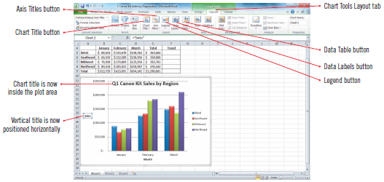
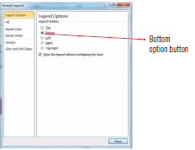
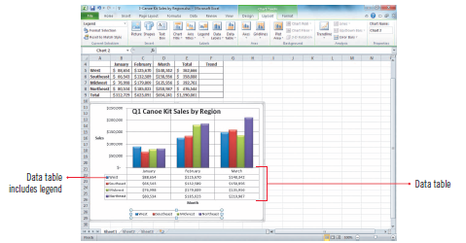
Customizing Chart Objects (cont.)
Vertical axis title/chart title
Format Legend
Data table with legend

Slide 19
Enhancing a Chart
Enhancing a chart with styles and effects improves its visual appeal and effectiveness
Any selected chart object can be modified in a variety of ways
apply a shape style
adjust the fill, outline and shape effects
apply WordArt styles
An example of an enhanced chart object
Chart Title

Slide 20
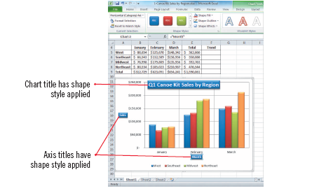
Enhancing a Chart (cont.)
Formatting enhancements

Slide 21
Creating a Pie Chart
A pie chart is an effective tool for comparing the relative values of pasts to a whole
Add a pie chart to the worksheet or add it as a separate chart sheet
A chart sheet is a sheet in a workbook that contains only a chart

Slide 22
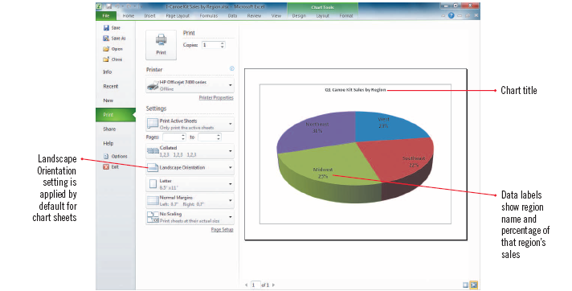
Creating a Pie Chart (cont.)
Completed pie chart in Backstage view

Slide 23
Creating Sparklines
Sparklines are tiny charts that fit in one cell and illustrate trends in selected cells
There are three types of sparklines you can add to a worksheet:
Line sparkline is a miniature line chart that is ideal for showing a trend over time
Column sparkline is a tiny column chart that includes a bar for each cell in a selected range
Win/Loss sparkline shows tow types of bars—one for wins and one for losses

Slide 24
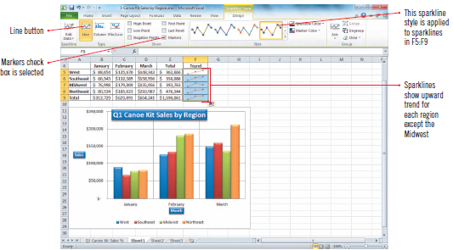
Creating Sparklines (cont.)
Create sparklines dialog box
Sparklines added to worksheet

Slide 25
Creating Sparklines (cont.)
Sparkline types and uses

Slide 26
Summary
Charts are an immediately visual way of easily communicating numerical data
Excel provides many types and styles of charts
It is critical to choose a chart type that appropriately shows your data
Use the variety of colors, fills, and effects to enhance your chart
Keep in mind that it is easy to overdo colors and effects, with the result that your chart is hard to understand and “busy”
Add text as needed to your chart sheet using headers, footers or text boxes

Slide 27
Summary
Keep in mind that it is easy to overdo colors and effects, with the result that your chart is hard to understand and “busy”
Add text as needed to your chart sheet using headers, footers or text boxes

