Slide 1
Unit J: Creating a Database
Microsoft Office 2010 - Illustrated Fundamentals

Slide 2
Objectives
Understand databases
Create a database
Create a table in Datasheet view
Create a table in Design view

Slide 3
Objectives (cont.)
Modify a table and set properties
Enter data in a table
Edit data in Datasheet view
Create and use a form

Slide 4
Unit J Introduction
You can use Access to create a database to help you manage and track a large collection of related data
A database is an organized collection of related information
Any type of information can be contained in a database

Slide 5
Understanding Databases
Access is a database system (DBMS)
A database is a powerful tool for:
Storing
Organizing
Retrieving information
A database containing just one table is called a simple database; two or more tables of related information is called a relational database

Slide 6
Understanding Databases (cont.)
A database stores data in or more spreadsheet-like lists called tables
Each row in a table is called a record
records consists of fields, which are columns holding information about one aspect of a record
column headings are field names
a form is a user-friendly window that is used to input data

Slide 7
Understanding Databases (cont.)
One you add data to a database you can easily access it
A query extracts data from one or more database tables according to set criteria
A report is a summary of information pulled from the database specifically designed for printing
Tables, forms, queries, and reports are program components called objects

Slide 8
Understanding Databases (cont.)
Common Access database objects

Slide 9
Understanding Databases (cont.)
Database table
Database form

Slide 10
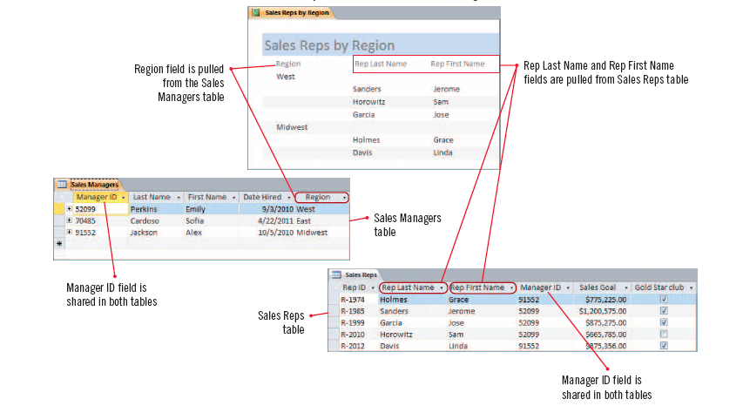
Understanding Databases (cont.)
Relational database report

Slide 11
Creating a Database
There are two basic ways to create an Access database:
starting with a blank database, or
using a template
Creating a database from a template can save time as it contains ready-made database objects such as tables with field names appropriate to a particular type of database
In Backstage view, the New tab provides options for creating a new blank database or from a variety of templates

Slide 12
Creating a Database (cont.)
With the Access program window open, below the ribbon there are two panes
the right pane, is a blank table datasheet with a temporary table name, Table 1
the left pane is called the Navigation Pane, this is where all database objects for the open database are listed

Slide 13
Understand Access File formats
By default, Access 2010 saves new databases with the file extension .accdb (the file format established for Access 2007)
The Access program window title bar displays (Access 2007) in the title bar
The Access 2007 file format allows for features that are not supported by previous Access versions
If you need to share a database with users of Access 2003, you can create a copy of it in the .mdb format

Slide 14
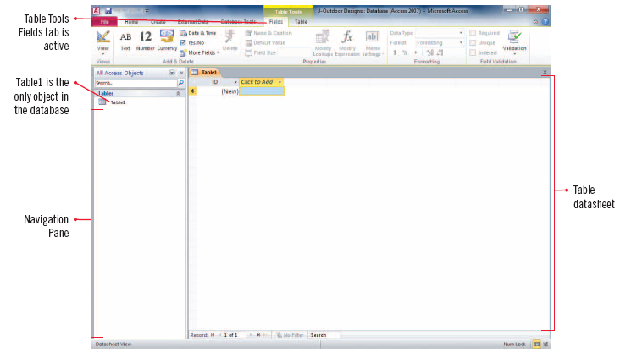
Creating a Database (cont.)
Blank table datasheet

Slide 15
Creating a Table in Datasheet View
When working in a new database, a blank table opens in Datasheet view
In Datasheet view, you can add fields and view the data contained in the table
Before beginning to add fields to a table it is a good idea to save the table with an appropriate name
Each object within an Access database that you create will need to be saved

Slide 16
Creating a Table in Datasheet View (cont.)
To add a field to a table, you need to specify its data type, such as text, currency, etc. and then specify a name
Every table in a database must contain one field that is designated as the primary key field, which uniquely identifies each record among all other records in the database
Be default, every blank new table in Access includes a blank ID field which is automatically designated the primary key field, but can be changed

Slide 17
Creating a Table in Datasheet View (cont.)
Table with four fields

Slide 18
Creating a Table in Datasheet View (cont.)
Common field data types

Slide 19
Creating a Table in Design View
It is often easier to add fields to a new or an existing table using Design view
In Design view, you use a grid to enter fields and specify field data types
In addition you can add field descriptions that identify the purpose of a field and help users understand the information that the field is meant to contain
Use Design view to view and change the designated primary key field

Slide 20
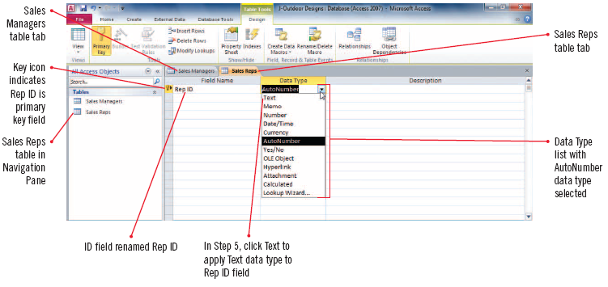
Creating a Table in Design View (cont.)
Specifying a data type in Design view

Slide 21
Modifying a Table and Setting Properties
After creating a table, you may need to make changes to it such as adding or deleting a field, descriptions, or renaming a field
Design View is the best view for modifying a table structure
In Design view you can set Field properties
Field properties are data characteristics that dictate how Access stores, handles, and displays field data

Slide 22
Modifying a Table and Setting Properties (cont.)
If a field name is long, is technical, or uses abbreviations, you may want to change its Caption property
The Caption property is a label that appears in a form or in Datasheet view in place of a field name
Use the Field Properties pane to view and change properties for a selected field

Slide 23
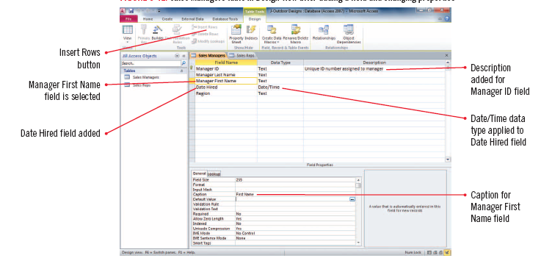
Modifying a Table and Setting Properties (cont.)
Design view with added field and changing properties

Slide 24
Entering Data in a Table
To enter data in a table using Datasheet view, click where you want to enter a value and start typing
Each row of the table is one record
A Row selector to the left of each record lets you select a record or records
The field names at the top of each column identify the fields
The data you enter in each field is called a field value

Slide 25
Entering Data in a Table (cont.)
Field values entered in tables in Datasheet view

Slide 26
Entering Data in Datasheet View
The data in a database is dynamic and always changing
The data constantly need updating to reflect changes
To keep the data in a database current, you need to add and delete records and make edits to individual fields
You can easily edit data in a table in Datasheet view using the editing skills you learned for Word and Excel

Slide 27
Entering Data in Datasheet View (cont.)
To edit a field value, you need to select either the entire field value or the part of it you want to edit and type the replacement data
When making edits in a datasheet, you may find it helpful to resize the columns to make the data easier to see
the border between the field names is called the column separator
double-click on the separator to have the column automatically resize larger or smaller to fit the widest field name or content

Slide 28
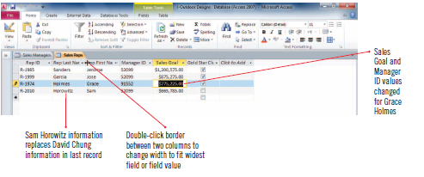
Entering Data in Datasheet View (cont.)
Resizing a column in Datasheet view
Edited records in Datasheet view

Slide 29
Printing objects in Access
When printing information in Access you usually create a report that includes selected fields
There may also be times that you want to print a datasheet or form
To print any object in Access, select the object in the Navigation pane, open the file tab and select Print
In Print Preview, you can use the tools on the Print Preview tab to adjust settings

Slide 30
Creating and Using a Form
A form is an efficient way to enter and edit data; it is easier to use and there are fewer data entry errors and less eyestrain
the simplest way to create a form is to click the Form button on the Create tab
A form usually displays one record at a time and contains form controls
Form controls are devices for inputting data; for example, text box, scroll bar, or check box
To view different records, you use the buttons on the navigation bar

Slide 31
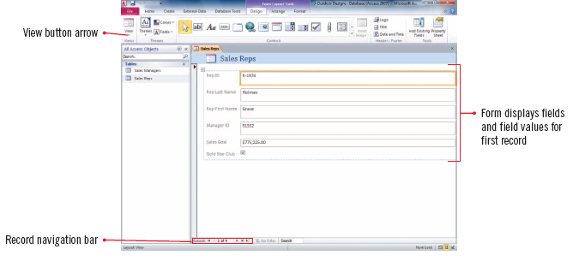
Creating and Using a Form (cont.)
New form in Layout view

Slide 32
Summary
A database is an efficient way to store, retrieve, and connect information
You can create a table in either design or datasheet view
Tables and forms are two of the ways to enter and organize data in a database
In a table, records are row, and fields (columns)hold values (representing a specific part of the record)
Tables can be modified and Field and Caption properties easily changed

