Slide 1
Microsoft Office 2010 - Illustrated Fundamentals
Unit K: Working with Data

Slide 2
Objectives
Open an existing database
Sort records in a table
Filter records in a table
Create a query using the Query Wizard
Modify a query in Design view

Slide 3
Objectives (cont’d)
Relate two tables
Create a query using two tables
Add a calculated field to a table

Slide 4
Unit K Introduction
You can pull out information you need from a database by filtering and querying and sorting the data
Sorting, using filters, creating queries and using calculated fields (fields which show the result of a mathematical expression) allows you to work with the database data how you wish
Setting up relationships between tables allows you to use fields from multiple tables in a query

Slide 5
Opening an Existing Database
Opening an existing Access database is similar to opening a Word or an Excel file
Click the Open command on the File tab in Backstage view, or you can open a recently used database by clicking its file name in the recent files used

Slide 6
Opening an Existing Database (cont.)
One difference between opening an Access database and opening a file in Word or Excel is that you can only open one Access database at a time
For multiple databases to be open you will need to open additional sessions of Access and then the database

Slide 7
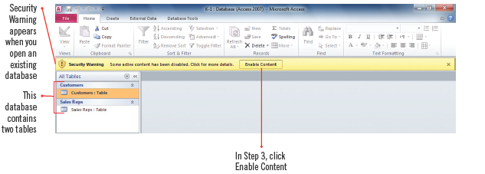
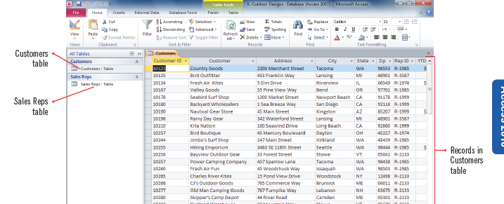
Opening an Existing Database (cont.)
Database open with Security Warning
Table in Datasheet view

Slide 8
Sorting Records in a Table
You can rearrange, or sort, the records in a table in alphabetical or numerical order
When sorting you need to indicate the field on which you want Access to sort and then specify:
Ascending order: A-Z or 0-9
Descending order: Z-A or 9-0
You may also want to sort records using more than one field, an example might be to sort by a customer name within a specific state

Slide 9
Capturing a screen shot of your sorted table
To capture a screen shot, start Microsoft Word, click the Insert tab, click the Screenshot button, then click the image of the screenshot in the available Windows menu
The screen shot of a sorted table will be pasted into a new word document which can be saved
Click the Access program button on the taskbar to return to Access

Slide 10
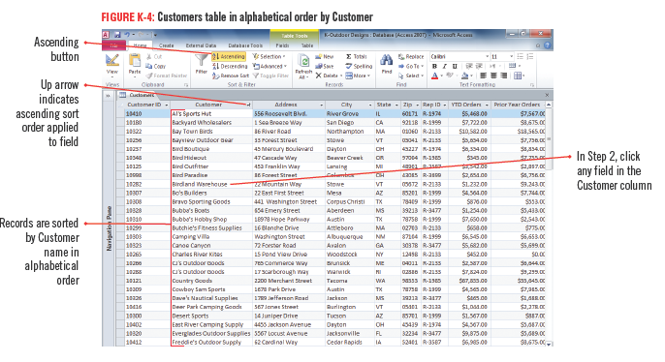
Sorting Records in a Table (cont.)
Alphabetic order sort on Customer field

Slide 11
Sorting on multiple fields
When sorting on multiple fields you need to decide which one will be the primary field and which field is to be sorted within the primary field grouping
The field that is primary is called the outermost sort field, and the field that is the secondary sort field is called the innermost sort field
To get the results you want, you must first sort the records by the Innermost field and then sort by the outermost field

Slide 12
Filtering Records in a Table
Records in a table can be filtered to display only the information that meet criteria that you specify
Criteria are conditions that must be met for a record to be displayed
The simplest way to filter a table is to select a field that matches your criterion and use the Equals command to display those records that match the selection

Slide 13
Filtering Records in a Table (cont.)
You can also apply a Number Filter to a selected field to filter records that are greater than, less than, or equal to a specific number or between two numbers
Filters cannot be saved as a database object
Filters can be saved as part of the table or form you are working on and reapply it the next time
Filter results can also be printed

Slide 14
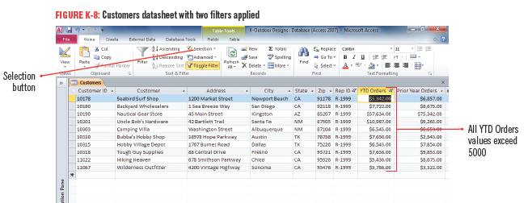
Filtering Records in a Table (cont.)
Table with two filters applied

Slide 15
Creating a Query Using the Query Wizard
A query is a database object that extracts data from one or more tables in a database according to criteria that you set
A query displays only the fields you specify
You can use a query to pull together information from several tables
As a query is an object, you can save it for later use
The simplest way to create a query is by using the Query Wizard

Slide 16
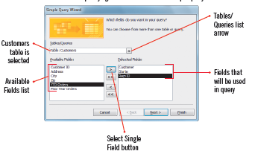
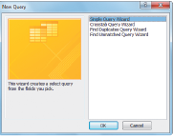
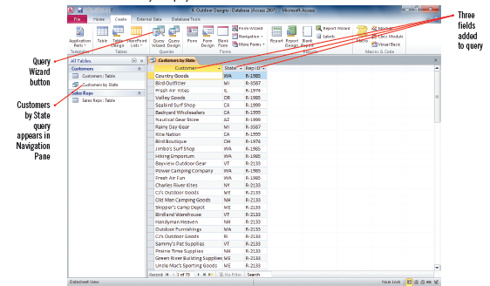
Creating a Query Using the Query Wizard (cont.)
Specifying table/fields for simple query
New query dialog box
Simple query results

Slide 17
Creating a Query Using the Query Wizard (cont.)
Select Filed buttons in Query Wizard

Slide 18
Modifying a Query in Design View
You can modify an existing query if you need to make changes using Design view
In Design view, you can:
add fields
delete fields
specify a sort order for one or more fields
specify criteria for fields
create a query

Slide 19
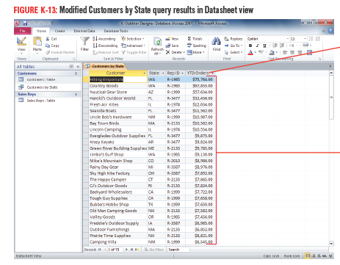
Modifying a Query in Design View (cont.)
Modified query in Datasheet view

Slide 20
Relating Two Tables
To take advantage of the power of Access you may want to create queries that pull fields from more than one table
Queries can be used to relate two tables, or specify a relationship between them
To relate tables, they must share a common field
The shared field must be the primary key field in one of the tables

Slide 21
Relating Two Tables (cont.)
You use the Relationships window to specify a relationship between two or more tables
The most common type of relationship to set up is a one-to-many relationship, in which the primary key field in one table is associated with multiple records in a second table
In the second table, the common field shared with the first table is called the foreign key

Slide 22
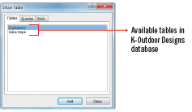
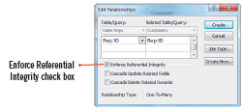
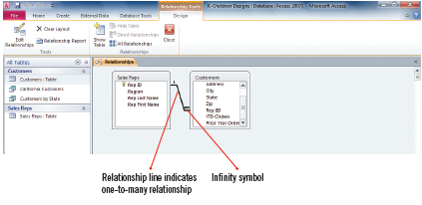
Relating Two Tables (cont.)
Show Table dialog box
Edit Relationships dialog box
Relationships window with one-to-many established relationship

Slide 23
Understanding good database design
Creating a well-designed database requires careful planning
what is the purpose and goals of the database?
what data will it store?
organize the database into categories of data
turn the categories of data into tables
define fields, data types and primary key
decide table relationships
Creating a well-designed structure for your database will ensure that your data is easy to access, maintain, and update

Slide 24
Creating a Query Using Two Tables
Setting up relationships between tables offers many advantages:
ability to create a query that pulls fields from two or more related tables
changes made to fields in one table are automatically reflected in related tables or queries (if referential integrity is selected)
This ensures consistent, accurate data

Slide 25
Creating a Query Using Two Tables (cont.)
Setting up table relationships also ensures that your data is valid and accurate
Access will prohibit any attempt to enter data in the foreign key field that is not consistent with the data in the primary key field

Slide 26
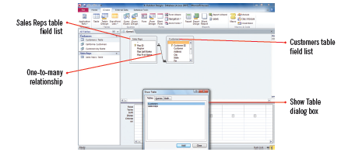
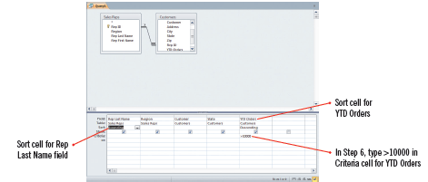
Creating a Query Using Two Tables (cont.)
Adding tables in Design view
Query with criteria and sorts
Query results in Datasheet view

Slide 27
Creating a Query Using Two Tables (cont.)
Comparison operators

Slide 28
Adding a Calculated Field to a Table
A calculated field is a field that contains an expression, which is a combination of fields, values, and mathematical operators
Showing the results of calculations based on values in certain fields is very useful
Calculated fields have the Calculated data type
Choosing a Calculated data type opens the Expression Builder dialog box where you can easily build the expression you want by specifying fields, values, and operators

Slide 29
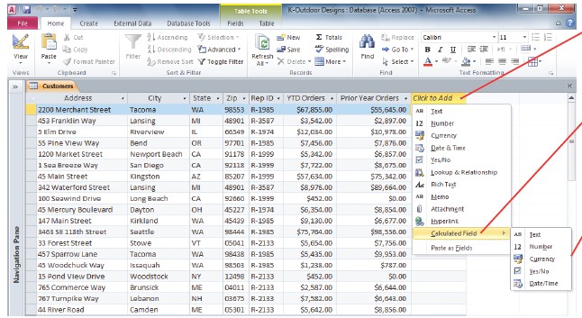
Adding a Calculated Field to a Table (cont.)
Adding a calculated field to a table

Slide 30
Summary
Good database design ensures that the data is easy to access, maintain, and update
You can find the information you need in a database quickly by using sort, filter, or query
Each table in a database needs a primary key field
You can relate tables so that information can be pulled from each table

