Slide 1
Microsoft Office 2010 - Illustrated Fundamentals
Unit L: Creating Database Reports

Slide 2
Objectives
Create a report using the Report Wizard
View a report
Modify a report
Add a field to a report

Slide 3
Objectives (cont’d)
Apply conditional formatting to a report
Add summary information to a report
Create mailing labels

Slide 4
Unit L Introduction
A report is a summary of database information designed specifically for printing
A report can include one or more database fields, summary information, clip art, and descriptive labels
You create report from tables or queries
After a report is created it can be modified to present information clearly and attractively

Slide 5
Creating a Report Using the Report Wizard
One way to create a report is by using the Report Wizard, which automatically create a report based on setting that you specify
You can create a report based on table or query data
Report data can be from on database object, or multiple objects

Slide 6
Creating a Report Using the Report Wizard (cont.)
Reports can be saved as objects in a database
Reports consist of sections that contain specific information
Choose the record source(s) to select the database object(s) from which a report gets its data
Use grouping to organize a report by field or field values

Slide 7
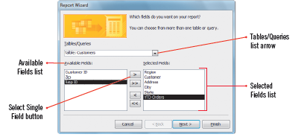
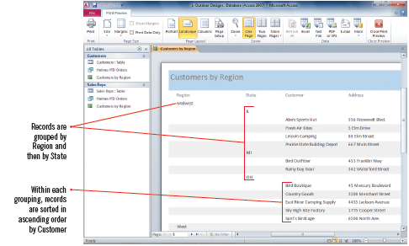
Creating a Report Using the Report Wizard (cont.)
Report Wizard dialog box
Report in Print Preview

Slide 8
Viewing a Report
Access provides several ways to view a report
Print Preview-see exactly how the report will look when printed
Report View-looks similar to Print Preview, it displays the report in continuous flow without page break
Design View-includes many tools for modifying a report, but shows only the structure of the report not the included data
Layout View-does not include as many modification tools as Design view, but it shows you report data

Slide 9
Viewing a Report (cont.)
Available report views in Access

Slide 10
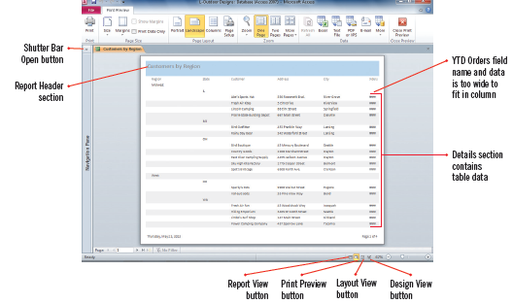
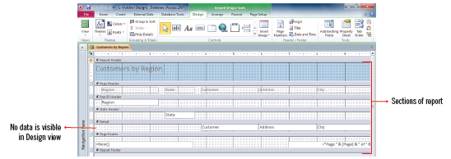
Viewing a Report (cont.)
Page 1 of report in Print Preview
Report in Design view
Filtering a report in Report view

Slide 11
Modifying a Report
Reports are commonly modified to improve it’s appearance and readability
Columns often need to be resized or moved
You can use Layout view to resize, move, and delete columns

Slide 12
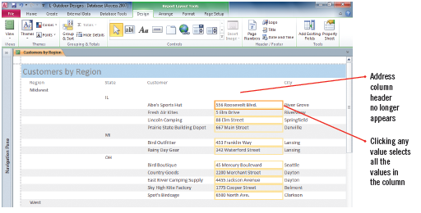
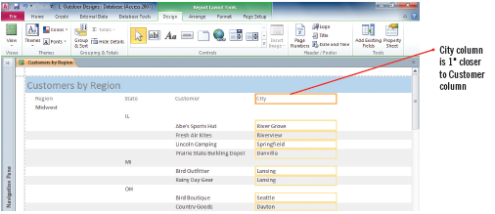
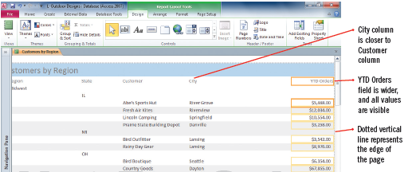
Modifying a Report (cont.)
Selecting a field in Layout view
City column moved in Layout view
Repositioned/Resized fields

Slide 13
Adding a Field to a Report
You can use Layout view to add a field to a report
open the Field List, then double-click the desired field
Fields are added to the left side of a report
adjustments might need to be made to the other columns to place the new field where needed
When you add a field to a report, the field label is automatically added to the header section, and the control is added to either the Group Header or the Detail section

Slide 14
Adding a Field to a Report (cont.)
A field is composed of two parts: the field label, and its associated control
A control is an object that displays information in a report
Different controls are used for each data type

Slide 15
Adding a Field to a Report (cont.)
Report section

Slide 16
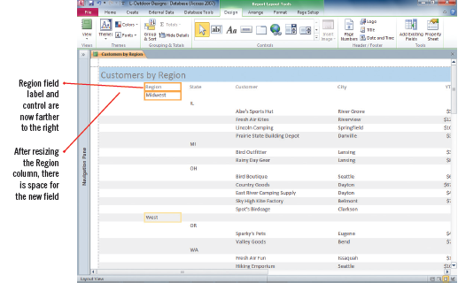
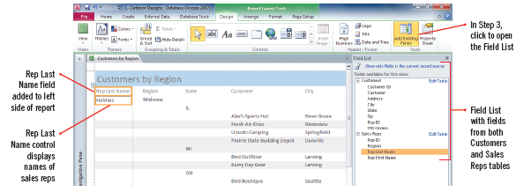
Adding a Field to a Report (cont.)
Report with resized column
Adding a new field with the Field List

Slide 17
Applying Conditional Formatting to a Report
As in an Excel worksheet, you can apply conditional formatting in an Access report to highlight key information
Conditional formatting is a way to draw attention to information that meets specific
You access the Conditional formatting rules Manager dialog box from the Report Layout Tools Format tab in Layout view

Slide 18
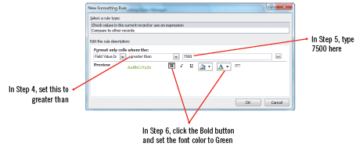
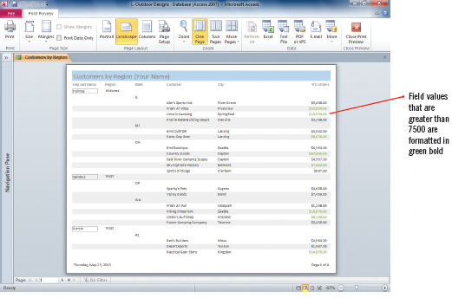
Applying Conditional Formatting to a Report (cont.)
New Formatting Rule dialog box
Conditional formatting applied

Slide 19
Applying a theme to a report
You can instantly change the appearance of a report by applying a theme
Access includes 40 different themes

Slide 20
Adding Summary Information to a Report
Summary information in a report displays statistics about one or more fields in a database
Summaries include statistics for sum, average, count, minimum and maximum in any numeric field
There are five summary calculations you can use in your database reports
You can add summary information while creating the report with the Report Wizard

Slide 21
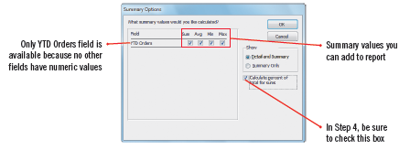
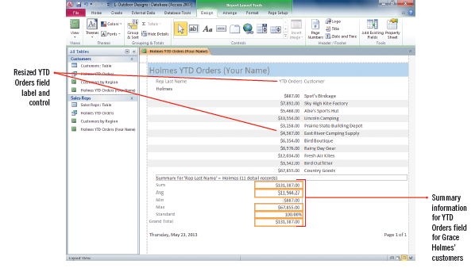
Adding Summary Information to a Report (cont.)
Summary Options dialog box
Changing the column width

Slide 22
Adding Summary Information to a Report (cont.)
Common summary calculations available in database reports

Slide 23
Creating Mailing Labels
You do not have to print all reports
You can use the data in a database to create other forms of printer output, such as labels or envelopes
Use the Label Wizard to create labels containing data from any fields in the database
Labels can be based on queries or tables

Slide 24
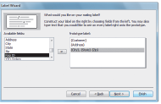
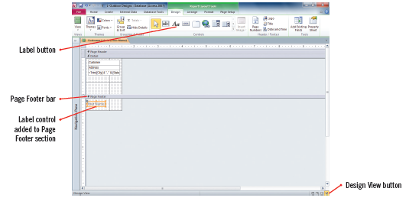
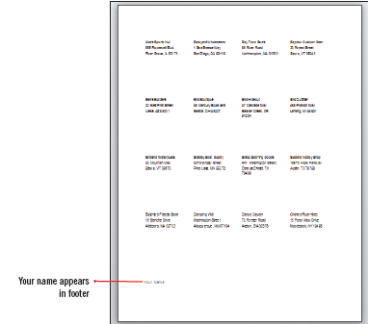
Creating Mailing Labels (cont.)
Label Wizard dialog box
Adding a label to Page Footer
Customer Labels

Slide 25
Summary
Reports are created from tables or queries in a database
One way to create a report is by using Report Wizard
Reports are easily modified in Layout view

Slide 26
Summary
Use conditional formatting to highlight information that meets certain criteria
Summary information is useful in displaying certain statistics in a report
You can create mailing labels using the Label Wizard and specifying certain fields of a report to print (name and address)

