Slide 1
Microsoft Office 2010 - Illustrated Fundamentals
Unit M: Creating a Presentation

Slide 2
Objectives
View a presentation
Use a theme
Enter text on a slide
Format text
Add a text box

Slide 3
Objectives
Create SmartArt
Add a header and footer
Print handouts

Slide 4
Unit Introduction
PowerPoint is a presentation graphics program that allows you to create slides, which are on-screen pages
putting slides together, you can create a slide show
you can select from an array of templates and themes, add photographs, clip art, sound and video
text can be converted into stunning graphics
handouts, notes and outlines can be created to augment the presentation
presentations can be viewed on a computer, video projector or published on the web

Slide 5
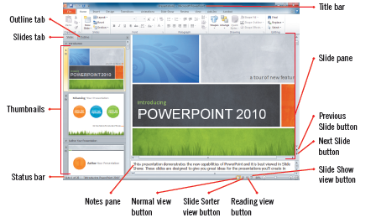
Viewing a Presentation
Several ways to view a presentation:
Normal view
Slide Sorter view
Slide Show view
Reading view
Presentation open in Normal view

Slide 6
Viewing a Presentation (cont.) Normal View
Divided into 3 areas:
Slide pane: Shows the full layout of the slide; this is the largest area
Slides tab and Outline tab: Show slide thumbnails and text-only outline version useful for quickly navigating through the presentation; these are on the left of the screen
Notes pane: Used to input text relevant to a specific slide; located at the bottom

Slide 7
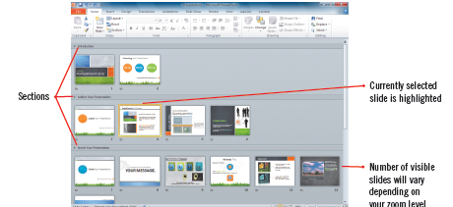
Viewing a Presentation (cont.) Slide Sorter View
Shows thumbnails of the entire presentation
Useful for reordering and deleting slides
Presentation in Slide Sorter view

Slide 8
Viewing a Presentation (cont.) Slide Show and Reading view
Slide Show view previews the presentation as the audience will see it
Reading view is used to view the presentation in full screen but also see the title and status bars
Additional views provided by PowerPoint:
Notes Page view
Three (3) Master views for working with recurring elements within a presentation

Slide 9
Using a Theme
Themes add a distinctive professional touch to the presentation
Themes can make a presentation clearer and more interesting
Using a preformatted PowerPoint theme saves time
You can easily create custom themes by changing the background, colors, or fonts
Theme thumbnails appear in the Themes gallery displaying built-in themes as well as those you have created

Slide 10
Using Themes gallery options
Clicking a thumbnail in the gallery applies it to every slide in the presentation
Set As Default theme applies the selected theme to all new presentations and the theme is moved to the top of the Themes Gallery
Having too many themes in a single presentation can be visually overwhelming and diminish effectiveness
The gallery can be added to the Quick Access toolbar

Slide 11
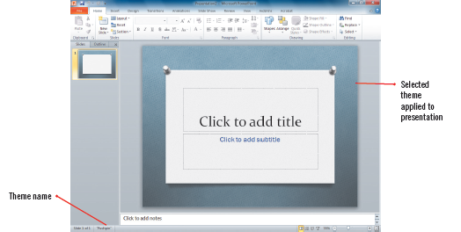
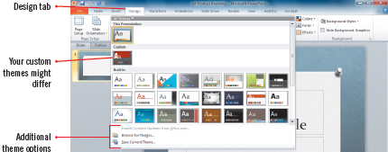
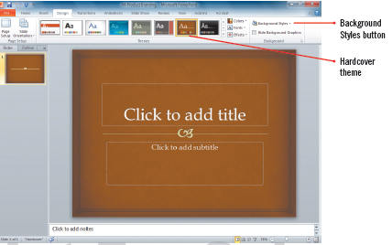
Using a Theme (cont.)
Pushpin theme
Themes gallery
Hardcover theme

Slide 12
Entering Text on a Slide
Text is added in the Slide pane or the Outline tab
Slide pane shows exactly how the text will look
Outline tab is useful when working with a lot of text
The first slide is the title slide
two (2) placeholders for title and subtitle
When you add a new slide, the default placeholders adjust to the new content and are the title and content slide layout
Place holders are identified with a dashed-line selection box
Once filled, placeholders become editable objects

Slide 13
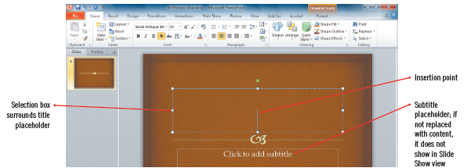
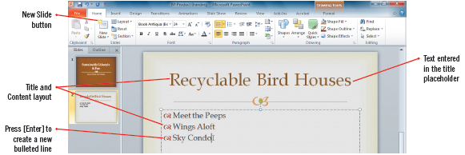
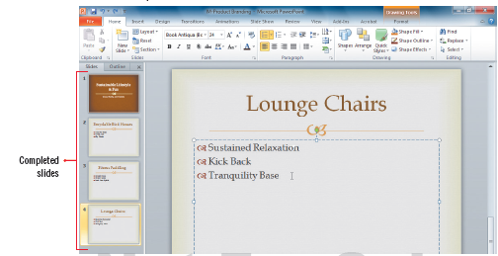
Entering Text on a Slide (cont.)
Entering text in a placeholder
Bulleted text
Completed slides

Slide 14
Formatting Text
Format presentation text to emphasize specific words or phrases and improve how the text appears
Use commands on the Ribbon to change font type, size, and color
You can also change the fonts by using the Fonts button in the Themes group

Slide 15
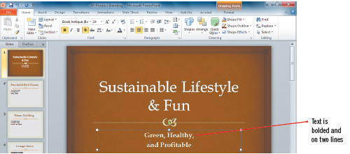
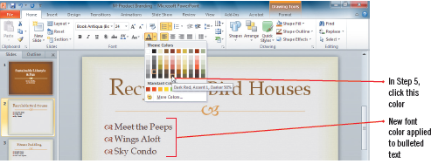
Formatting Text (cont.)
Bolded and formatted subtitle
Selecting a theme color
Different theme fonts

Slide 16
Adding a Text Box
There may be times when you want to add new text to a slide but outside of a text placeholder, such as a label
You can add a text box, apply a style to it, and place it anywhere on the slide
Type the text, format it, move it, and apply a Quick Style as desired
Multiple formatting attributes can be applied at one time

Slide 17
Using sections
To eliminate long presentations becoming difficult to manage and to access quickly, insert sections in the slideshow
Entire sections can have themes, animations, transitions and other enhancements
Select the slides in the presentation to be included in the section and Add the section
Sections allows you to access slide quickly and also only print certain sections

Slide 18
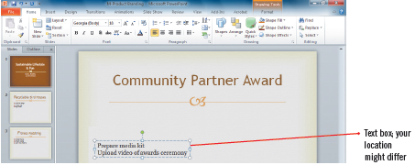
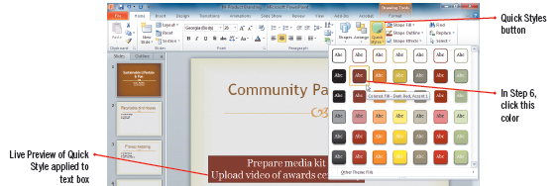
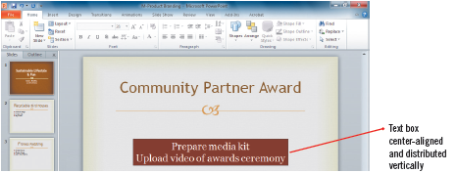
Adding a Text Box (cont.)
Creating a text box
Applying a Quick Style
Completed text box

Slide 19
Creating a Custom Theme
You can create a custom theme with colors, fonts, and/or effects
In the Themes group, click the Colors button and click Create New Theme Colors; select colors and give the theme a unique name
do the same using the Fonts and/or Effects buttons
the unique names you assign to the theme colors and theme fonts will be visible in their respective galleries
To create an overall custom theme, apply the theme and theme colors, theme fonts, and theme effects as desired and then save

Slide 20
Creating SmartArt
You can convert text or transform photographs to SmartArt and create visually rich diagrams
SmartArt includes dozens of layouts organized in categories that can be used to make text stand out and visually communicate information
You can include photos with the graphics
Once created, a SmartArt graphic can be modified just as you can with any object
SmartArt Categories

Slide 21
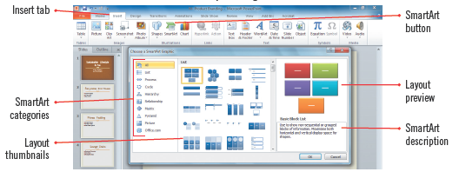
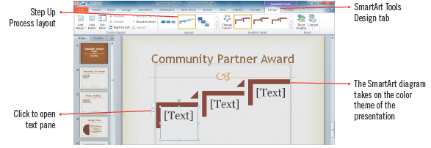
Creating SmartArt (cont.)
SmartArt Graphic dialog box
SmartArt inserted in a slide

Slide 22
Adding a Header and Footer
Headers and/or footers can be added to show information such as the current slide number, presentation date, presenter’s name, the title of the presentation or even a copyright disclaimer
Footers appear in each slide and when notes, handouts, or outlines are printed
Headers are only visible when you print notes and handouts

Slide 23
Editing a slide master
There may be times when you want to make a design change to every slide automatically instead of manually
Every PowerPoint presentation contains a slide master
The Slide Master contains the layouts, design elements plus more for a presentation; and
You can make changes to the existing slide master and then save with a unique name

Slide 24
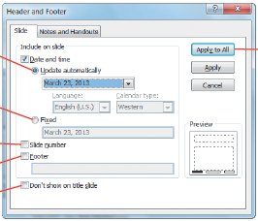
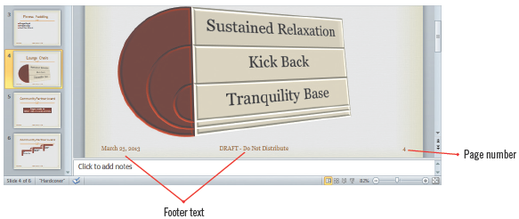
Adding a Header and Footer (cont.)
Header and Footer dialog box
Footer text and page number applied

Slide 25
Printing Handouts
To aid in a presentation, you can print the actual slides one to a page
You can print a handout, which prints one or more slides per page for your audience to use for notes
You can print Notes pages, which contain a small image, thumbnail, of each slide plus any speaker notes you added in the Notes pane

Slide 26
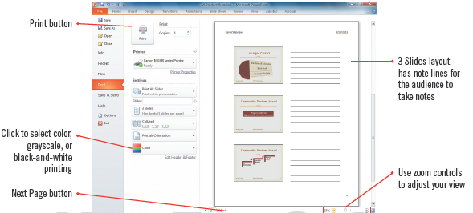
Printing Handouts (cont.)
Previewing handouts

Slide 27
Sharing a presentation
PowerPoint, in the File tab, provides many avenues for sharing a presentation
you can email it
or you can post the presentation online to Windows SkyDrive where it can be accessed using the PowerPoint Web App
or you can broadcast a copy of the presentation in real time for viewers having a free Windows Live ID to experience your presentation as you give it
or you can record a video of you presentation in Windows Media video (.wmv)

Slide 28
Summary
Presentations can easily be created to be visually appealing while communicating information to an audience
PowerPoint provides a variety of themes and templates
You can include clip art, photos, audio, video, and SmartArt graphics
You can print slides or print handouts
You can share presentations in real time, recorded, over the internet

