Slide 1
Microsoft Office 2010 - Illustrated Fundamentals
Unit N: Polishing and Running
a Presentation

Slide 2
Objectives
Add a shape
Add clip art
Work with pictures
Add sound and video

Slide 3
Objectives (cont’d)
Edit a video
Set slide timing and transitions
Animate slide objects
Create speaker notes

Slide 4
Unit N Introduction
You can enhance a PowerPoint presentation by adding media, such as shapes, clip art, photographs, sounds, and video
Adding graphics, such as images and photographs, and video to your slides illustrates your slide content
You can embed sound effects and music clips to narrate or add excitement

Slide 5
Adding a Shape
You can choose from a variety of built-in shapes to add visual interest or highlight information in a slide show
Shapes have the same formatting properties as other Office objects
You can alter various attributes such as style, fill, and lines

Slide 6
Adding a Shape (cont.)
Text can be added to a shape
There are many ways to align an object; one of the most popular is by using the ruler for exact measurements

Slide 7
Resizing graphics and images
You can modify shapes, clip art, and other images and illustrations using the Picture Tools Format contextual tab
opens whenever a graphic is selected

Slide 8
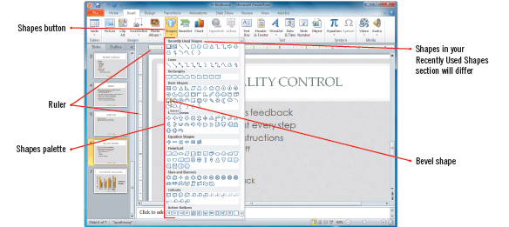
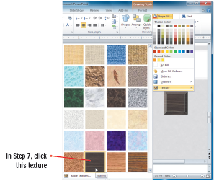
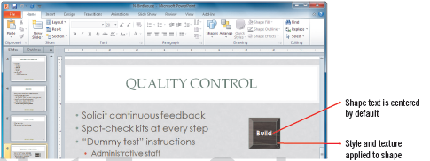
Adding a Shape (cont.)
Selecting a Shape
Selecting a Shape Fill
Style, texture, text added

Slide 9
Adding Clip Art
A clip art illustration, or other media, such as a photograph, videos, or audio files in a slide using the Clip Art task pane
Clicking the Clip Art icon in a content placeholder or click the Clip Art button in the Images group on the Insert tab opens the Clip Art task pane

Slide 10
Adding Clip Art (cont.)
You can search for clip art using keywords in collections of clip art
Effects can be applied to alter the appearance of clip art—it is fun to experiment

Slide 11
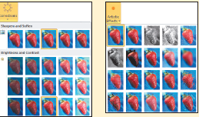
Understanding adjustment effects
PowerPoint contains substantial graphics-editing features that give you more creative control of your photographs and graphics
You can view a Live Preview of the effect on the image in a slide before you apply it
Picture adjustment features

Slide 12
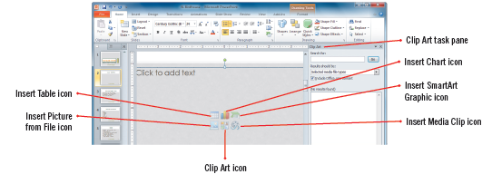
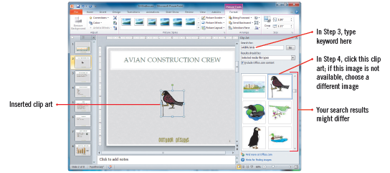
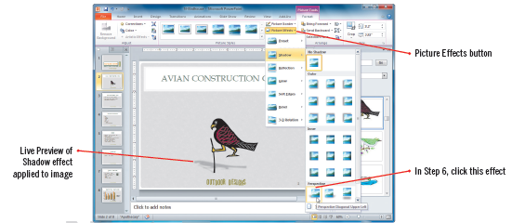
Adding Clip Art (cont.)
Inserting media
Inserted bird clip art
Live Preview effects

Slide 13
Working with Pictures
In PowerPoint a picture can be an image created and saved in any number of file formats—not just a photograph or clip art
You can use features on the Picture Tool format tab to:
adjust color
add effects and styles to photos
crop portions of a picture
work with opacity, or the transparency of an image

Slide 14
Understanding file types
Each file format supports images differently
Bitmap graph displays a picture image in a matrix of pixels on a grid
JPEG (Joint Photographic Experts Group) format uses and compresses color
Line art is GIF (Graphics Interchange Format)

Slide 15
Understanding file types (cont.)
Line art is GIF (Graphics Interchange Format)
You can insert video in common file formats such as AVI, Windows Media, MOV/QuickTime, etc.
Animated clip art and video from Office.com is created in Windows Metafile Format (WMF) format

Slide 16
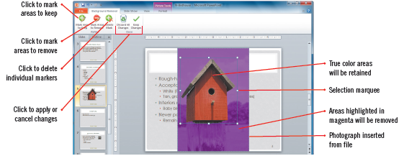
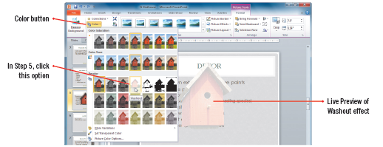
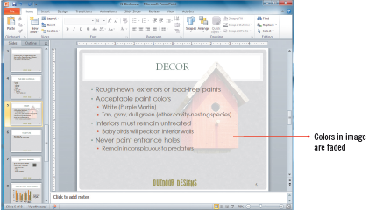
Working with Pictures (cont.)
Setting the marquee
Washout effect
Completed slide

Slide 17
Adding Sound and Video
Adding sound and video to a presentation can help your viewers remember the presented message
You can insert video and sound from the Clip Art task pane or from any storage device, link on the Web, or a record of your own audio
The features on the Playback tab for Audio Tools or Video Tools can adjust the length and behavior of a sound or video

Slide 18
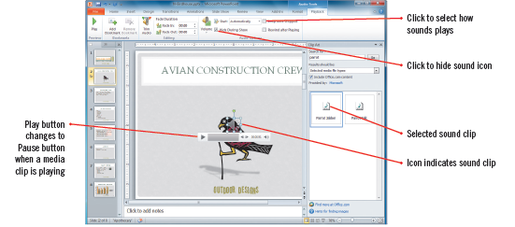
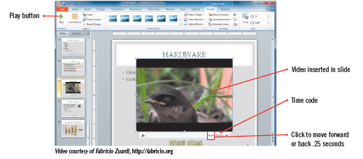
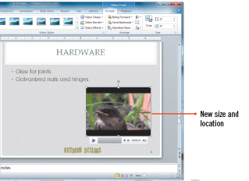
Adding Sound and Video (cont.)
Inserted sound clip
Inserting video
Modified video

Slide 19
Editing a Video
You can edit a video from within PowerPoint to create the perfect visual event for your audience
Features on the Playback tab edit the length and appearance of an inserted video such as:
if the video fades in and out
how and when it plays or rewinds

Slide 20
Editing a Video (cont.)
The Trim feature lets you determine the video’s length and its start and end frames
Features on the Format tab allow you to adjust the video’s appearance such as:
you can select a poster frame-an image on your computer or an image created from a video frame to use as the video’s “cover” or preview image
To have the video best match your theme, you can add styles, borders or effects to it

Slide 21
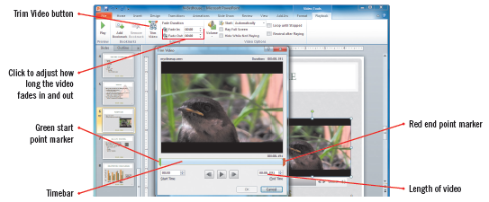
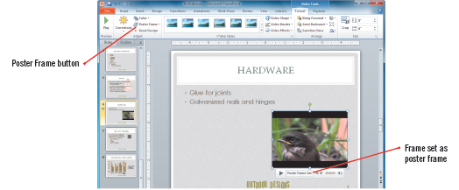
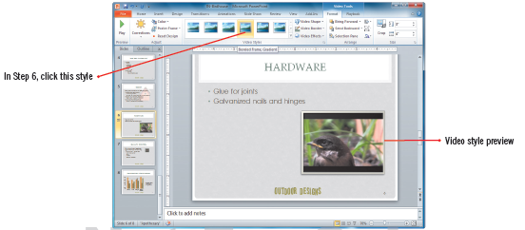
Editing a Video (cont.)
Trim Video dialog box
Seeing a poster frame
Applying a video style

Slide 22
Setting Slide Timing and Transitions
There are many times when you want to run a presentation automatically, not manually
You may also want to customize how slides appear in a slide show

Slide 23
Setting Slide Timing and Transitions (cont.)
You can set slide timings and transitions
a timing is the number of seconds a slide remains on the screen before advancing
a transition is a special effect that determines how a slide appears as it enters and leaves the screen
you can adjust settings for individual slide or apply one setting to multiple slides

Slide 24
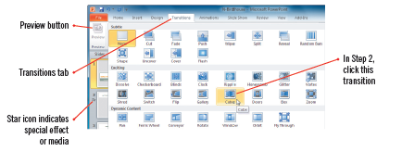
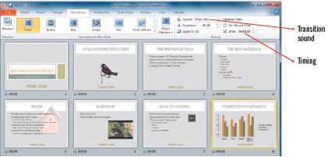
Setting Slide Timing and Transitions (cont.)
Selecting a slide transition
Inserting a transition sound

Slide 25
Compressing and optimizing media
Including video and audio files in a presentation increases the size of your presentation
A large file may be difficult to share with others
The Info tab in Backstage view contains features that optimize your presentation
The Compress Media button lets you see how much space the media files in your presentation currently take up

Slide 26
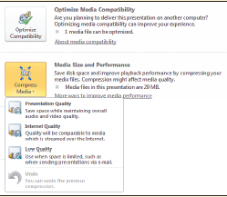
Compressing and optimizing media (cont.)
PowerPoint automatically displays the Optimize Compatibility button when it detects that you have inserted media whose format might be incompatible when other users try to play it
Optimize Compatibility and Compress Media options

Slide 27
Animating Slide Objects
Individual objects, such as text objects and images in a slide, such as clip art, photos, illustrations, and charts can be animated
You select an animation from the Animations tab, and adjust how and when the animation effect plays
Multiple animations can be applied to an object
The Animation Painter can be used to apply the same settings to other objects

Slide 28
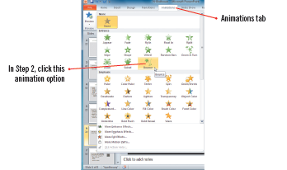
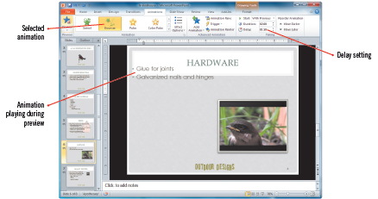
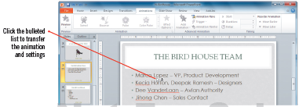
Animating Slide Objects (cont.)
Selecting an animation
Previewing animation
Using the Animation Painter

Slide 29
Creating Speaker Notes
As a presenter, having speaker notes on hand that list key points can be very helpful
For your audience, distributing speaker notes with handouts provides additional detail and background
You enter speaker notes in the Notes area in Normal view or in Notes Page view
When you print speaker notes, each slide is printed on its own page with the additional notes, including graphics displaying below the slide on the page

Slide 30
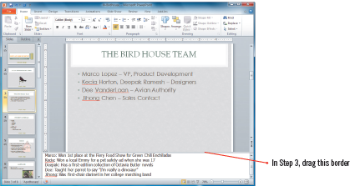
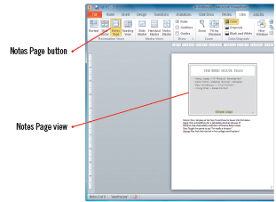
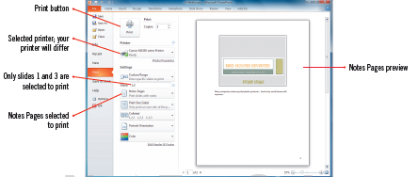
Creating Speaker Notes (cont.)
Resized Notes pane
Slide and notes
Printing Notes Pages

Slide 31
Summary
PowerPoint presentations can be greatly enhanced by adding shapes, clip art, photos, sounds, and movies/video clips
PowerPoint presentations can be set up to run automatically
You can set slide timing and transitions, and add special effects
You can create speaker notes

