Slide 1
Microsoft Office 2010 - Illustrated Fundamentals
Unit O:
Integrating Office 2010 Programs

Slide 2
Objectives
Insert an Excel chart onto a PowerPoint slide
Insert PowerPoint slides from a Word document
Insert screen captures into a Word document
Insert text from a Word file into an open document

Slide 3
Objectives (cont’d)
Link an Excel chart to a Word document
Update a linked Excel chart in a Word document
Insert Access fields in a Word document
Perform a mail merge

Slide 4
Unit O Introduction
You can create documents that combine information from different Office programs, such as a newsletter you create in Word that also contains a chart created in Excel
Screens or parts of screens in any open window can be captured as an image to paste into a document or save as an image file

Slide 5
Inserting an Excel Chart into a PowerPoint Slide
An Excel chart is an excellent tool for communicating numerical data visually
When you create a chart in PowerPoint, you embed data that is editable in Excel into the presentation
Once the chart is created, you can update it when you open the spreadsheet in Excel of when you activate the Chart Tools tab in PowerPoint

Slide 6
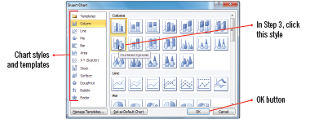
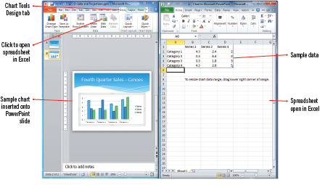
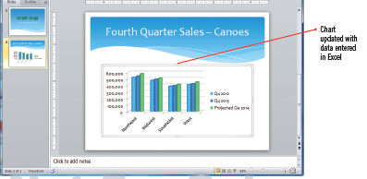
Inserting an Excel Chart into a PowerPoint Slide (cont.)
Choosing a chart style
Split screen PowerPoint/Excel
Completed chart

Slide 7
Inserting PowerPoint Slides from a Word Document
You can use a Word outline as a starting point for a new PowerPoint presentation, or to add slide to an existing presentation
Outline view makes it easy to see how a document is organized
When you insert a Word document into PowerPoint, Outline view lets you see how the structure will translate to the levels in a slide
Level 1 lines of text appear as slide titles, and lower-level text appears as bulleted text

Slide 8
Using outlines in Word and PowerPoint
If using an outline in PowerPoint that is created in Word, it is best to create a document formatted for that purpose
As you type your outline text, use the Outline Level list arrow in the Outline Tools group to apply a heading level for each line
The heading tags in Word determine the structure of the outline when it is imported into PowerPoint
You can also save a PowerPoint presentation in outline format and then open it in Word

Slide 9
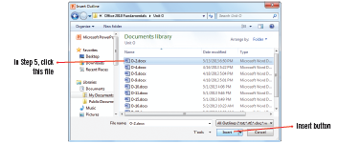
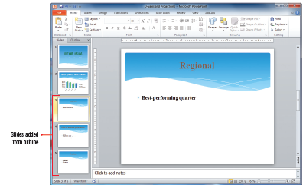
Inserting PowerPoint Slides from a Word Document (cont.)
Insert Outline dialog box
Word document in Outline view
PowerPoint slides created from Word

Slide 10
Inserting Screen Captures into a Word Document
The Screenshot feature is available in Word or PowerPoint, and allows you to capture an image from another non-minimized program window and then insert it into a Word or PowerPoint file
You can take a screen shot of the entire window or a part, which gives you a quick way to include graphics you could not otherwise insert

Slide 11
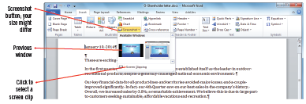
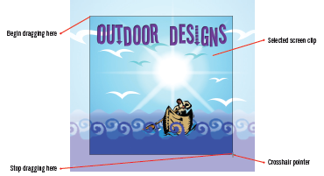
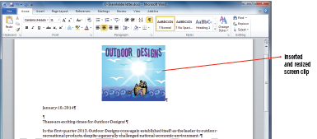
Inserting Screen Captures into a Word Document (cont.)
Options for the Screenshot button
Selecting a screen clip
Inserted screen clip

Slide 12
Inserting Text from a Word File into an Open Document
Used when you want to combine two files, or insert another document into the current document
Although you can easily copy and paste information between two or more open documents, it is sometimes easier to insert the contents from a file without having to open it first

Slide 13
Placing an Access table in a Word document
You can insert an Access table into a Word document by various methods
copy the entire table or individual records and paste them into a Word document
use the Export feature in Access to export objects, such as a table, report, query, or form
Access always exports to a new Rich Text Format (RTF) file, you cannot export to an open Word document
the object in Word is not linked to Access and any modifications you make to an exported table in Word affect only the Word document

Slide 14
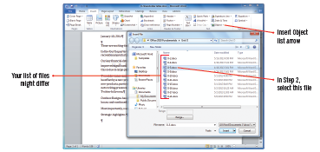
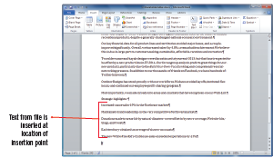
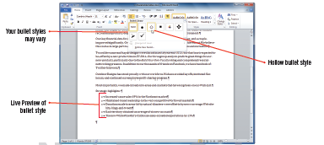
Inserting Text from a Word File into an Open Document (cont.)
Insert File dialog box
Inserted file into letter
Formatting bulleted text

Slide 15
Linking an Excel Chart to a Word Document
Linking data shared updated information between files and programs
A link displays information from a source file, containing the data,, and the destination file, the location to which the data is copied or moved
In a Word document, linked data looks just like inserted or embedded data
Linked data can be edited in the native program just by double-clicking the data

Slide 16
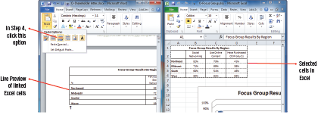
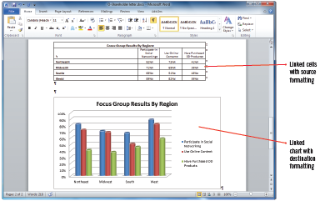
Linking an Excel Chart to a Word Document (cont.)
Selecting paste option
Viewing Excel chart pasted as a link

Slide 17
Updating a Linked Excel Chart in a Word Document
The great thing about working with linked files is the ability to update the source file and every linked object automatically updates
You can also update a linked object manually be right-clicking it and clicking Update Link or be selecting the linked object and press [F9] which updates links in any Office application

Slide 18
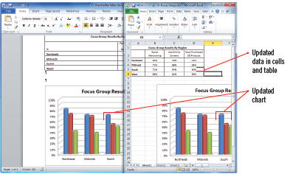
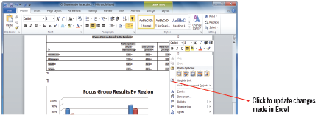
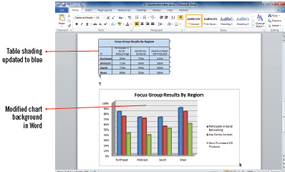
Updating a Linked Excel Chart in a Word Document (cont.)
Viewing updated data from linked file
Updating data in Word
Updated objects

Slide 19
Inserting Access Fields into a Word Document
A form letter is a document that contains standard body text and a custom heading containing the name and address for one of many recipients
The letter, or main document, is usually created in Word
The data source is usually a compiled in a table, a worksheet, or a database such as Access

Slide 20
Inserting Access Fields into a Word Document (cont.)
From the main document and the data source a third file, a merged document is created, called a mail merge
Before performing a mail merge, you add merge fields to the main document, which are placeholders to indicate where the custom information from the data source should appear

Slide 21
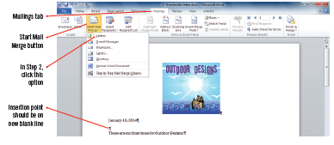
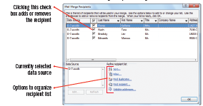
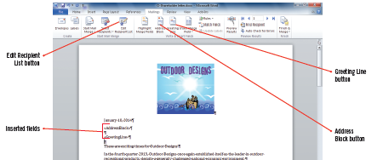
Inserting Access Fields into a Word Document (cont.)
Selecting Mail Merge option
Recipients dialog box
Inserted merge fields

Slide 22
Performing a Mail Merge
After setting up your main document, designating your data source, and inserting merge fields, you are ready to create your merged documents
You can preview the mail merge to ensure that all the information displays properly in the final document

Slide 23
Using mail merge to send personalized e-mail messages
Using mail merge to create the e-mail message enable you to personalize messages ensuring that only the recipient’s e-mail address appears in the To: text box in the e-mail message
The steps for creating an e-mail merge are basically the same as for a letter mail merge

Slide 24
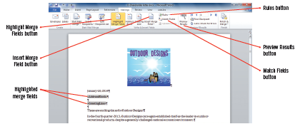
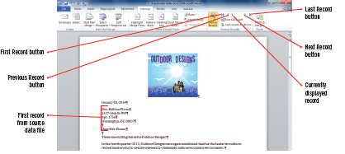
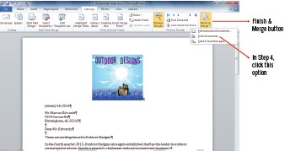
Performing a Mail Merge (cont.)
Highlighted merge fields
Previewing merged file
Printing merged letters

Slide 25
Summary
As you have seen, Word, Excel, PowerPoint, and Access can be used alone or in combination as a powerful tool to create, edit and analyze a variety of records and documents
Using the programs in Microsoft Office Suite together can provide a tremendous increase in efficiency and accuracy
You can accomplish personalized communications via snail mail or e-mail utilizing the Mail Merge process

